Slide 1
Citizen Air Quality Platform
JanVayu
A deep walkthrough of
India's citizen air quality
accountability platform.
जनवायु · ஜன்வாயு · জনবায়ু
What's covered. Every section of janvayu.in: live data and forecasts, health and exposure tools, the budget tracker, accountability dashboards, citizen tools, and the underlying data and design.
Citizen-built. Data-led.
Independent. Non-partisan.
Presented by Varna Sri Raman · janvayu.in · May 2026

Slide 2
OPENING
What we'll cover, in nine chapters
1. Frame & entry
Why JanVayu exists; the role-selector splash; how the site organises itself.
2. Live picture
Dashboard, live map, rankings, comparison, trends, forecast, hyperlocal, correlations, alerts, pollution calendar.
3. Health & exposure
Health Impact (GEMM), Children's Health, Women's Health, Indoor Air, Exposure Report, Should I Go Outside, Purifier, School Closures.
4. Economic & migration
Economic Cost calculator; Migration & Displacement; Migration Calculator.
5. Policy & accountability
Policy Effectiveness, Budget Tracker, Political accountability, Industrial Sources, Mission Tracker (E1–E5), Scorecards, AI Brief, Clean Air Wins, Legal Framework, RTI Assistant.
6. Citizen action
Take Action, Citizen Plan, Voices, Workshops, Learning Games, Social Feed, Live News.
7. Tools & knowledge
Ask JanVayu (AI), Tools, Glossary, Reading List, Downloads, Data Archive.
8. About, footer, compliance
Provenance, licensing, disclaimers, IT Act compliance.
9. Using JanVayu in your work
How researchers, journalists, and advocates can pull data, embed widgets, file RTIs, and integrate findings.
OPENING · AGENDA
JanVayu · janvayu.in · Walkthrough
Notes:
Quick orient before the demo. The deck follows nine chapters. We'll spend most time in chapters 2 to 5 since those are the parts of JanVayu most useful for research and advocacy. I'll show every panel and explain how to navigate it, what data sits behind it, and how to use it in your work.

Slide 3
CHAPTER
Chapter 1
Frame & entry
Why JanVayu exists, who built it, and how the site introduces itself to a first-time visitor.

Slide 4
CHAPTER 1 · WHY
Why a citizen air quality platform at all?
1.72M
~70%
9.5% of GDP
22× WHO
Indian deaths per year from ambient PM2.5
share of the global ambient-PM2.5 mortality burden borne by India
estimated annual economic cost of air pollution
Loni (UP) ranked most polluted city on Earth in IQAir 2025
Lancet Countdown 2025, India chapter (revised up from 1.5M)
Lancet GBD 2024 derivation
Lancet Countdown 2025; earlier World Bank work put it at 1.36%
IQAir World Air Quality Report, March 2026
CHAPTER 1 · THE PROBLEM
JanVayu · janvayu.in · Walkthrough
Notes:
Three numbers that frame the entire project. First, 1.72 million Indian deaths a year from ambient PM2.5, revised upward in the Lancet Countdown 2025 India chapter from the earlier 1.5 million figure. Second, India bears about 70% of the global ambient-PM2.5 mortality burden. Third, the same Lancet Countdown work now estimates the annual economic cost at around 9.5% of GDP, much higher than the older World Bank 1.36% figure. The IQAir 2025 ranking showing Loni in UP as the most polluted city on Earth, at 22 times the WHO PM2.5 guideline, was the trigger for many of the May 2026 updates.

Slide 5
CHAPTER 1 · WHAT
What JanVayu actually is, in one paragraph
JanVayu (जनवायु, people's air) is India's independent, citizen-built air quality accountability platform. It tracks live PM2.5 across 33+ cities, translates exposure into health and economic costs using peer-reviewed dose-response models, and follows the public money meant to fix the problem. It is not a government dashboard and not affiliated with any commercial entity. It is non-partisan, independently funded, and published under MIT (code) and CC BY-NC-SA 4.0 (content) licences.
PM2.5-first
AQI hides danger. We display PM2.5 in μg/m³ with WHO multipliers (×n WHO) as the headline metric. AQI is shown as a secondary number.
Independent verification
RTI responses, CPCB data, NASA FIRMS imagery, peer-reviewed studies. Not government self-reporting.
Justice-aware
Air pollution is not evenly distributed. Indoor air, occupational exposure, and spatial injustice are explicit, separate sections.
Pan-Indian access
Multilingual UI (English, Hindi, Tamil, Marathi, Bengali). Name chosen for pan-India linguistic accessibility.
CHAPTER 1 · WHAT JANVAYU IS
JanVayu · janvayu.in · Walkthrough
Notes:
This is the paragraph I will read aloud first if anyone asks me what JanVayu is. The four principles below it are the editorial spine: PM2.5 first (because AQI composites mask danger), independent verification (not government self-reporting), justice-aware (indoor and occupational exposure given their own panels), and pan-India linguistic access. Notice the rendered Devanagari and the explanation of the name: JanVayu means 'people's air'. The name was chosen by community vote, in part for its pan-Indian readability across scripts.

Slide 6
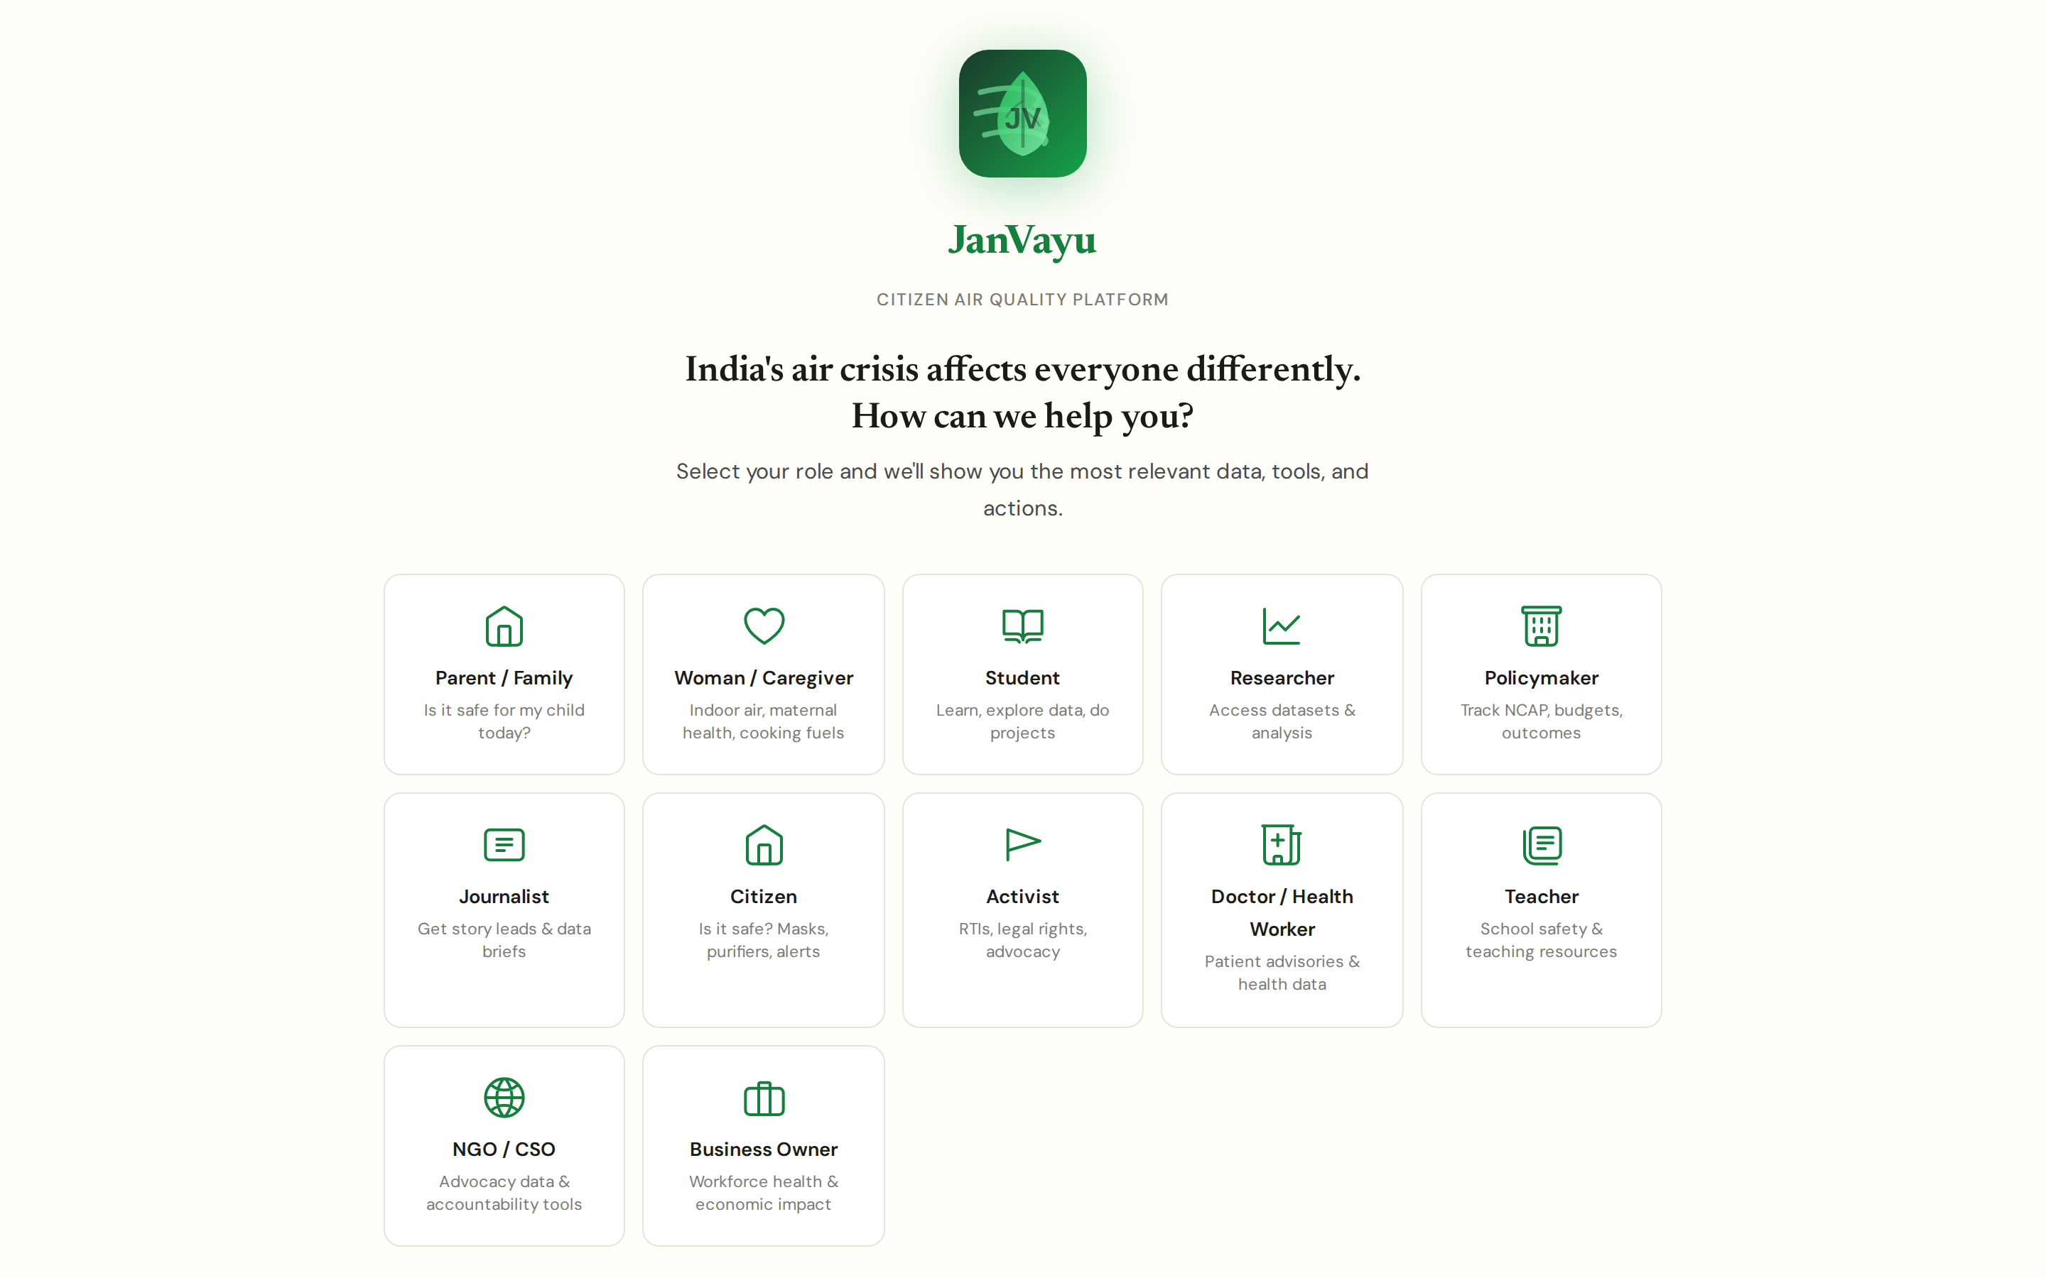
CHAPTER 1 · ENTRY
#splash (first load)
The first thing a visitor sees
Personalised entry by role, a 'pick your path' splash
Twelve role tiles: Parent/Family, Woman/Caregiver, Student, Researcher, Policymaker, Journalist, Citizen, Activist, Doctor/Health Worker, Teacher, NGO/CSO, Business Owner.
Picking a role personalises the home view to surface the most relevant data and tools for that user.
Woman/Caregiver and the split Citizen-vs-Activist tiles were added in the late-May 2026 refresh, reflecting that those audiences have distinct needs: indoor air and maternal health for one, RTIs and legal rights for the other.
An explicit 'Skip, show me everything' escape hatch respects users who want the full firehose. Role is stored locally and can be changed any time from the icon at the top right; no account required.
CHAPTER 1 · ENTRY
JanVayu · janvayu.in · Walkthrough
Notes:
On first load, every visitor sees this role selector. It's a deliberate design choice: the site has 45 panels and even seasoned users can find it overwhelming. By asking who you are first, we surface the three or four panels you're most likely to use. A parent gets Children's Health, AQI Alerts, School Closures, and Should I Go Outside. A journalist gets the Accountability Brief, Mission Tracker, and City Scorecards. A researcher gets the Reading List and Data Archive. The Woman/Caregiver tile, added in late May, surfaces Indoor Air, Women's Health, and PMUY/Ujjwala data; the split into Citizen and Activist was a response to user feedback that those two roles wanted very different things, one asks 'is my air safe?', the other asks 'how do I file an RTI?'. The skip link is intentional, if you know what you're looking for, you get the full menu. Role is stored in localStorage and can be changed anytime.

Slide 7
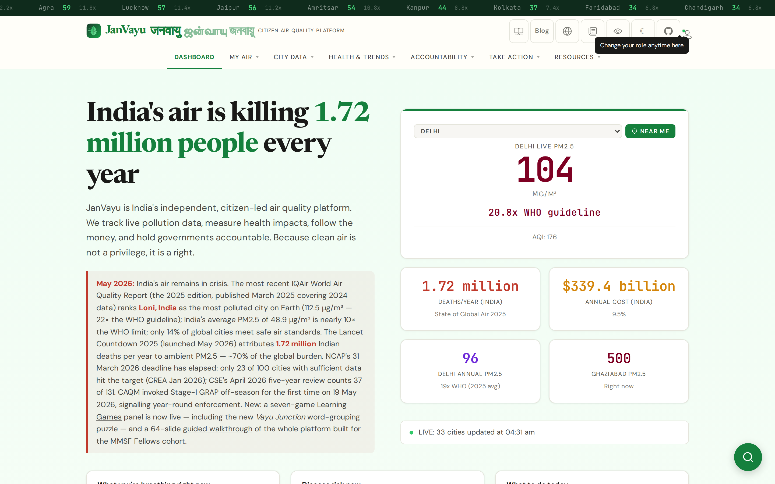
CHAPTER 1 · SHELL
#site header (post-onboarding)
Site shell: what every panel inherits
Persistent header, live ticker, and a seven-group mega-menu
Top: rolling ticker showing live PM2.5 for 33+ cities with the ×WHO multiplier (no abstraction, no composite).
Branding row: multilingual logo (JanVayu / जनवायु / ஜன்வாயு), search (Ctrl+K), blog, language toggle, glossary, accessibility, dark mode, GitHub, role badge.
Mega-menu collapses 45 panels into seven groups: Dashboard · My Air · City Data · Health & Trends · Accountability · Take Action · Resources.
Below 1024px the whole nav collapses into a slide-out drawer; everything stays one tap away.
CHAPTER 1 · SHELL
JanVayu · janvayu.in · Walkthrough
Notes:
Every panel inherits this shell. The persistent ticker matters: a visitor can read live PM2.5 for any city in the country without leaving the panel they're on. The mega-menu is the single most important UI change in the May rebuild, earlier versions had a 17-tab horizontal nav, which was unusable at this scale. Now 45 panels organise into seven logical groups. Search is keyboard-shortcut-driven (Ctrl+K) and indexes every panel.

Slide 8
CHAPTER
Chapter 2
The live picture
Real-time PM2.5, forecasts, comparisons, geographic spread, and seasonal patterns. Ten panels that answer the question: what is happening, where, right now.

Slide 9
CHAPTER 2 · LIVE PICTURE
#dashboard
Dashboard
The single answer to 'how bad is it right now?'
Headline editorial framing: 1.72 million people, every year. The number first, then the methodology.
Live PM2.5 card (Delhi default, switchable via 33-city dropdown or 'NEAR ME' geolocation): value in μg/m³, ×WHO multiplier, AQI shown as secondary.
Four stat cards: India deaths/year (SoGA 2025), annual cost ($339.4B / 9.5% GDP, Lancet Countdown 2025), Delhi annual PM2.5 (96 μg/m³, 19× WHO), and a 'right now' card for a feature city.
Live worst/best cities, GRAP status for Delhi-NCR, and 'Latest Updates' news feed all anchor to current state.
CHAPTER 2 · LIVE PICTURE
JanVayu · janvayu.in · Walkthrough
Notes:
The dashboard answers the simplest question. Read aloud: 'JanVayu is India's independent, citizen-led air quality platform. We track live pollution data, measure health impacts, follow the money, and hold governments accountable. Because clean air is not a privilege, it is a right.' The May 2026 alert prominently surfaces the IQAir 2025 finding that Loni topped the world rankings at 22× WHO, and that only 14% of global cities meet safe air standards. The PM2.5-first display is deliberate: AQI is a composite that smears together pollutants of very different toxicity. Showing μg/m³ alongside the ×WHO multiplier preserves both the comparable number and its proximity to the safety threshold.

Slide 10
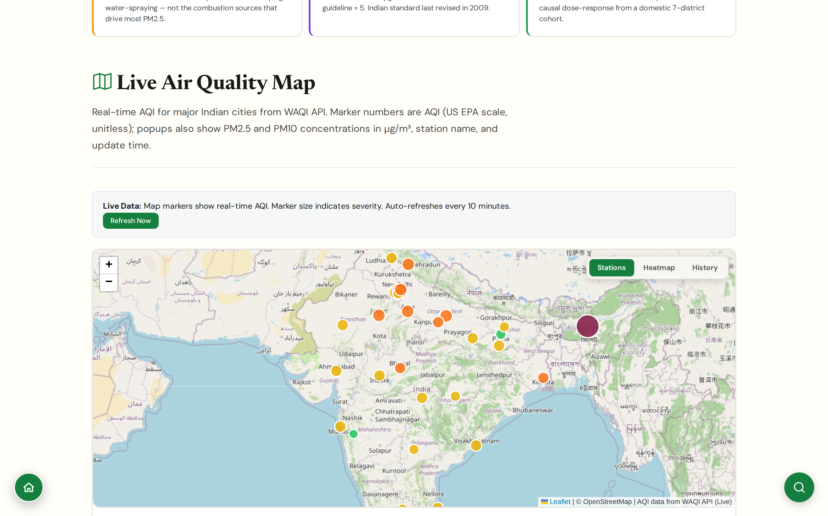
CHAPTER 2 · LIVE PICTURE
#map
Live Map
Three view modes: stations, heatmap, and historical climatology
Leaflet-based interactive map with live AQI from WAQI API; markers sized by severity, auto-refreshing every 10 minutes.
Three view modes via the toggle: Stations (default), Heatmap (pollution density), History (CPCB/IQAir climatology, 2024 to present).
Marker numbers are US EPA AQI (unitless); clicking a marker reveals PM2.5 and PM10 in μg/m³, station name, and update time.
Useful for spotting hyperlocal hotspots that city-aggregate AQI dashboards conceal, and for visualising seasonal patterns via History mode.
CHAPTER 2 · LIVE PICTURE
JanVayu · janvayu.in · Walkthrough
Notes:
The map ships three views from a single toggle. Stations is the default: 800-plus live markers from the WAQI feed. Heatmap renders the same data as a density surface, useful when you're talking about spatial patterns rather than specific stations. History was added in May, drawing from CPCB and IQAir climatology back to 2024; it lets you compare today against the same calendar week in a previous year. Marker numbers are US EPA AQI rather than WHO multipliers because the WAQI feed publishes it that way and we don't transform; click any marker for the underlying PM2.5 and PM10 readings in μg/m³, where the WHO comparison is more meaningful.

Slide 11
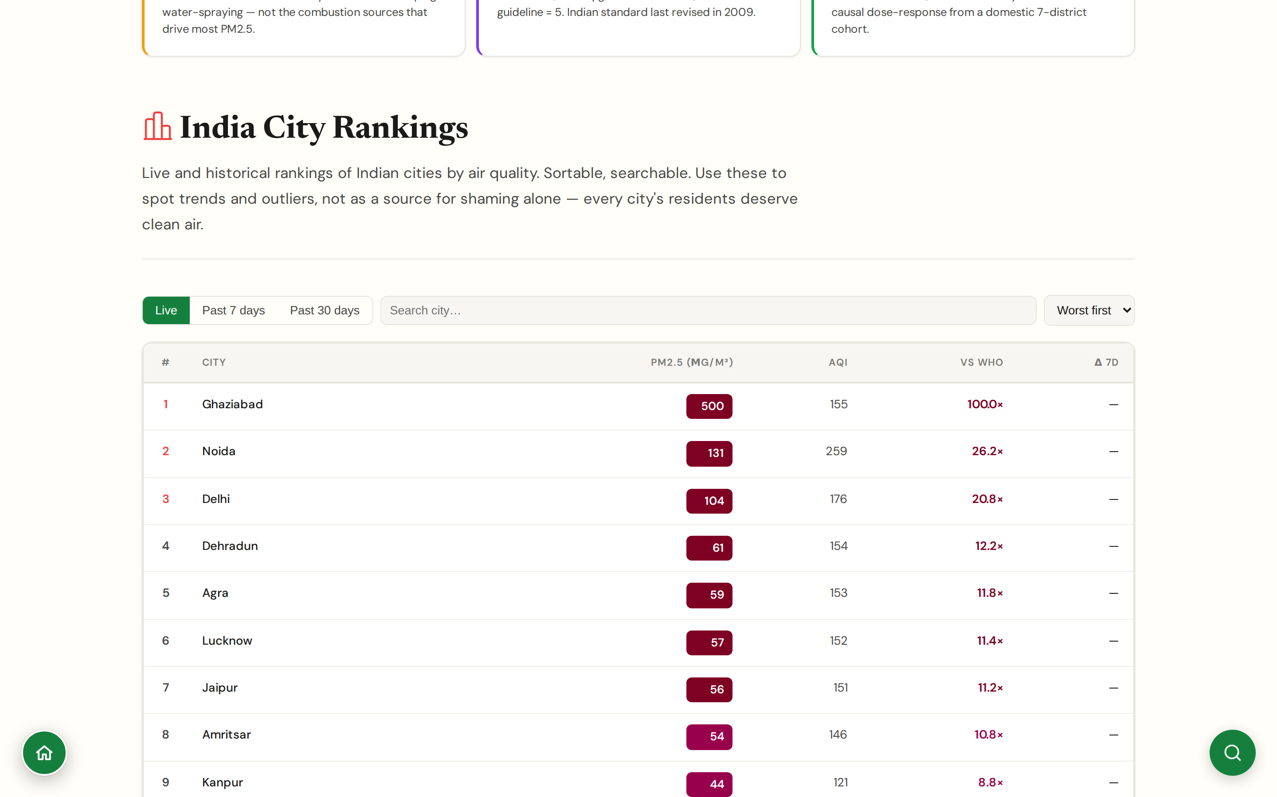
CHAPTER 2 · LIVE PICTURE
#rankings
City Rankings
Worst and best, ranked live and over the year
Live ranked list of cities by current PM2.5: who is breathing the worst air at this hour.
Annual rankings reproduce IQAir 2025 with the 22× Loni headline and the cluster of UP/Delhi-NCR cities at the top.
Comparative ×WHO column makes the rankings interpretable across scales (a city at 5× and one at 20× are not 'both unsafe').
Designed to be quotable for journalists; rankings link out to the underlying data source.
CHAPTER 2 · LIVE PICTURE
JanVayu · janvayu.in · Walkthrough
Notes:
Rankings are the most-shared content on the site. Journalists in particular use this. The decision to display ×WHO multipliers alongside the rank is what makes JanVayu different from a Wikipedia table, '5× WHO' and '20× WHO' are not the same crisis, and a ranked list with only ordinal positions hides that.

Slide 12
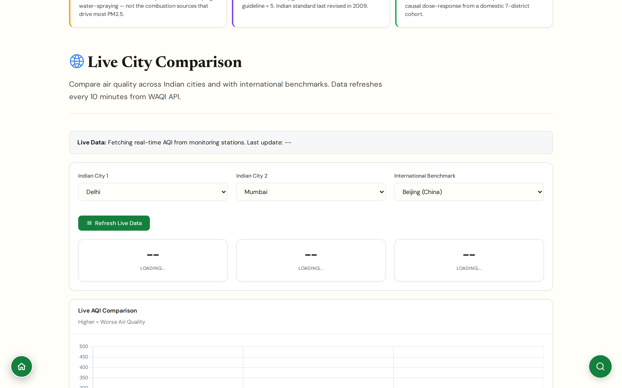
CHAPTER 2 · LIVE PICTURE
#compare
City Comparison
Side-by-side comparison of up to three cities
Pick any three cities from the dropdown; the comparison panel pulls live data simultaneously.
Comparison covers: current PM2.5, ×WHO ratio, 24-hour AQI trend, dominant pollutant, station count.
Useful for op-eds and policy briefs: e.g. 'Delhi today is breathing X times what Bengaluru is breathing.'
Last update timestamp shown explicitly so cited comparisons are time-stamped.
CHAPTER 2 · LIVE PICTURE
JanVayu · janvayu.in · Walkthrough
Notes:
This panel exists because comparison is how policy gets argued. Someone writing about Maharashtra's pollution response needs to be able to say 'Mumbai is currently at 4× WHO, while Delhi is at 16× WHO and Chennai is at 2× WHO' with a screenshot and a timestamp. The panel makes that one click instead of three lookups.

Slide 13
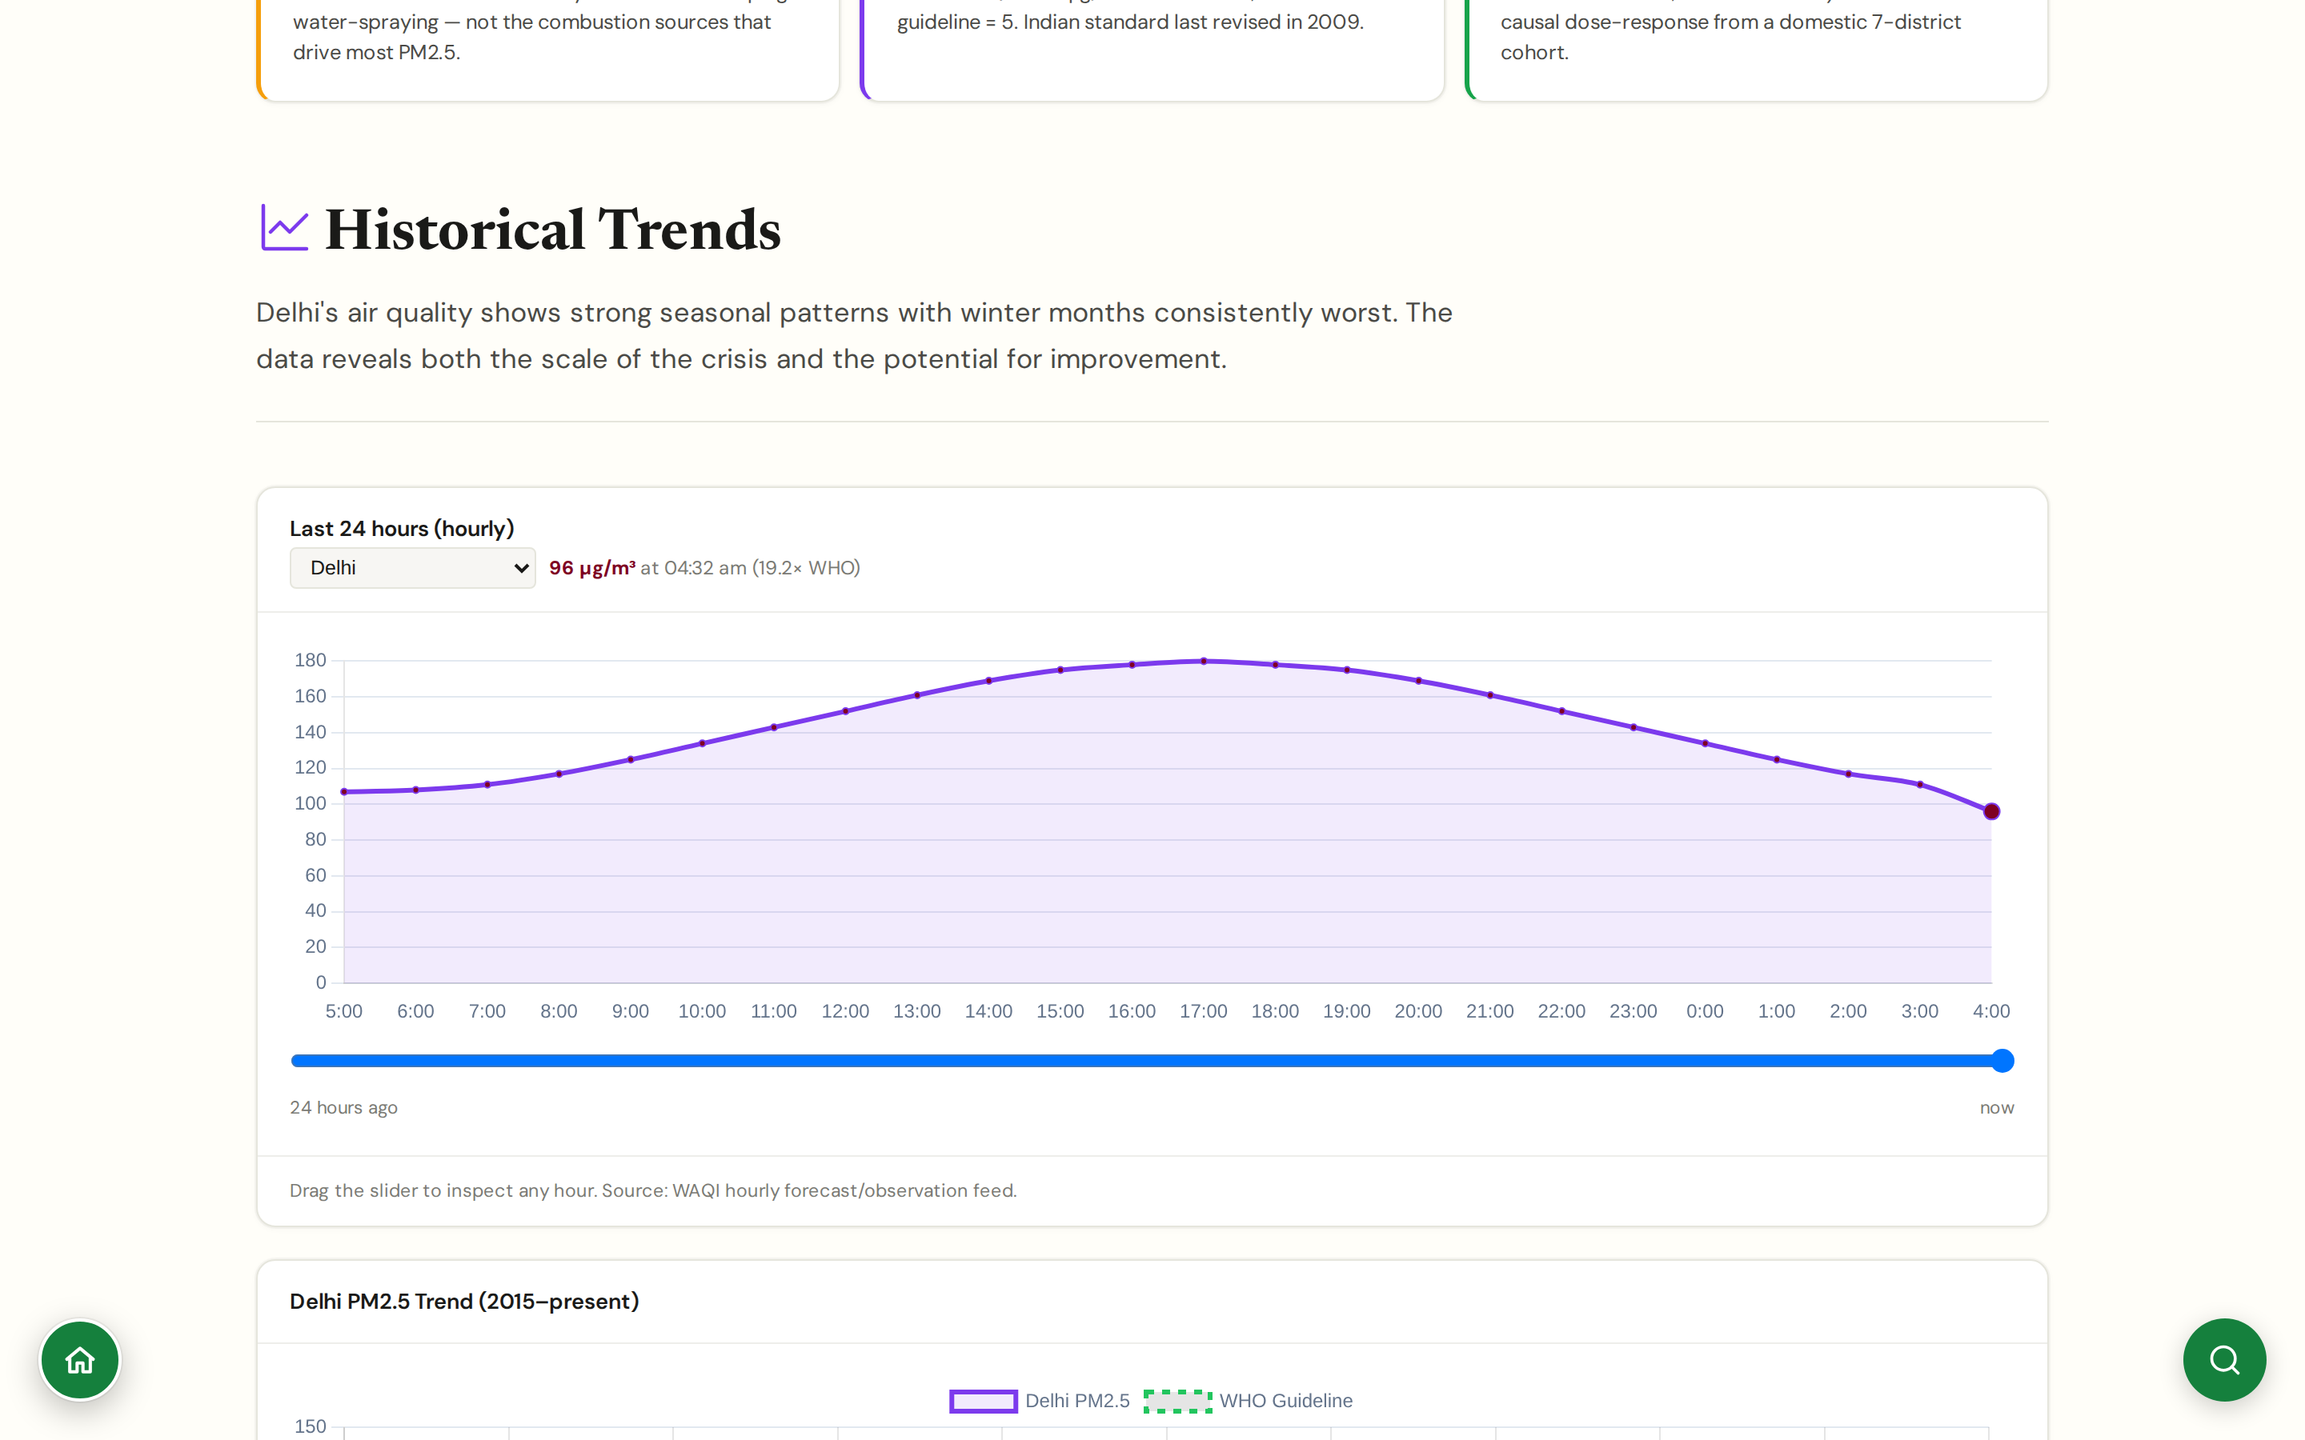
CHAPTER 2 · LIVE PICTURE
#trends
Historical Trends
Annual and seasonal PM2.5 trajectories
Long-run series from CPCB CAAQMS and PRANA Portal: how PM2.5 has moved year on year since 2015.
Headline timeline updated through May 2026: NCAP deadline elapsed, NGT directions, GRAP changes, IQAir release.
Seasonal breakdown isolates the winter inversion period (October–February) from monsoon and pre-monsoon.
Useful for assessing whether NCAP and city-level interventions are actually moving the needle.
CHAPTER 2 · LIVE PICTURE
JanVayu · janvayu.in · Walkthrough
Notes:
Trends is where you go to see whether NCAP worked. The honest answer is that PM10 trends are flatter than the targets implied. Guttikunda et al. 2024 found 'no change in the fraction of cities above 150 μg/m³ between 2019 and 2023.' The CSE Five-Year Review in April 2026 revised the count of cities hitting even the original 20% reduction target to 37 of 131. This panel surfaces that data without commentary; the Mission Tracker layers the interpretation on top.

Slide 14
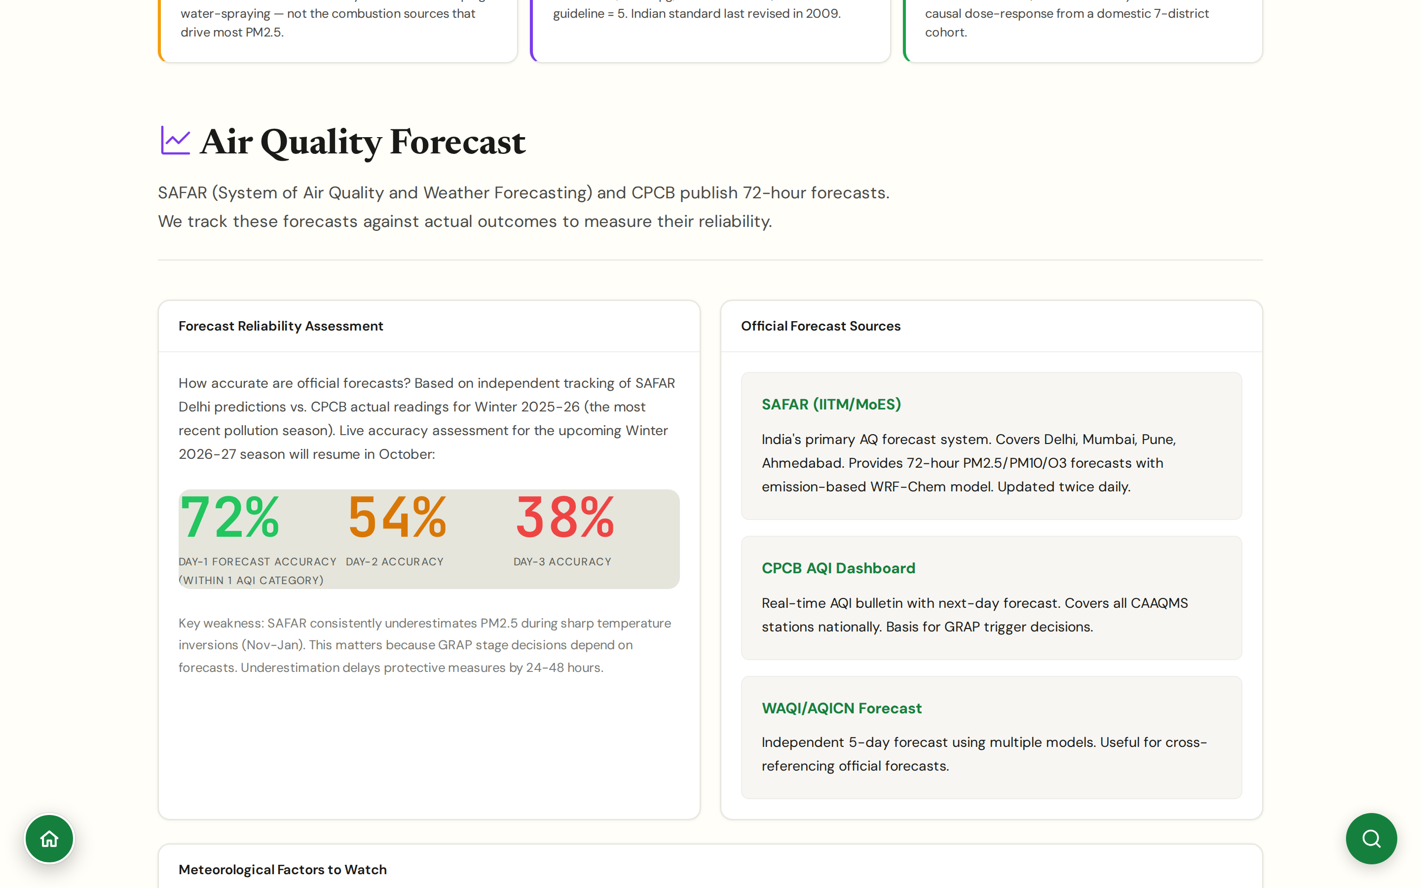
CHAPTER 2 · LIVE PICTURE
#forecast
Air Quality Forecast
Auditing official forecasts against actual outcomes
Not a forecaster but a forecast auditor: tracks SAFAR (IITM/MoES), CPCB AQI dashboard, and WAQI/AQICN forecasts against subsequent CPCB readings.
Most recent reliability assessment (Winter 2025-26): 72% Day-1 accuracy, 54% Day-2, 38% Day-3, where 'accurate' means within one AQI category.
Key documented weakness: SAFAR consistently underestimates PM2.5 during sharp temperature inversions (Nov-Jan); this delays GRAP triggers by 24-48 hours.
Live accuracy tracking resumes October 2026 with the start of the Winter 2026-27 pollution season.
CHAPTER 2 · LIVE PICTURE
JanVayu · janvayu.in · Walkthrough
Notes:
This panel is a meta-tool, not a forecast. India already has three forecast systems, SAFAR is the official one from IITM, CPCB publishes its own, and WAQI provides an independent five-day model. We don't compete with them; we record what each forecast said and what the actual reading turned out to be. The accuracy numbers are sobering: Day-1 is decent at 72 percent within-one-category, but Day-3 falls to 38 percent. The structural failure mode is the November-January inversion period, exactly when forecasts matter most for GRAP triggering. When SAFAR underestimates the upcoming peak by even half a category, GRAP Stage III or IV gets invoked 24-48 hours late and the protective measures (construction halt, vehicle bans) come after the peak rather than before.

Slide 15
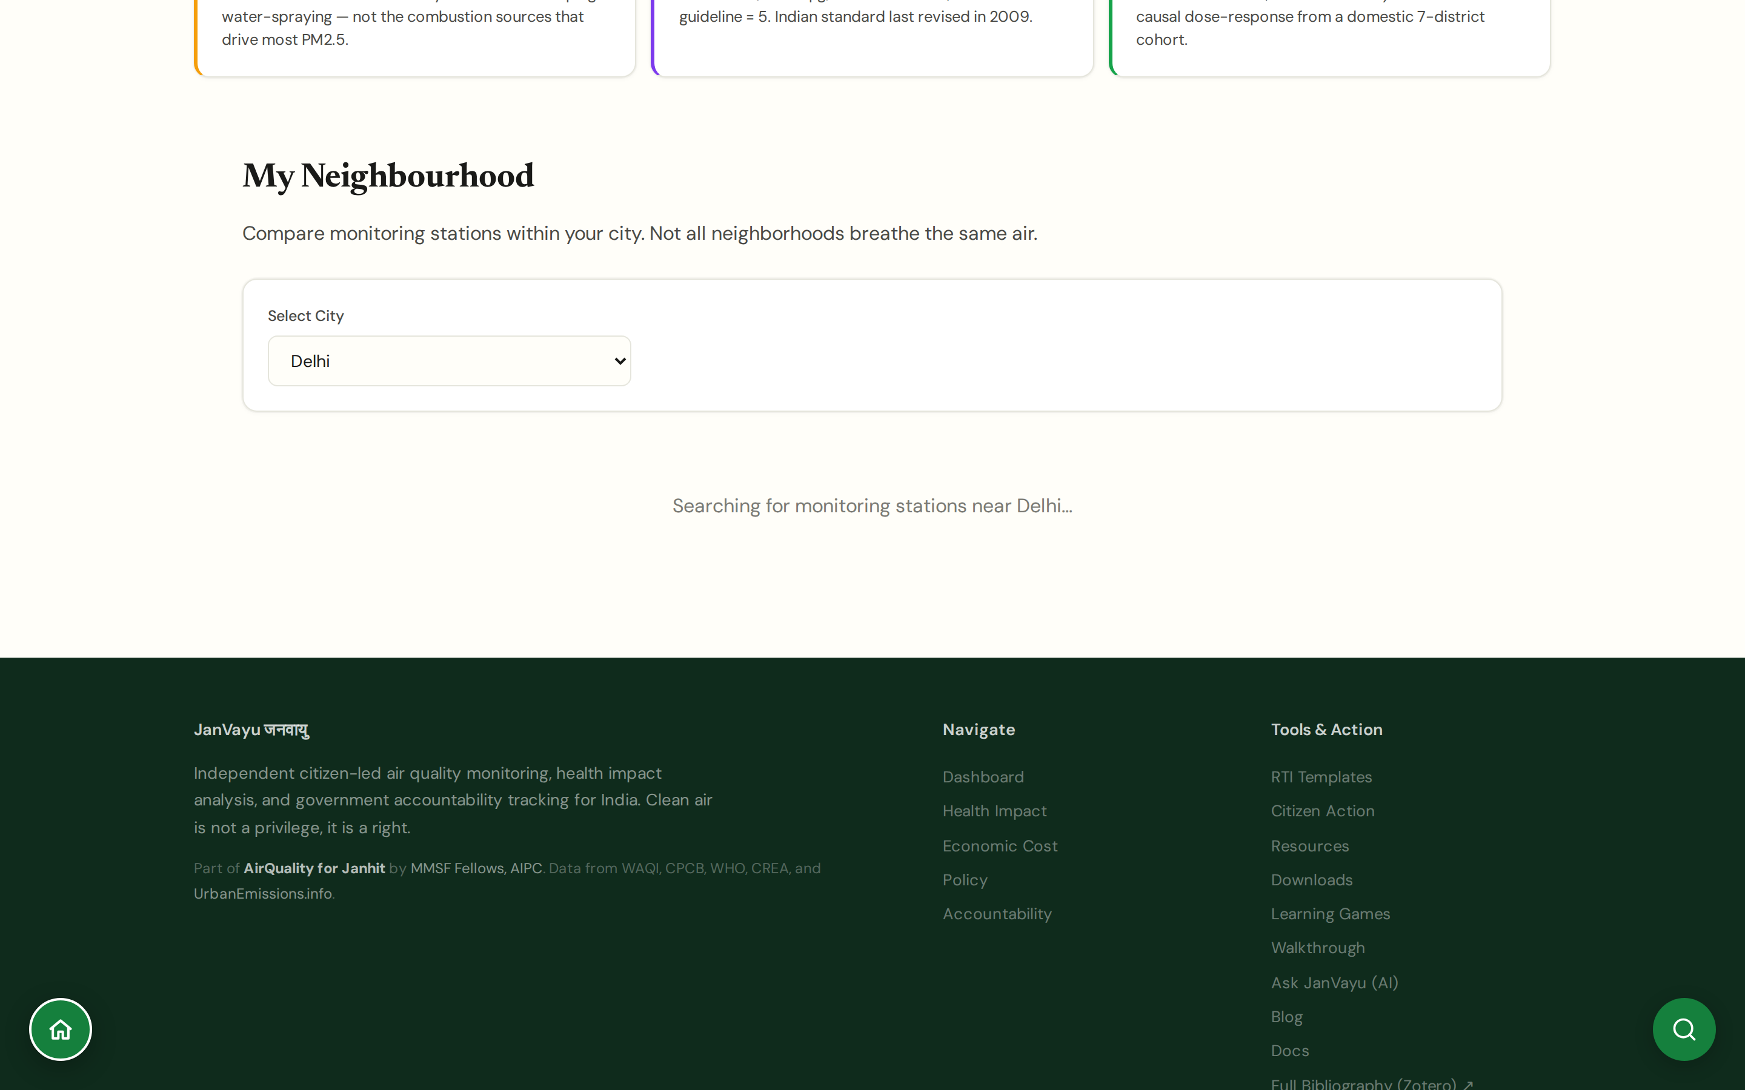
CHAPTER 2 · LIVE PICTURE
#hyperlocal
My Neighbourhood
Air quality at the neighbourhood scale
Pulls every nearby sensor (CPCB + WAQI low-cost networks) within a configurable radius of a point.
Reveals intra-city variation that city-aggregate AQI hides: industrial belts, traffic corridors, ridge areas.
Important for environmental justice analysis: poor neighbourhoods often have substantially worse air than the city mean.
Caveat surfaced: low-cost sensors need correction; raw readings are flagged as such.
CHAPTER 2 · LIVE PICTURE
JanVayu · janvayu.in · Walkthrough
Notes:
My Neighbourhood is the panel that researchers working on environmental justice will use most. The point: when a city reports an AQI of 200, that average can hide neighbourhoods at 350 and neighbourhoods at 80. The dispersion is not random, it tracks income and proximity to industrial corridors. JanVayu explicitly flags low-cost sensor data so users know to apply caution, but the pattern is strong enough that the underlying inequality is visible even with that uncertainty.

Slide 16
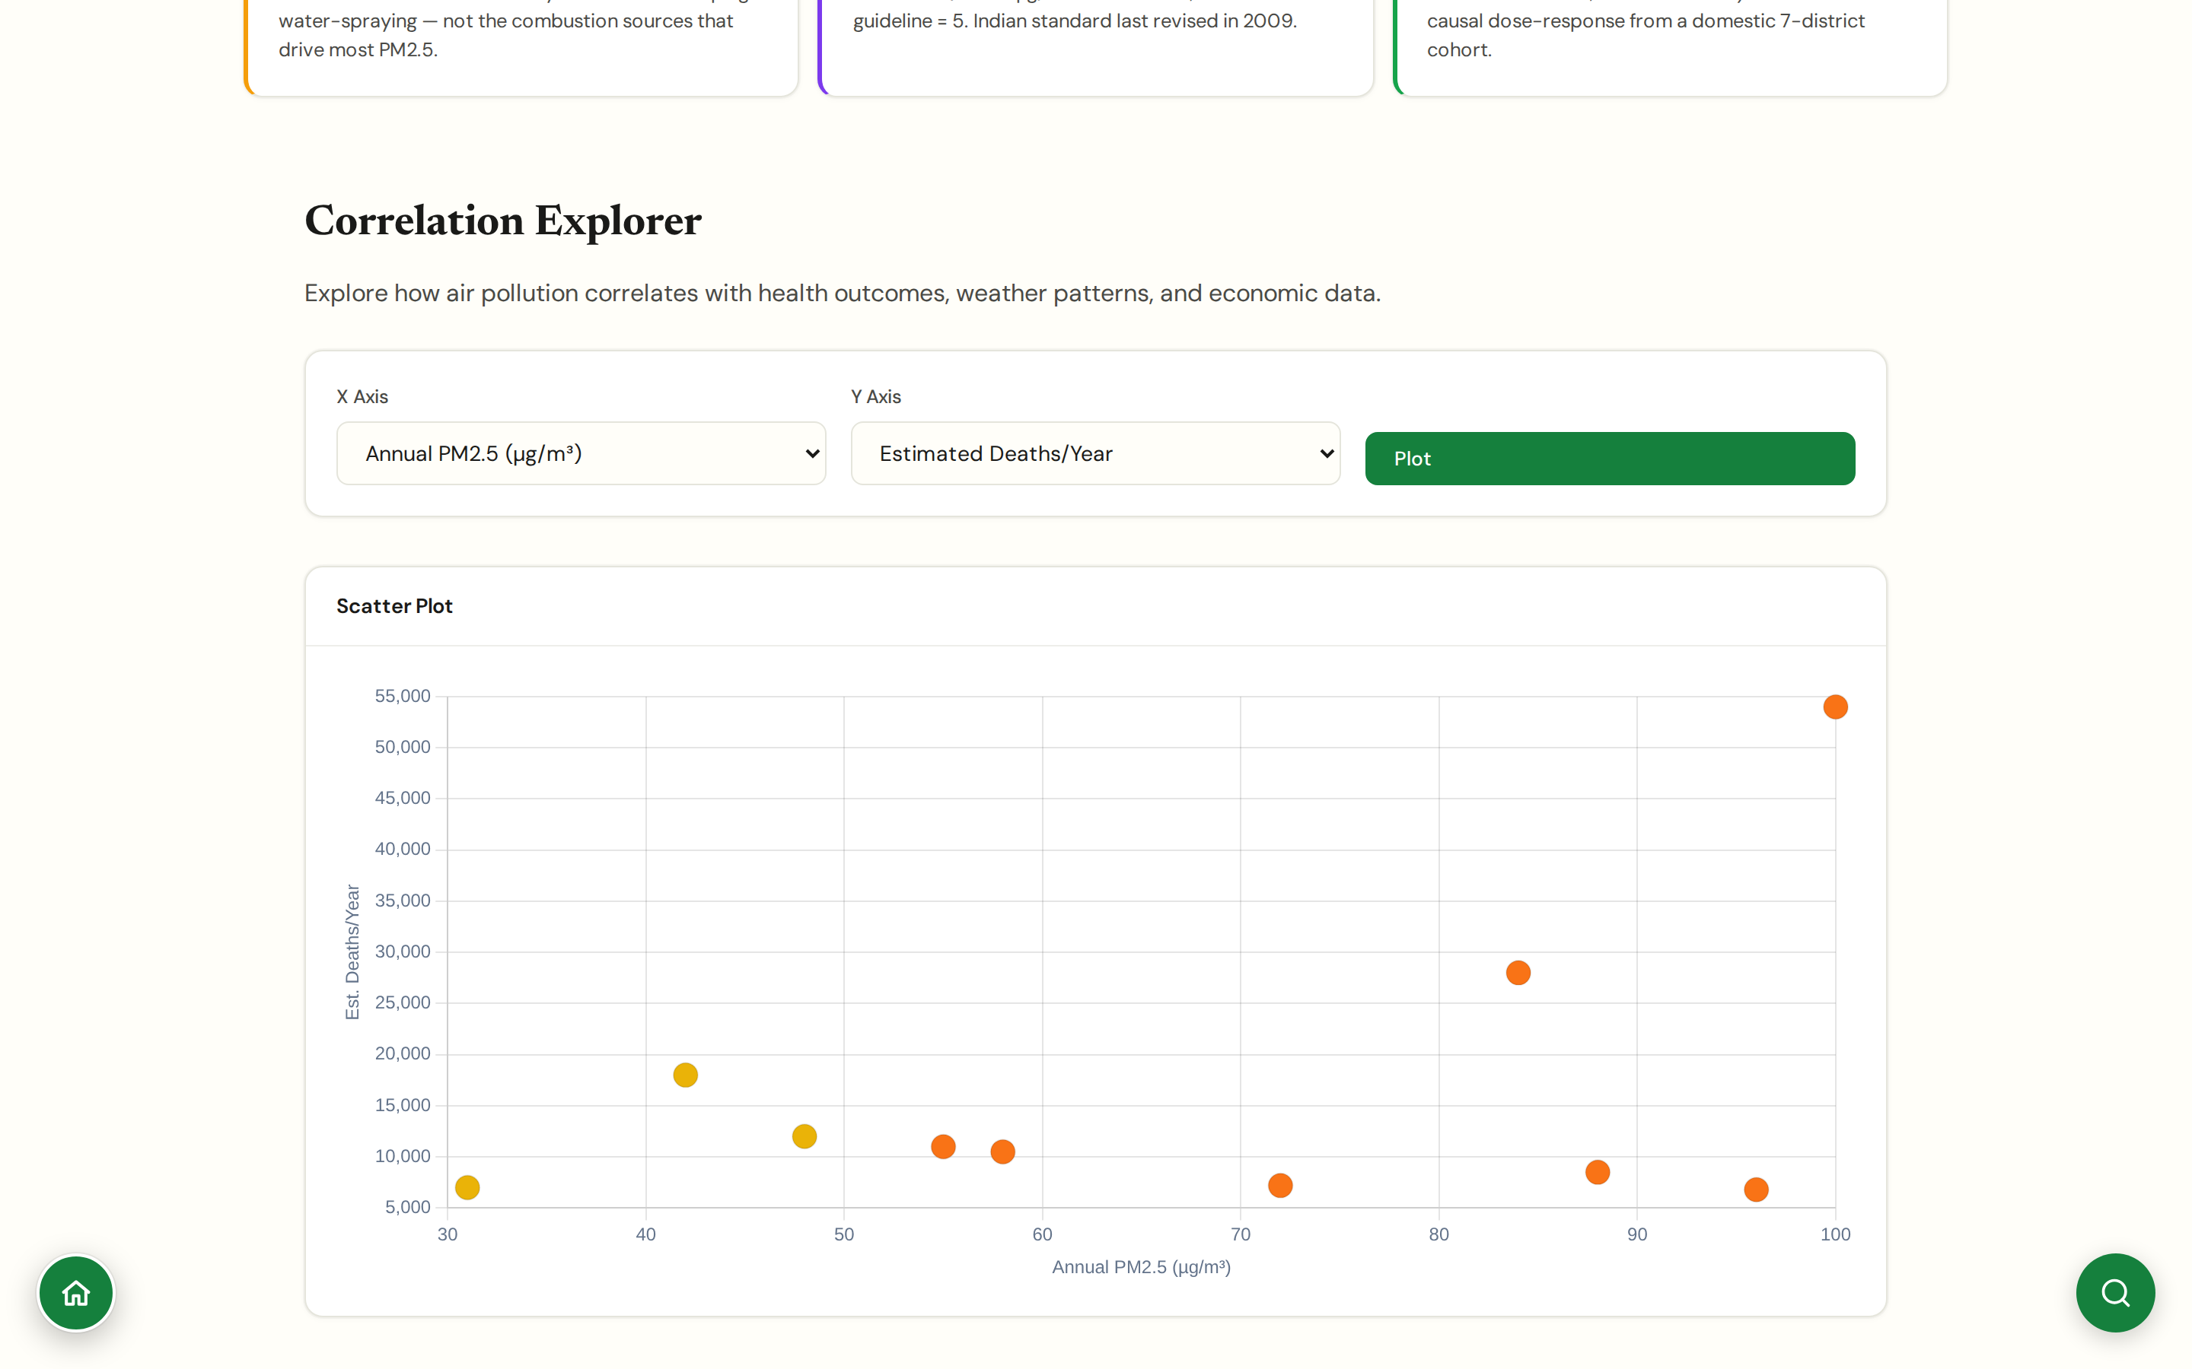
CHAPTER 2 · LIVE PICTURE
#correlations
Pollution Correlations
Explore how PM2.5 correlates with health, economic, and demographic outcomes
Scatter and correlation plots across Indian cities: X-axis options include annual PM2.5, average AQI, and population; Y-axis options include estimated deaths/year, life-years lost, economic cost (% GDP), and a hospital admissions index.
Designed for journalists and researchers building the link between exposure and outcome at a city level, not for source apportionment within a single city.
Outputs are population-level estimates, useful for the 'X city loses Y life-years per μg/m³' framing common in policy memos.
Underlying data anchors to Lancet Countdown 2025, GBD 2021, and Krishna et al. 2024.
CHAPTER 2 · LIVE PICTURE
JanVayu · janvayu.in · Walkthrough
Notes:
This panel is the tool I use most often when drafting policy memos that need to make the city-level health-economic connection explicit. Pick a Y-axis (deaths per year is the strongest one), pick an X-axis (annual PM2.5 in μg/m³ is the cleanest), and the scatter plot makes the relationship visible across 30-plus Indian cities. The fitted line is interpretable as life-years lost or excess deaths per unit of PM2.5. For source-apportionment correlations (PM2.5 vs NO2, vs boundary layer height) we point users to specialised sources like the COALESCE network publications rather than building that here.

Slide 17
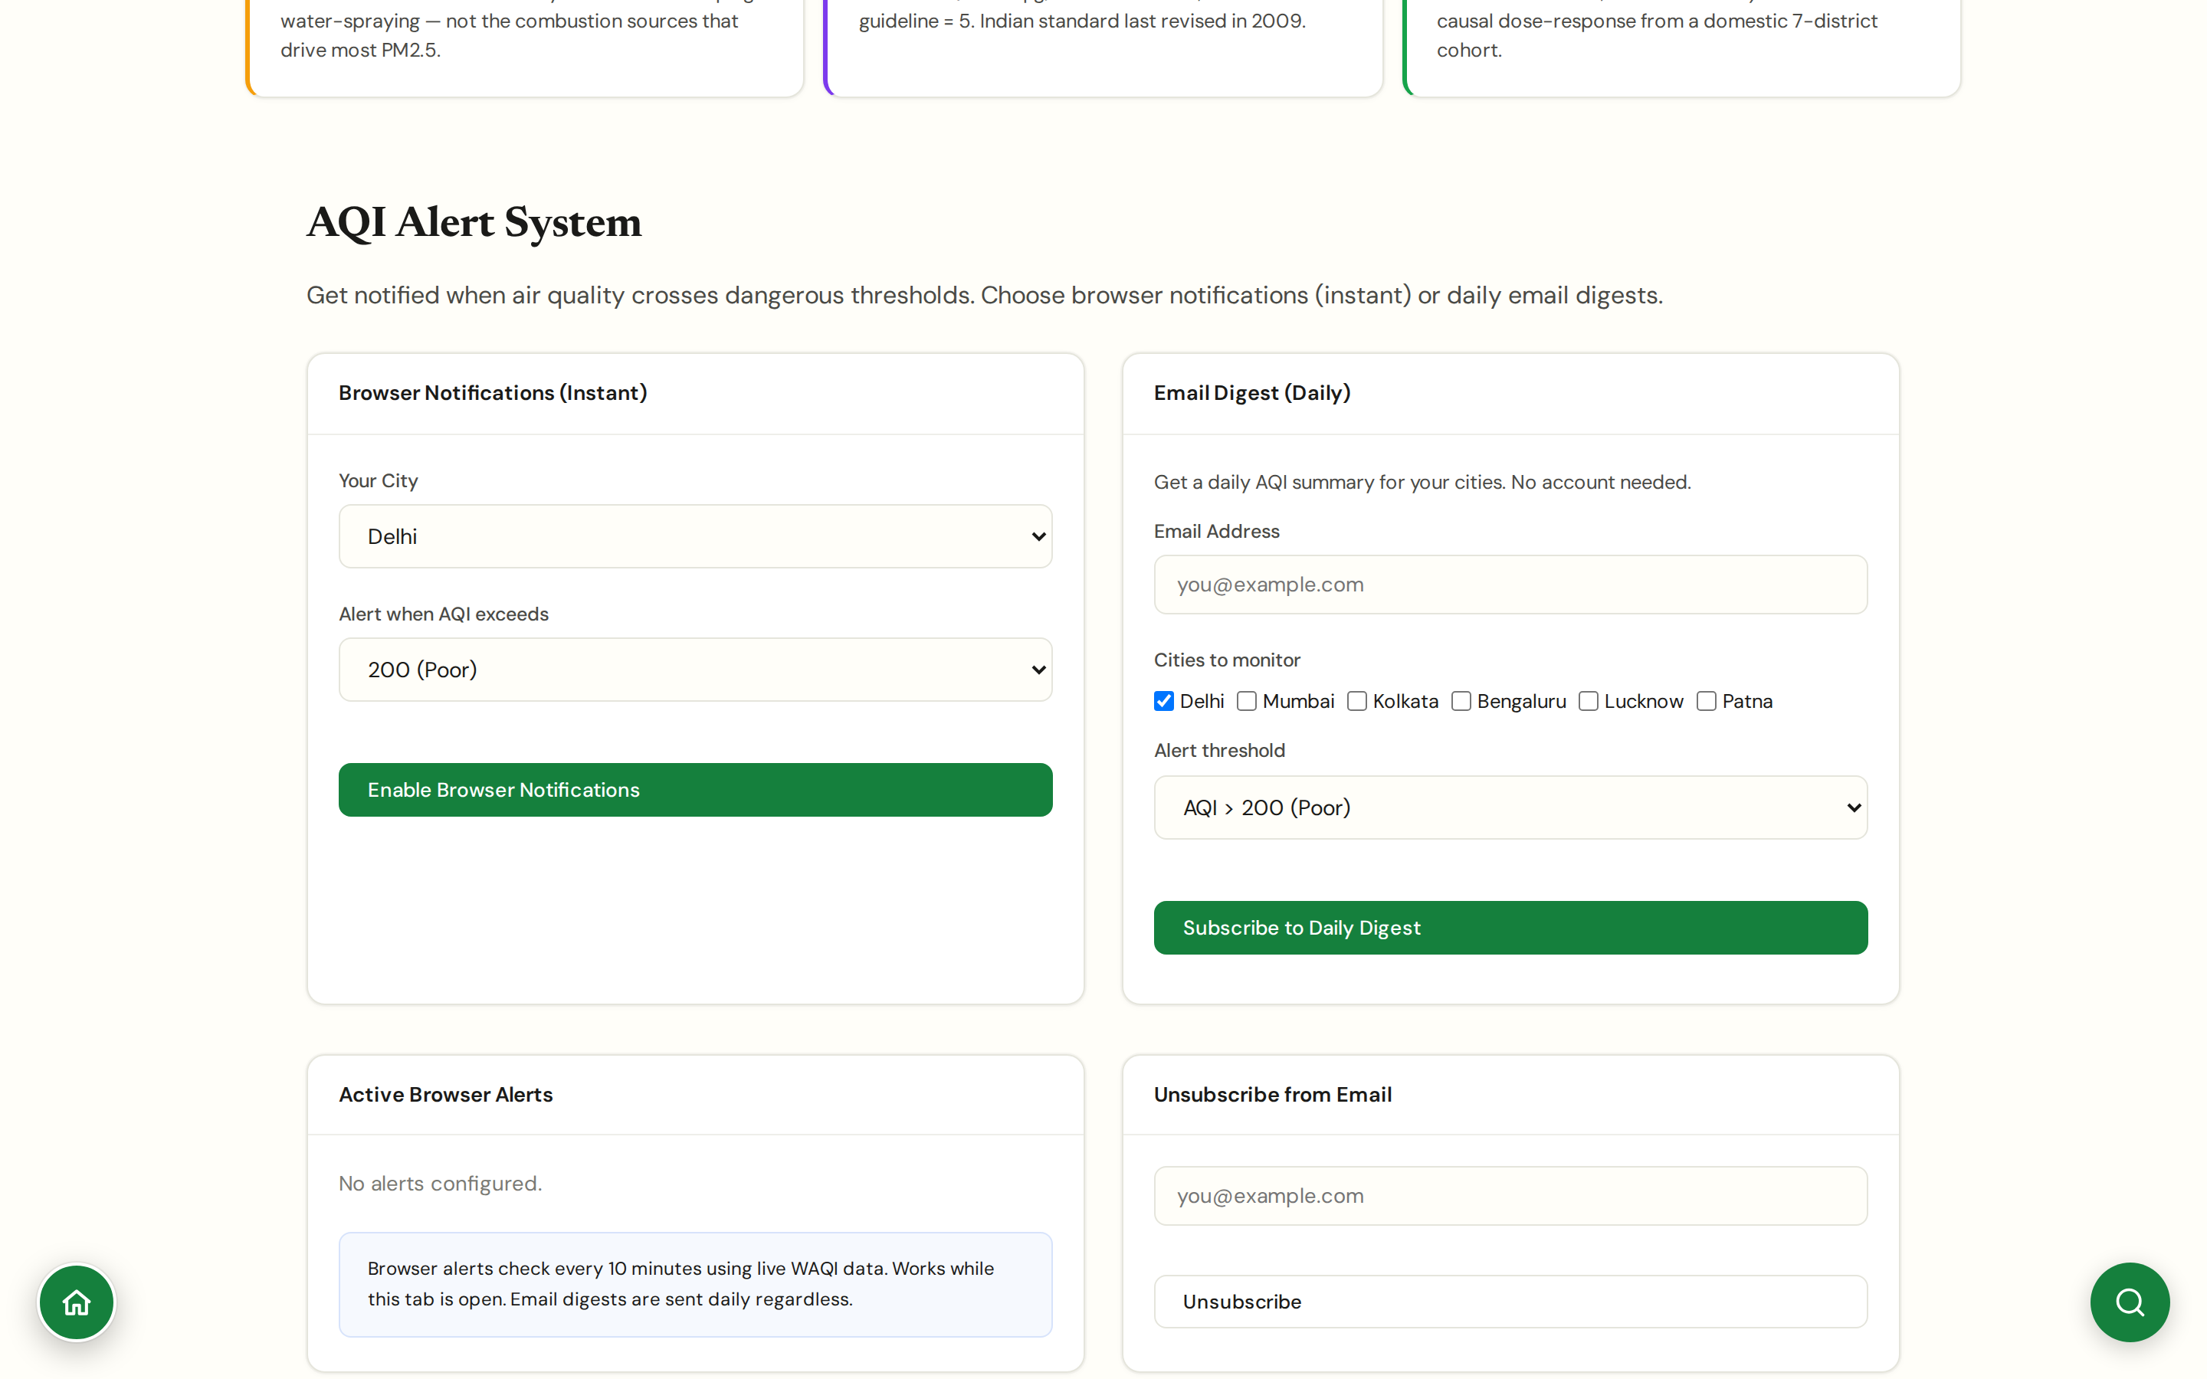
CHAPTER 2 · LIVE PICTURE
#aqi-alerts
AQI Alerts
Browser push or daily email digest when your city crosses a threshold
Two delivery channels: instant browser push notifications via the Web Push API, or a daily email digest.
Threshold options follow Indian AQI bands (100/200/300/400) since most users think in those categories; PM2.5 is shown in the alert payload alongside the AQI value for the WHO comparison.
Useful for vulnerable users (asthmatics, parents of young children, elderly carers) and for monitoring multiple cities at once via the email digest.
No account required. Browser subscription is per-device; email digest accepts a city list.
CHAPTER 2 · LIVE PICTURE
JanVayu · janvayu.in · Walkthrough
Notes:
Alerts close the loop between data and personal decision. The email digest is the recent addition: useful if you're monitoring air quality in two or three cities at once, say your home city and your parents' city, and you want one morning summary instead of constant notifications. Threshold defaults follow Indian AQI bands, 100 (Moderate), 200 (Poor), 300 (Very Poor), 400 (Severe). We don't default to WHO multipliers in the threshold UI because everyday users think in those AQI categories, but the alert payload always carries the underlying PM2.5 value so the WHO context is preserved.

Slide 18
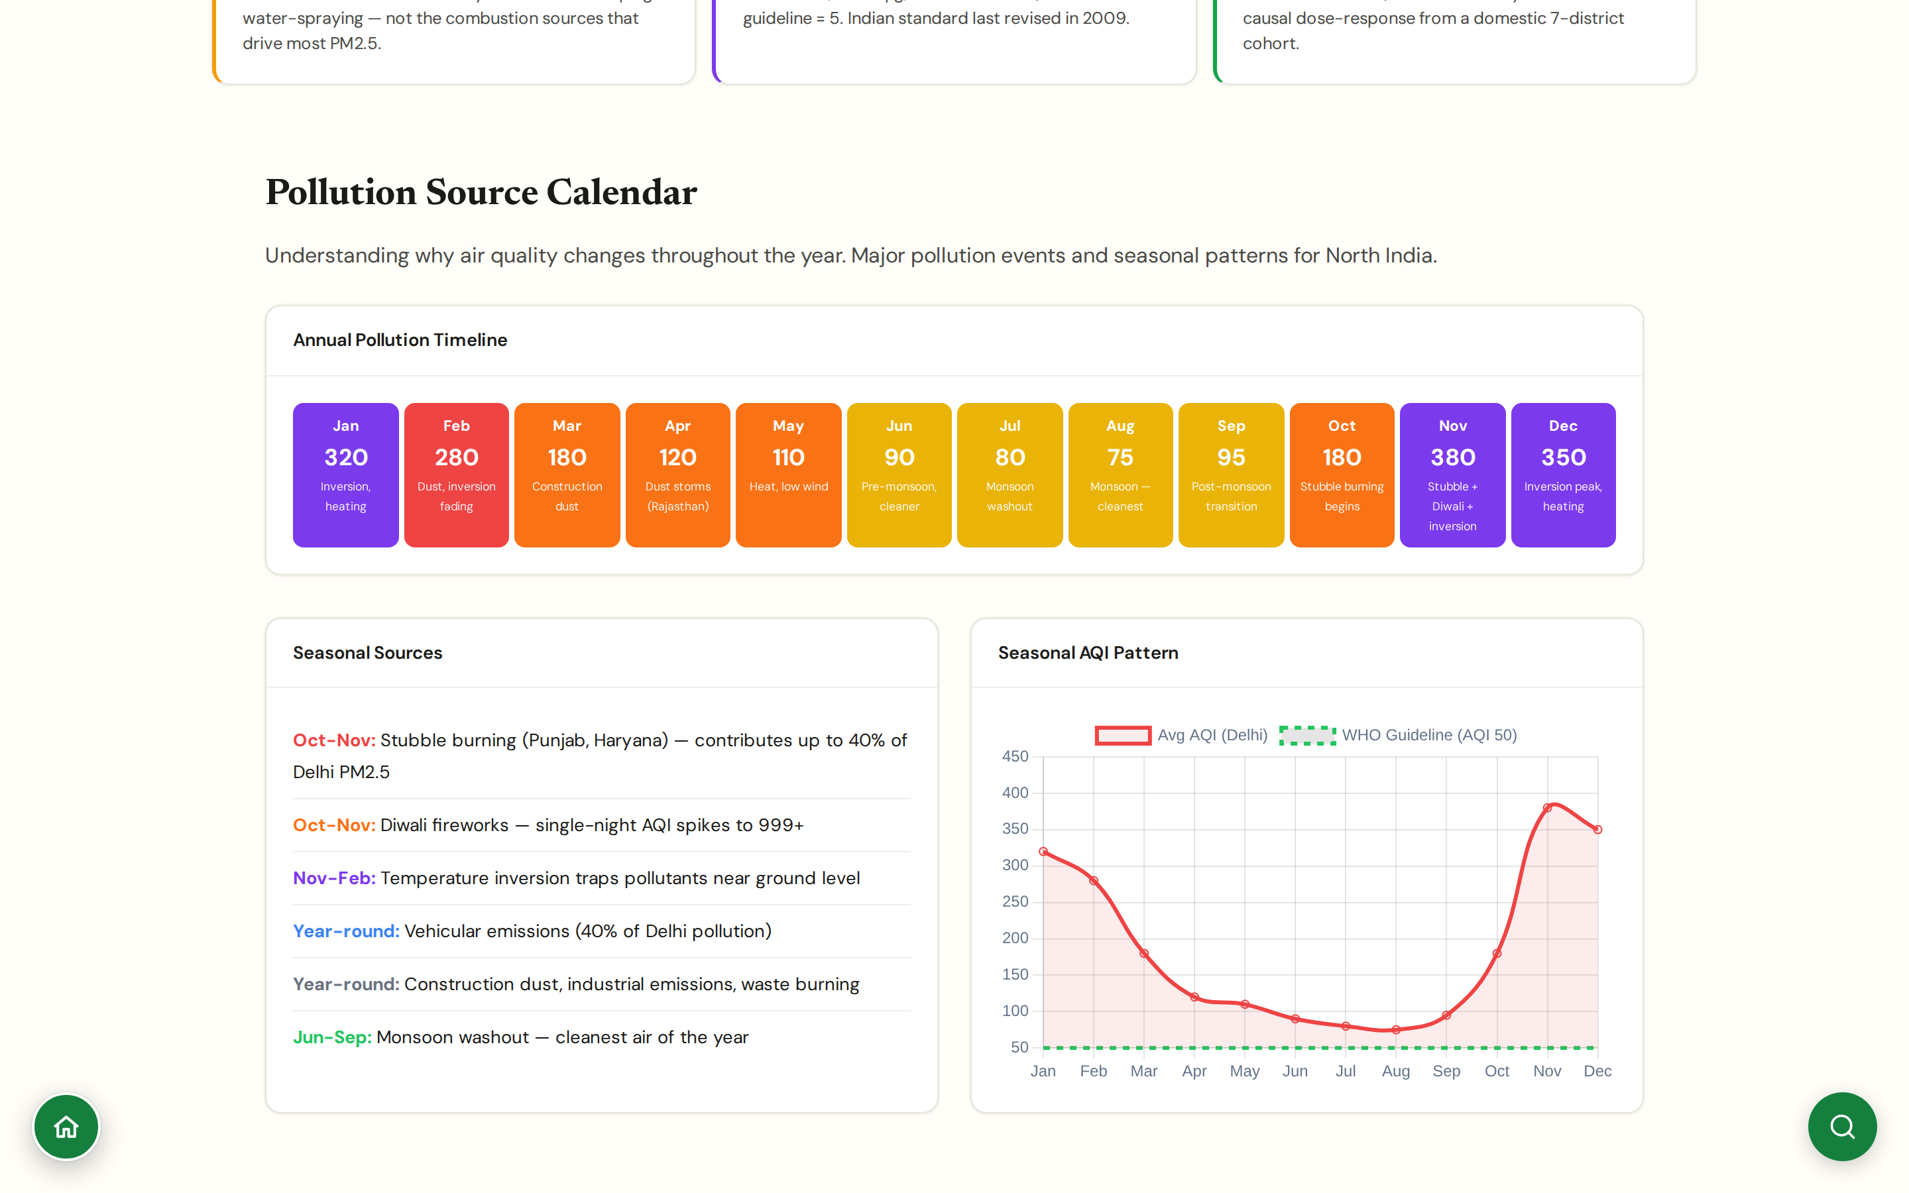
CHAPTER 2 · LIVE PICTURE
#pollution-calendar
Pollution Calendar
Twelve-month timeline showing average levels and the dominant source for each month
Annual timeline for North India: each month carries both an average AQI value and a named driver (Jan inversion + heating, Mar construction dust, Apr Rajasthan dust storms, Jul-Aug monsoon washout, Oct-Nov stubble + festive emissions, Dec inversion peak).
Makes the winter-vs-monsoon asymmetry visible at a glance: Aug averages ~75, Jan averages ~320 in Delhi.
Designed for planning: travel windows, marathon dates, school sports calendars, festival outdoor events.
Anchored in multi-year historical CPCB data, not the most recent year alone.
CHAPTER 2 · LIVE PICTURE
JanVayu · janvayu.in · Walkthrough
Notes:
The pollution calendar earns its place by naming the source for each month, not just showing the level. The deck audience tonight will already know December is bad; what's useful is seeing that March is bad because of construction dust rather than combustion, that April's bump is Rajasthan dust-storm season, that the cleanest weeks are the second half of August during peak monsoon. This is how source-attribution conversations should be calibrated by month, and it's the panel I send to marathon organisers, festival committees, and school sports planners.

Slide 19
CHAPTER
Chapter 3
Health & exposure
Translating μg/m³ into mortality, lost life-years, asthma risk, and 'should I send my child out today'. Eight panels rooted in peer-reviewed dose-response models.

Slide 20
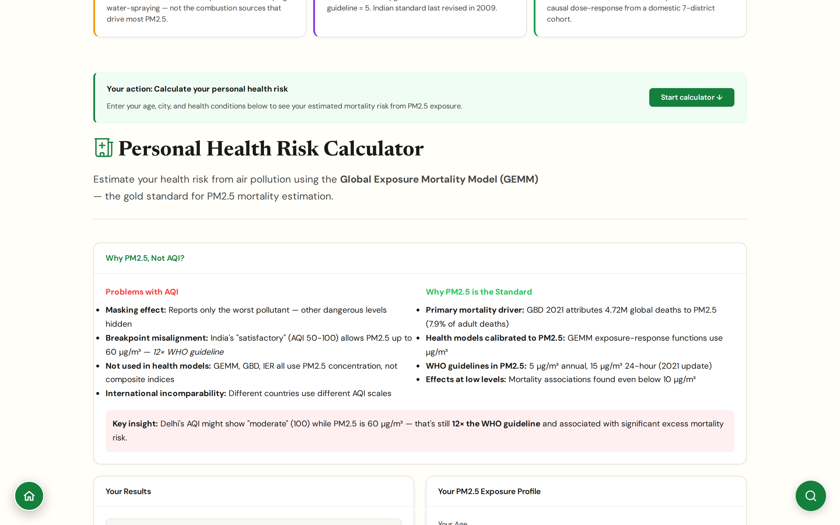
CHAPTER 3 · HEALTH & EXPOSURE
#health
Health Impact
Personal mortality risk via the Global Exposure Mortality Model
Calculator inputs: age, city (annual PM2.5), hours outdoors daily, pre-existing conditions (none / asthma / COPD / cardiovascular / multiple).
Outputs: excess mortality risk vs WHO guideline (5 μg/m³), expected life-years lost, cigarette-equivalent exposure (Berkeley Earth methodology).
Uses GEMM (Burnett et al., PNAS 2018), the dose-response function used in GBD studies; GBD 2021 attributes 4.72M global deaths to PM2.5 (7.9% of adult deaths).
Adjacent 'Why PM2.5, not AQI?' section makes the editorial choice explicit: AQI's masking effect (only reports the worst pollutant) and breakpoint misalignment (India's 'satisfactory' allows PM2.5 up to 60 μg/m³, 12× WHO) are surfaced inline.
CHAPTER 3 · HEALTH & EXPOSURE
JanVayu · janvayu.in · Walkthrough
Notes:
GEMM is the right choice over the older Integrated Exposure Response model because GEMM was fitted with Indian and Chinese cohorts where exposures actually reach the levels Indian residents face. The cigarette-equivalent is informally calibrated: a continuous PM2.5 exposure of 22 μg/m³ over a day is roughly equivalent to one cigarette in PM2.5 inhalation terms (Berkeley Earth, 2015). The 'Why PM2.5, Not AQI?' section directly under the calculator is the editorial spine: when Delhi's AQI shows 'moderate' at 100, PM2.5 can still be 60 μg/m³, twelve times the WHO guideline. The cigarette framing is controversial in epidemiology but it lands with audiences who don't read μg/m³ natively.

Slide 21
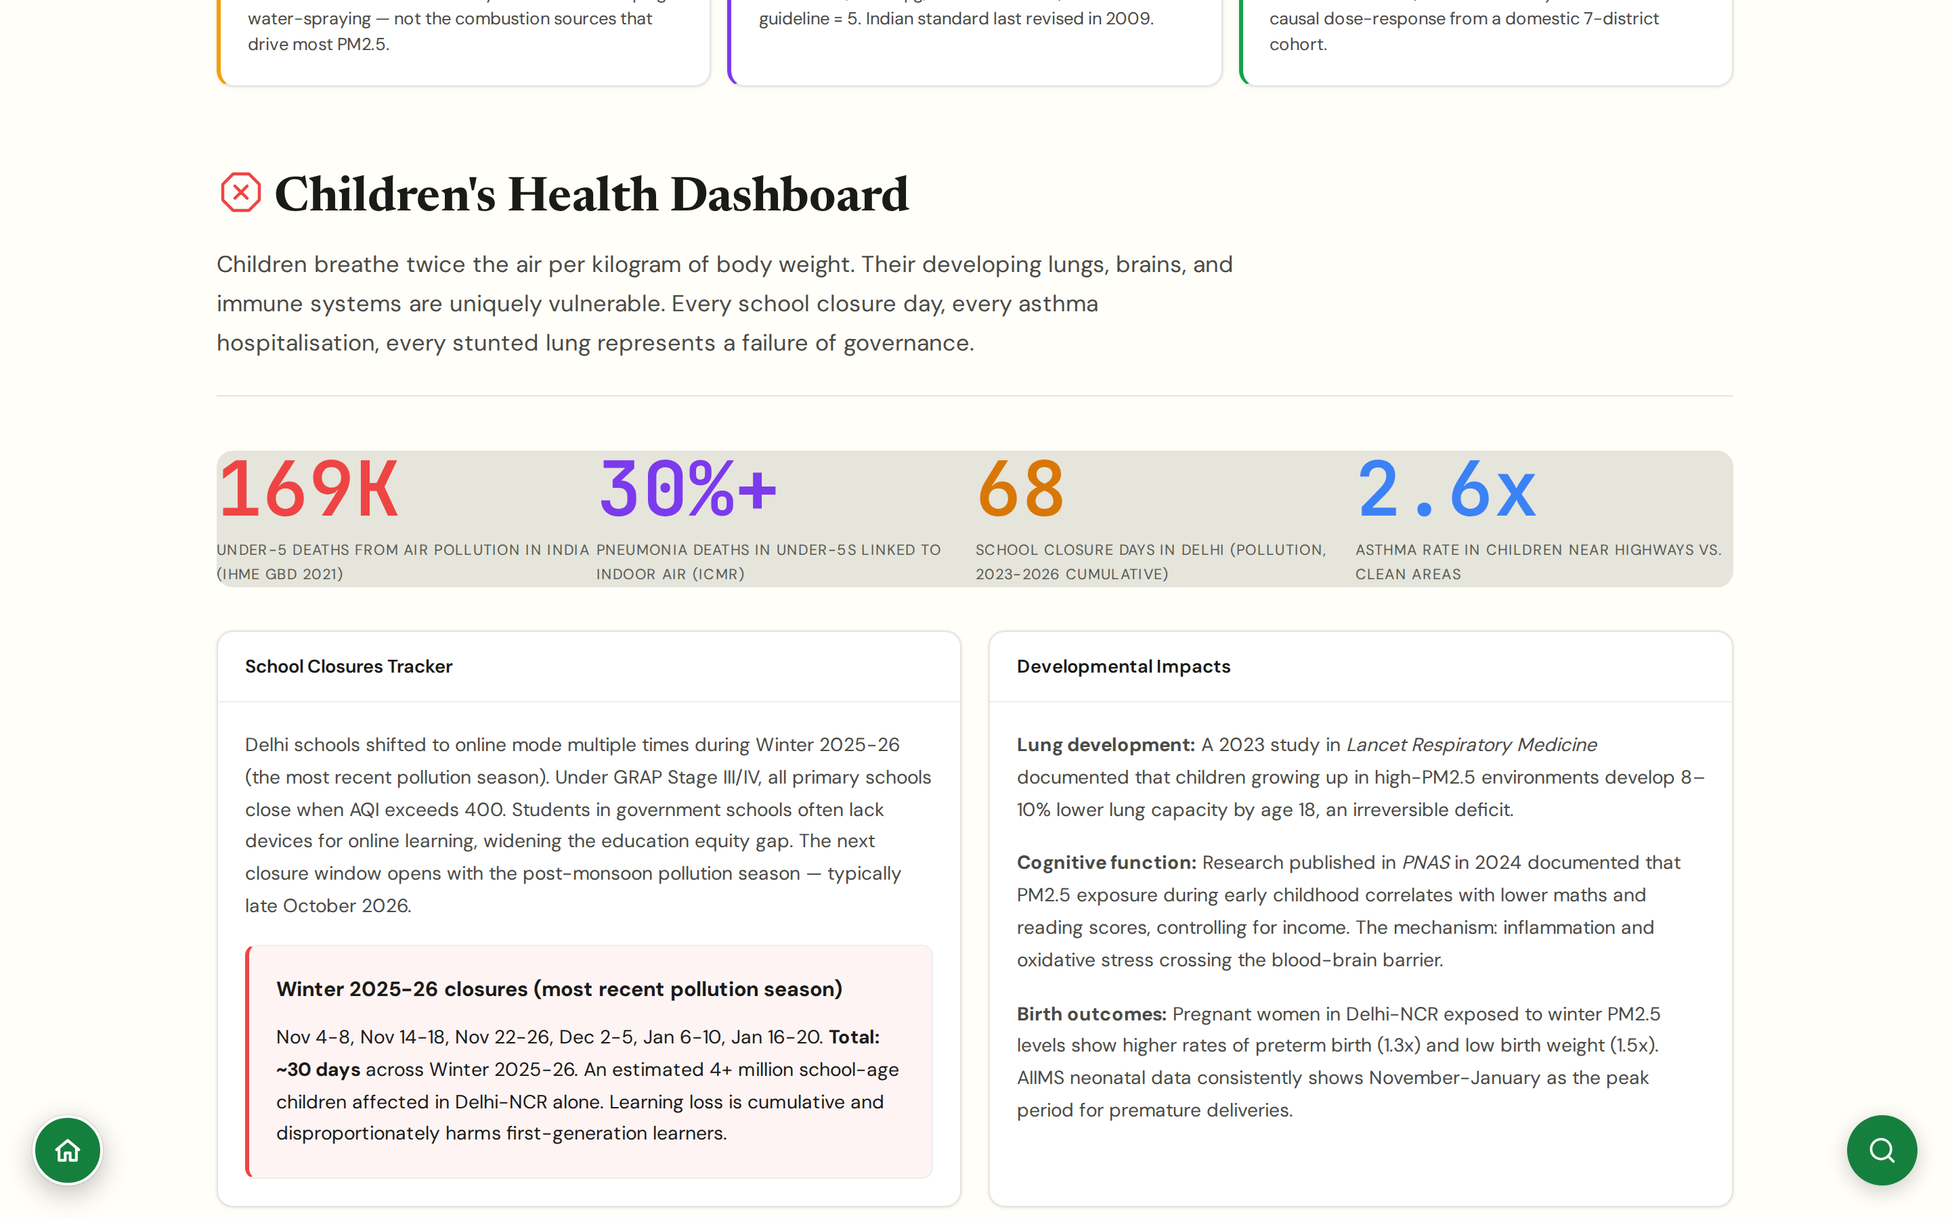
CHAPTER 3 · HEALTH & EXPOSURE
#children
Children's Health
Specific Indian paediatric numbers, not just 'children are more vulnerable'
169,000 under-5 deaths attributed to air pollution in India (IHME GBD 2021); 30%+ of under-5 pneumonia deaths linked to indoor air (ICMR); 2.6× asthma rate near highways.
School closure tracker: 68 cumulative pollution-driven closure days in Delhi (2023-2026); ~30 days in Winter 2025-26 alone across six closure windows from Nov to Jan; ~4M+ school-age children affected in Delhi-NCR.
Developmental impacts: 8-10% lower lung capacity by 18 in high-PM2.5 cohorts (Lancet Respiratory Medicine 2023); PM2.5 in early childhood linked to lower maths and reading scores controlling for income (PNAS 2024); 1.3× preterm and 1.5× low-birth-weight rates during Delhi winter peaks (AIIMS neonatal).
What parents can do (linked directly from the panel): request school air audits with low-cost sensors (Rs 3,000-5,000), advocate for HEPA or Corsi-Rosenthal box per classroom (Rs 5,000-10,000), file RTI on stalled Delhi government purifier procurement.
CHAPTER 3 · HEALTH & EXPOSURE
JanVayu · janvayu.in · Walkthrough
Notes:
Children's health is treated as a separate panel because the physiology genuinely differs. The lung-development window matters: PM2.5 exposure during the 0-18 window produces structural changes that don't reverse, the Lancet Respiratory Medicine 2023 figure of 8-10% lower lung capacity by adulthood is the right number to cite. The cumulative 68 school-closure days in Delhi over 2023-2026 is the political number; the four million children affected in Delhi-NCR is what makes it a policy demand rather than a personal-decision problem. The links to school air audits and Corsi-Rosenthal box procurement are the connection back to actionable steps, this panel is one click from School Closures and from the Take Action panel.

Slide 22
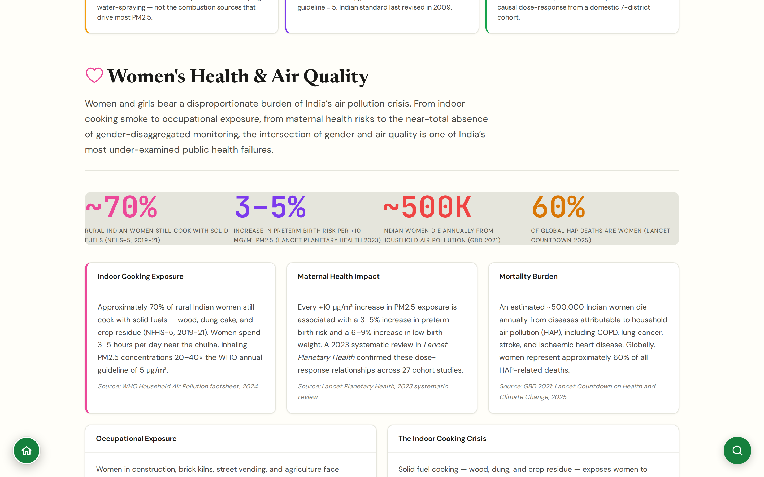
CHAPTER 3 · HEALTH & EXPOSURE
#gender
Women's Health
Why air pollution hits women harder, and the gender data gap
Roughly 70% of rural Indian women still cook with solid fuels (NFHS-5, 2019-21); indoor PM2.5 reaches 20-40× the WHO annual guideline during cooking, with 3-5 hours of daily exposure.
Each +10 μg/m³ PM2.5 raises preterm-birth risk by 3-5% and low-birth-weight risk by 6-9% (Lancet Planetary Health 2023 systematic review, 27 cohorts).
Roughly 500,000 Indian women die annually from household air pollution (GBD 2021); women bear about 60% of global HAP deaths (Lancet Countdown 2025).
Occupational exposure layered on top: construction, brick kilns, street vending, agriculture. India still lacks gender-disaggregated ambient monitoring at scale.
CHAPTER 3 · HEALTH & EXPOSURE
JanVayu · janvayu.in · Walkthrough
Notes:
The Women's Health panel was added in the late-May 2026 refresh and it closes a real gap in the earlier deck. Women's exposure is compositionally different from men's, not just more or less of it. Indoor cooking is the dominant pathway for the majority of rural Indian women and it sits structurally outside everything CPCB measures. The maternal health literature is now solid enough to surface as policy-relevant: the Lancet Planetary Health 2023 review covers 27 cohort studies on PM2.5 and birth outcomes. The mortality numbers come from GBD 2021 and Lancet Countdown 2025. The final bullet is the actionable item for researchers in this room: India lacks gender-disaggregated ambient monitoring almost entirely, and that is a closable gap.

Slide 23
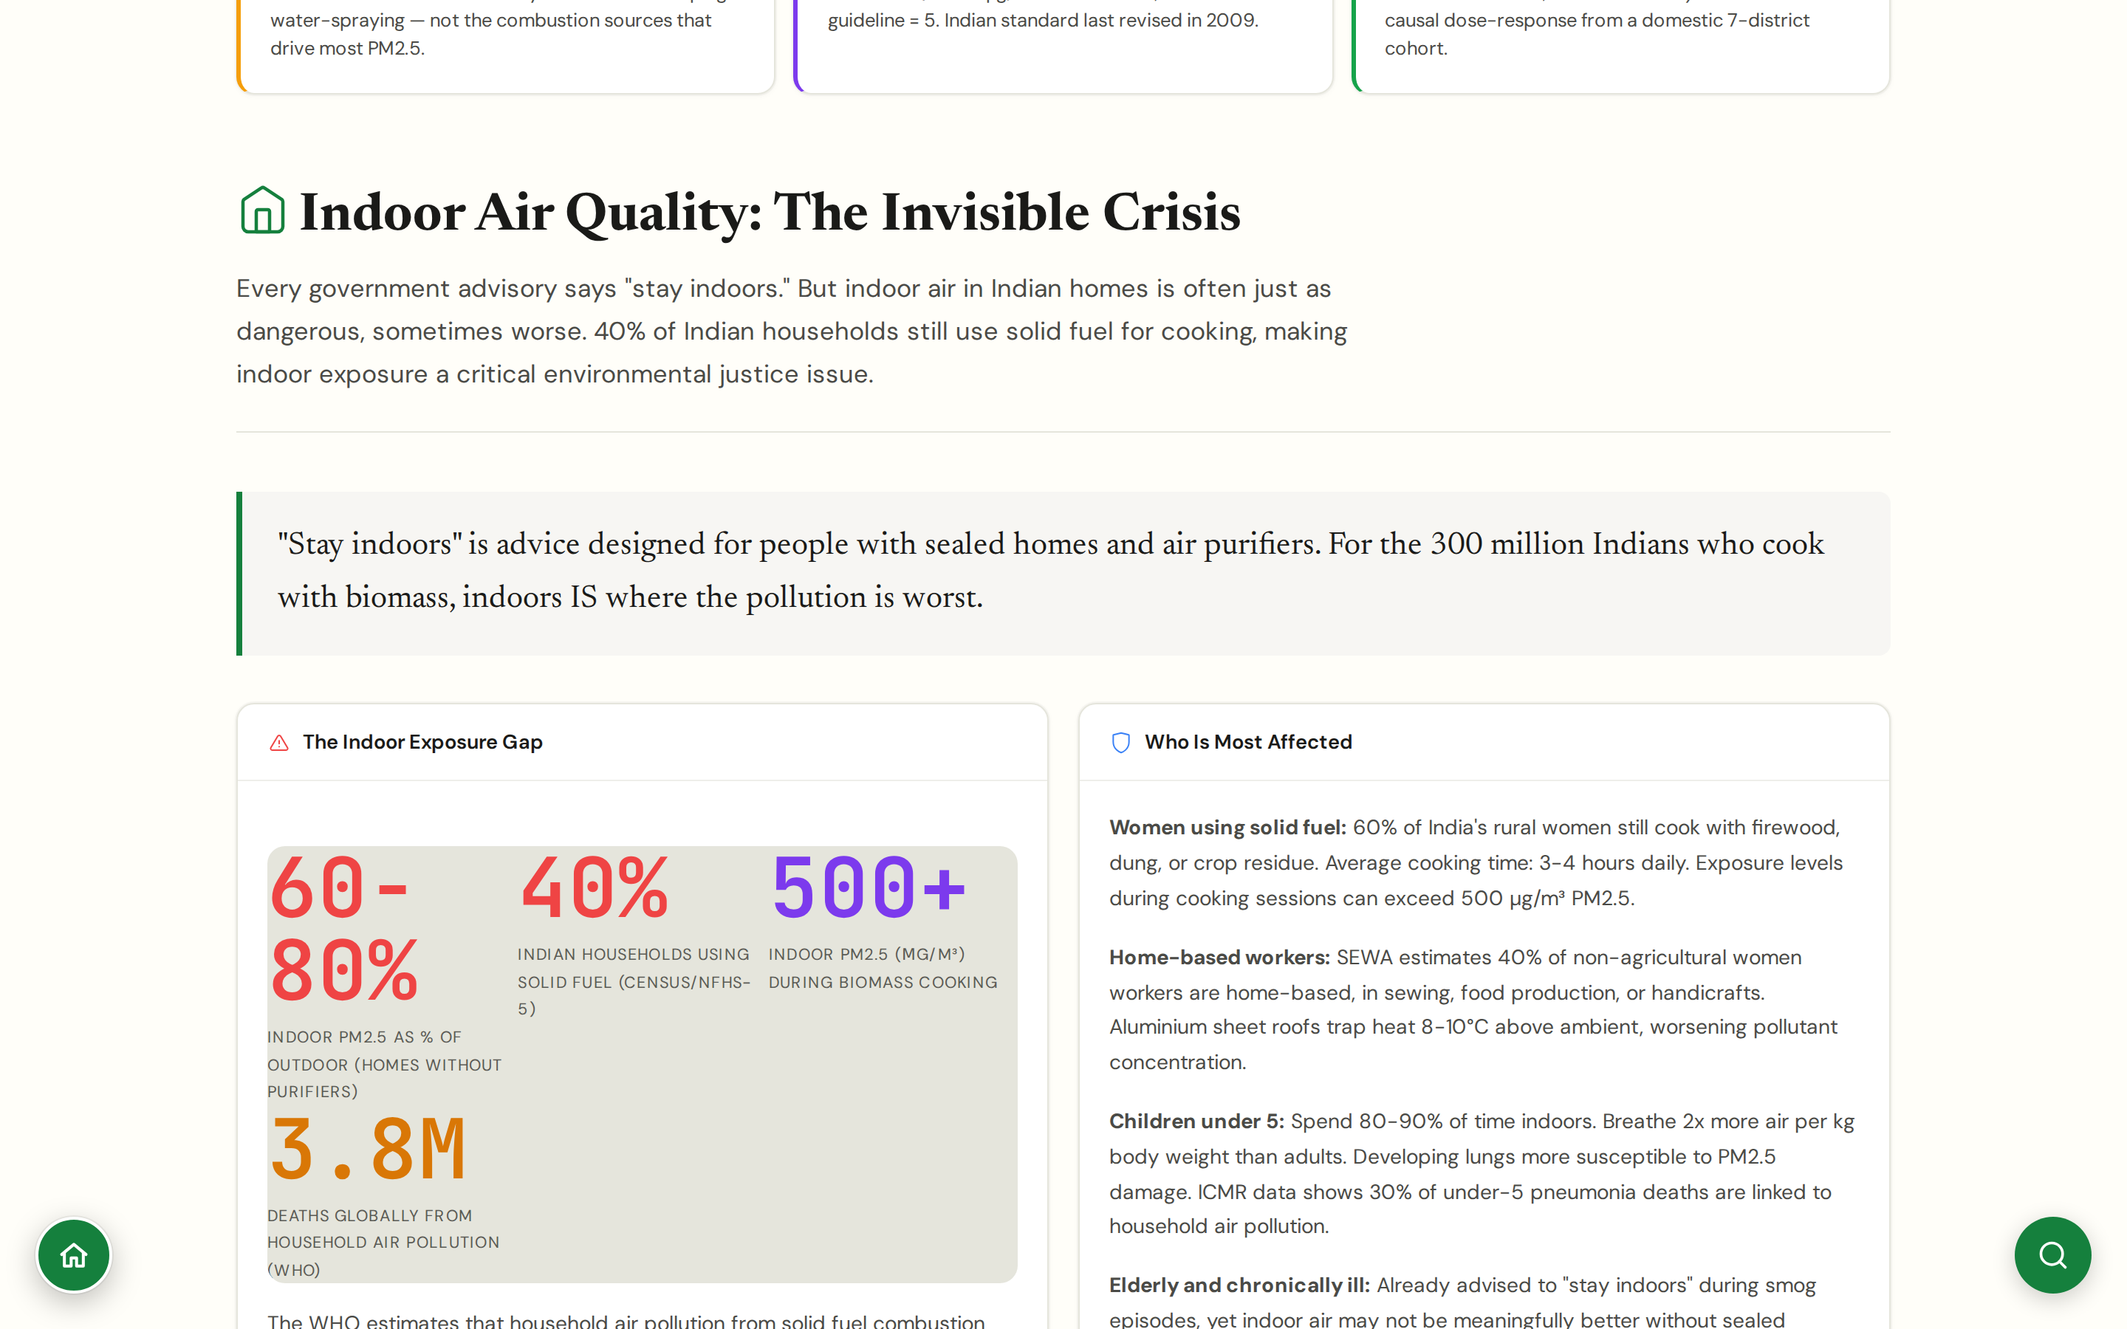
CHAPTER 3 · HEALTH & EXPOSURE
#indoor
Indoor Air
The half of the problem ambient sensors miss entirely
40% of Indian households still use solid fuel for cooking (Census/NFHS-5); indoor PM2.5 reaches 500+ μg/m³ during biomass cooking; 3.8M global deaths annually from household air pollution (WHO).
60% of rural Indian women cook with firewood, dung, or crop residue, 3-4 hours daily; SEWA estimates 40% of non-agricultural women workers are home-based (sewing, food, handicrafts) in heat-trapping aluminium-roofed homes.
Children under 5 spend 80-90% of time indoors; ICMR data links 30% of under-5 pneumonia deaths to household air pollution; PMUY 2.0 distributed 10+ Cr connections but refill rates remain 50-60% in some states.
Practical guidance with costs: Corsi-Rosenthal box (Rs 2,000-3,000) reduces indoor PM2.5 by 40-60%; LPG/induction transition; cross-ventilation and kitchen separation per WHO Housing and Health Guidelines (2018).
CHAPTER 3 · HEALTH & EXPOSURE
JanVayu · janvayu.in · Walkthrough
Notes:
Indoor air is the half of the problem that ambient sensors miss entirely. The State of Global Air's 3.8 million annual deaths from household air pollution is the headline. In India the bottleneck is the gap between Ujjwala 2.0's 10+ crore cylinder distribution and the actual refill rate, which drops to 50-60 percent in some states because refill costs are prohibitive. The Corsi-Rosenthal box, a HEPA filter taped to a box fan for 2,000-3,000 rupees, is the most consequential low-cost intervention: it cuts indoor PM2.5 by 40-60 percent and scales to schools and clinics where branded purifiers are unaffordable. The SEWA-cited number, 40 percent of non-agricultural working women are home-based in heat-trapping aluminium-roofed workspaces, is the occupational-exposure angle most policy people miss.

Slide 24
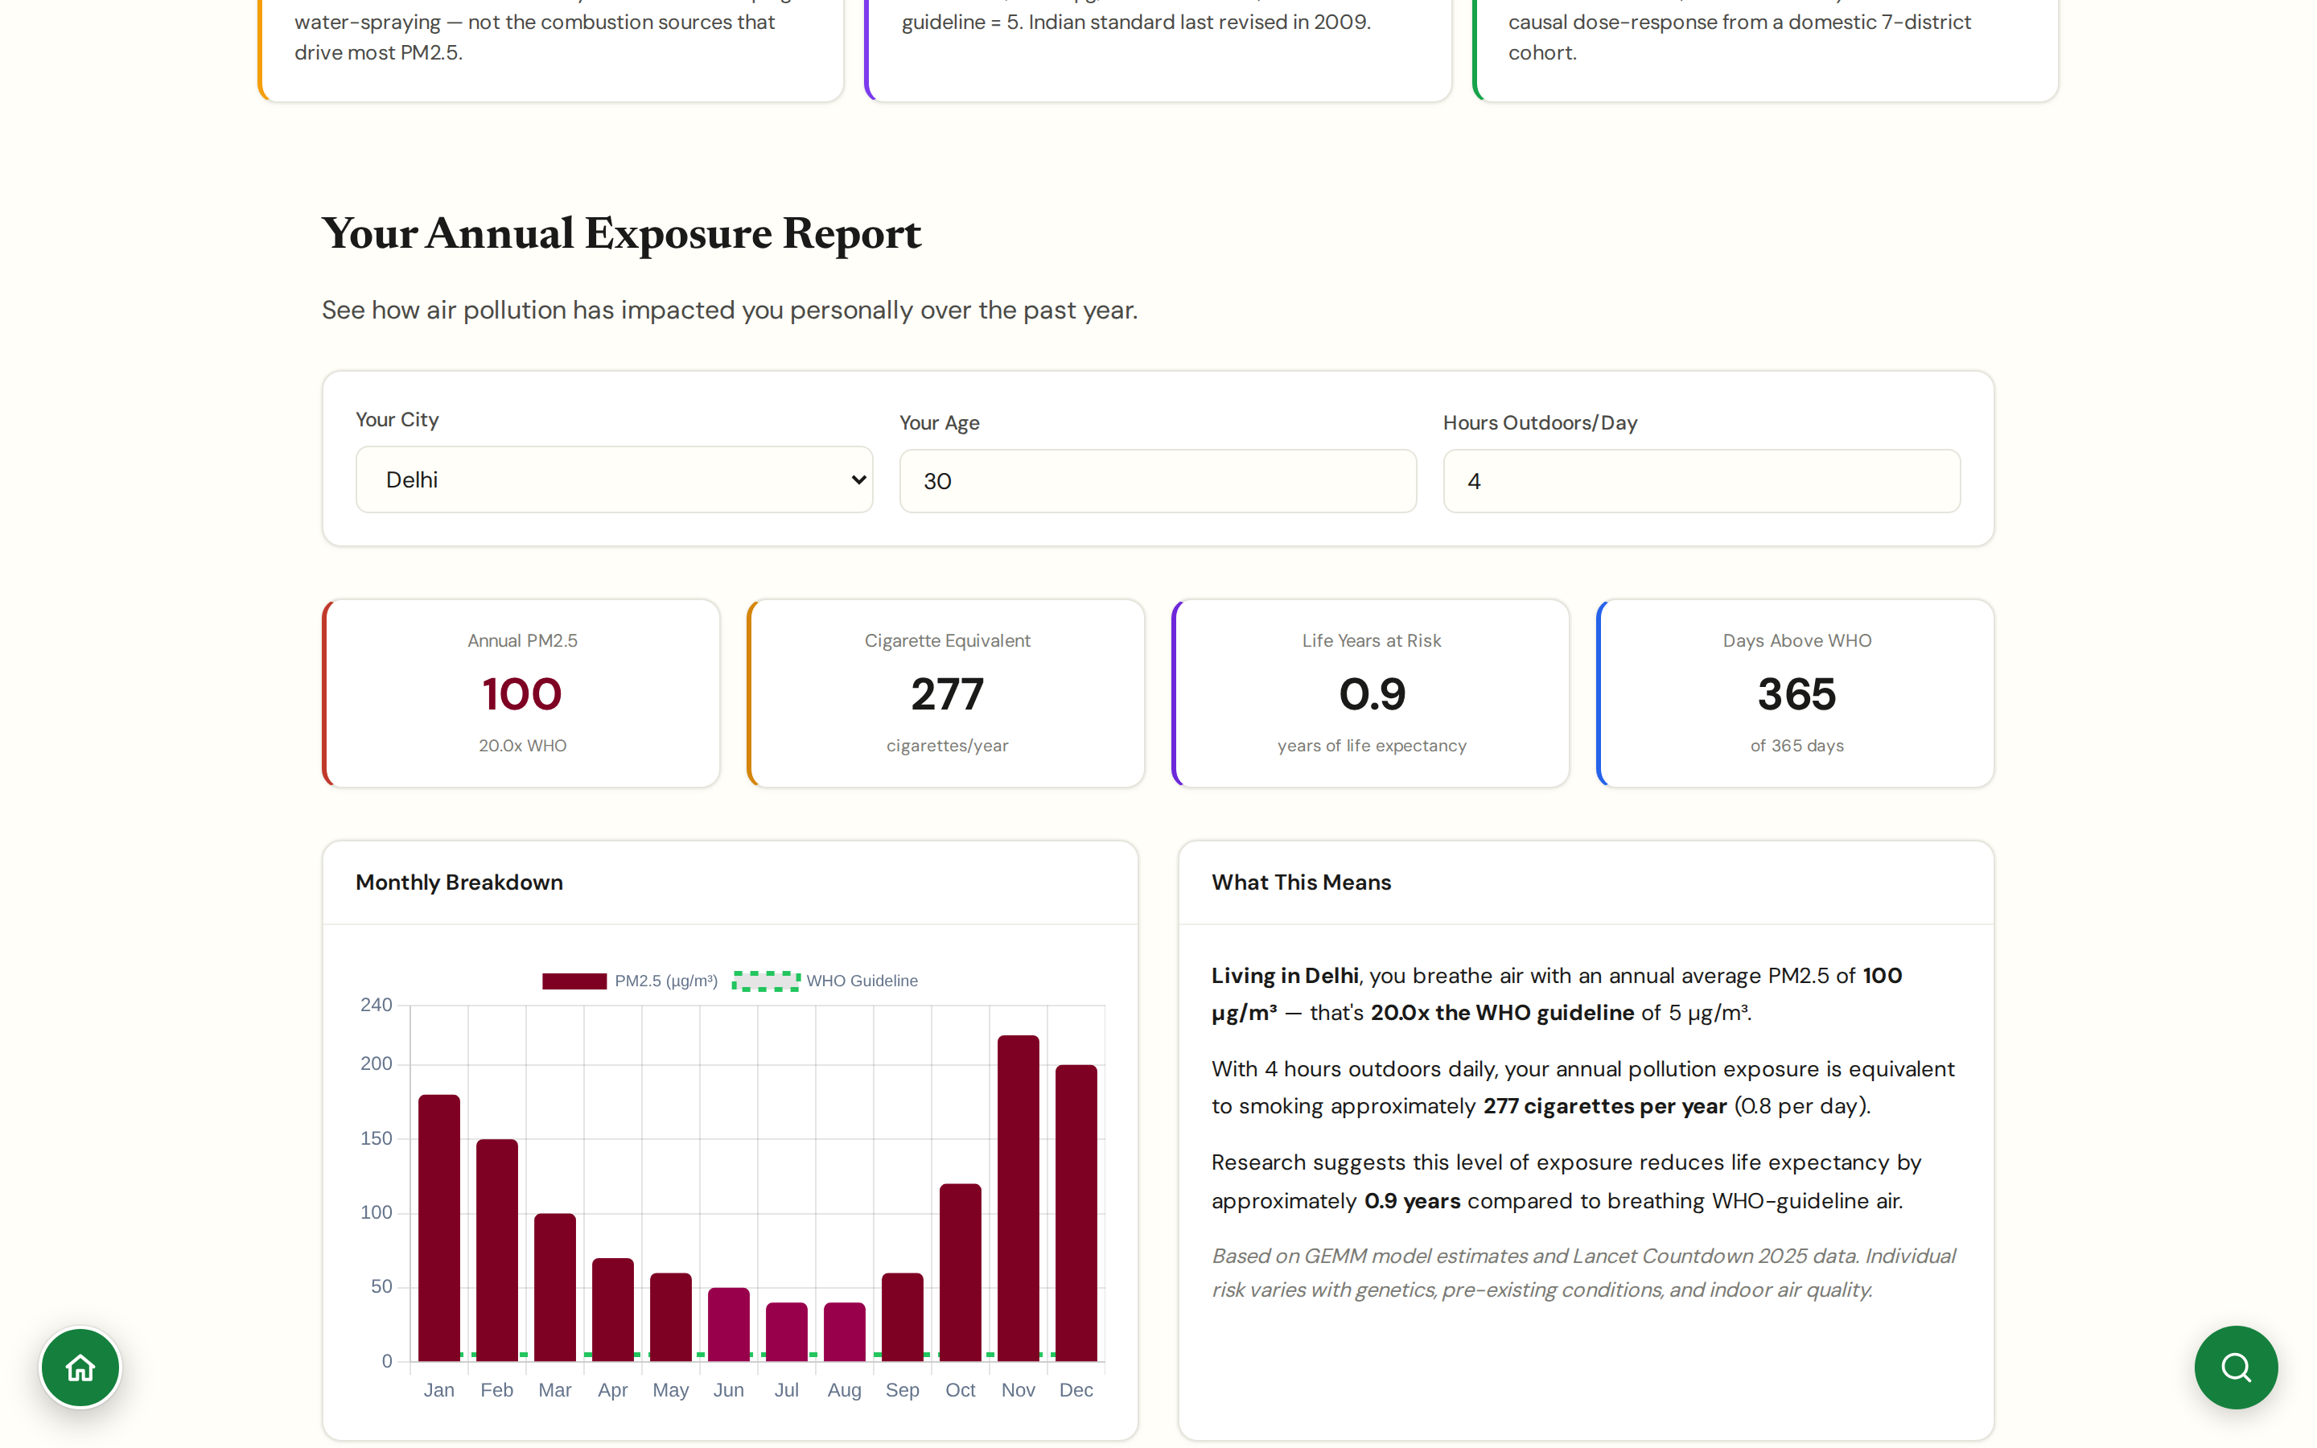
CHAPTER 3 · HEALTH & EXPOSURE
#exposure-report
Exposure Report
A personal exposure dossier you can download
Pulls your city's PM2.5 over a user-selected window and computes cumulative exposure metrics.
Compares your cumulative exposure to WHO annual guideline (5 μg/m³) and to a healthy baseline.
Outputs as a clean PDF the user can share with a doctor or use in a complaint or letter.
Designed for occupational exposure cases: gig workers, traffic police, sanitation workers, vendors.
CHAPTER 3 · HEALTH & EXPOSURE
JanVayu · janvayu.in · Walkthrough
Notes:
The exposure report is one of the most legally useful things on JanVayu. A traffic constable or a delivery rider standing in a Delhi intersection for eight hours a day has a cumulative PM2.5 exposure that is genuinely a workplace safety issue. Having a generated PDF that quantifies this, using public, citeable data, turns a vague grievance into something a labour department or a court can act on.

Slide 25
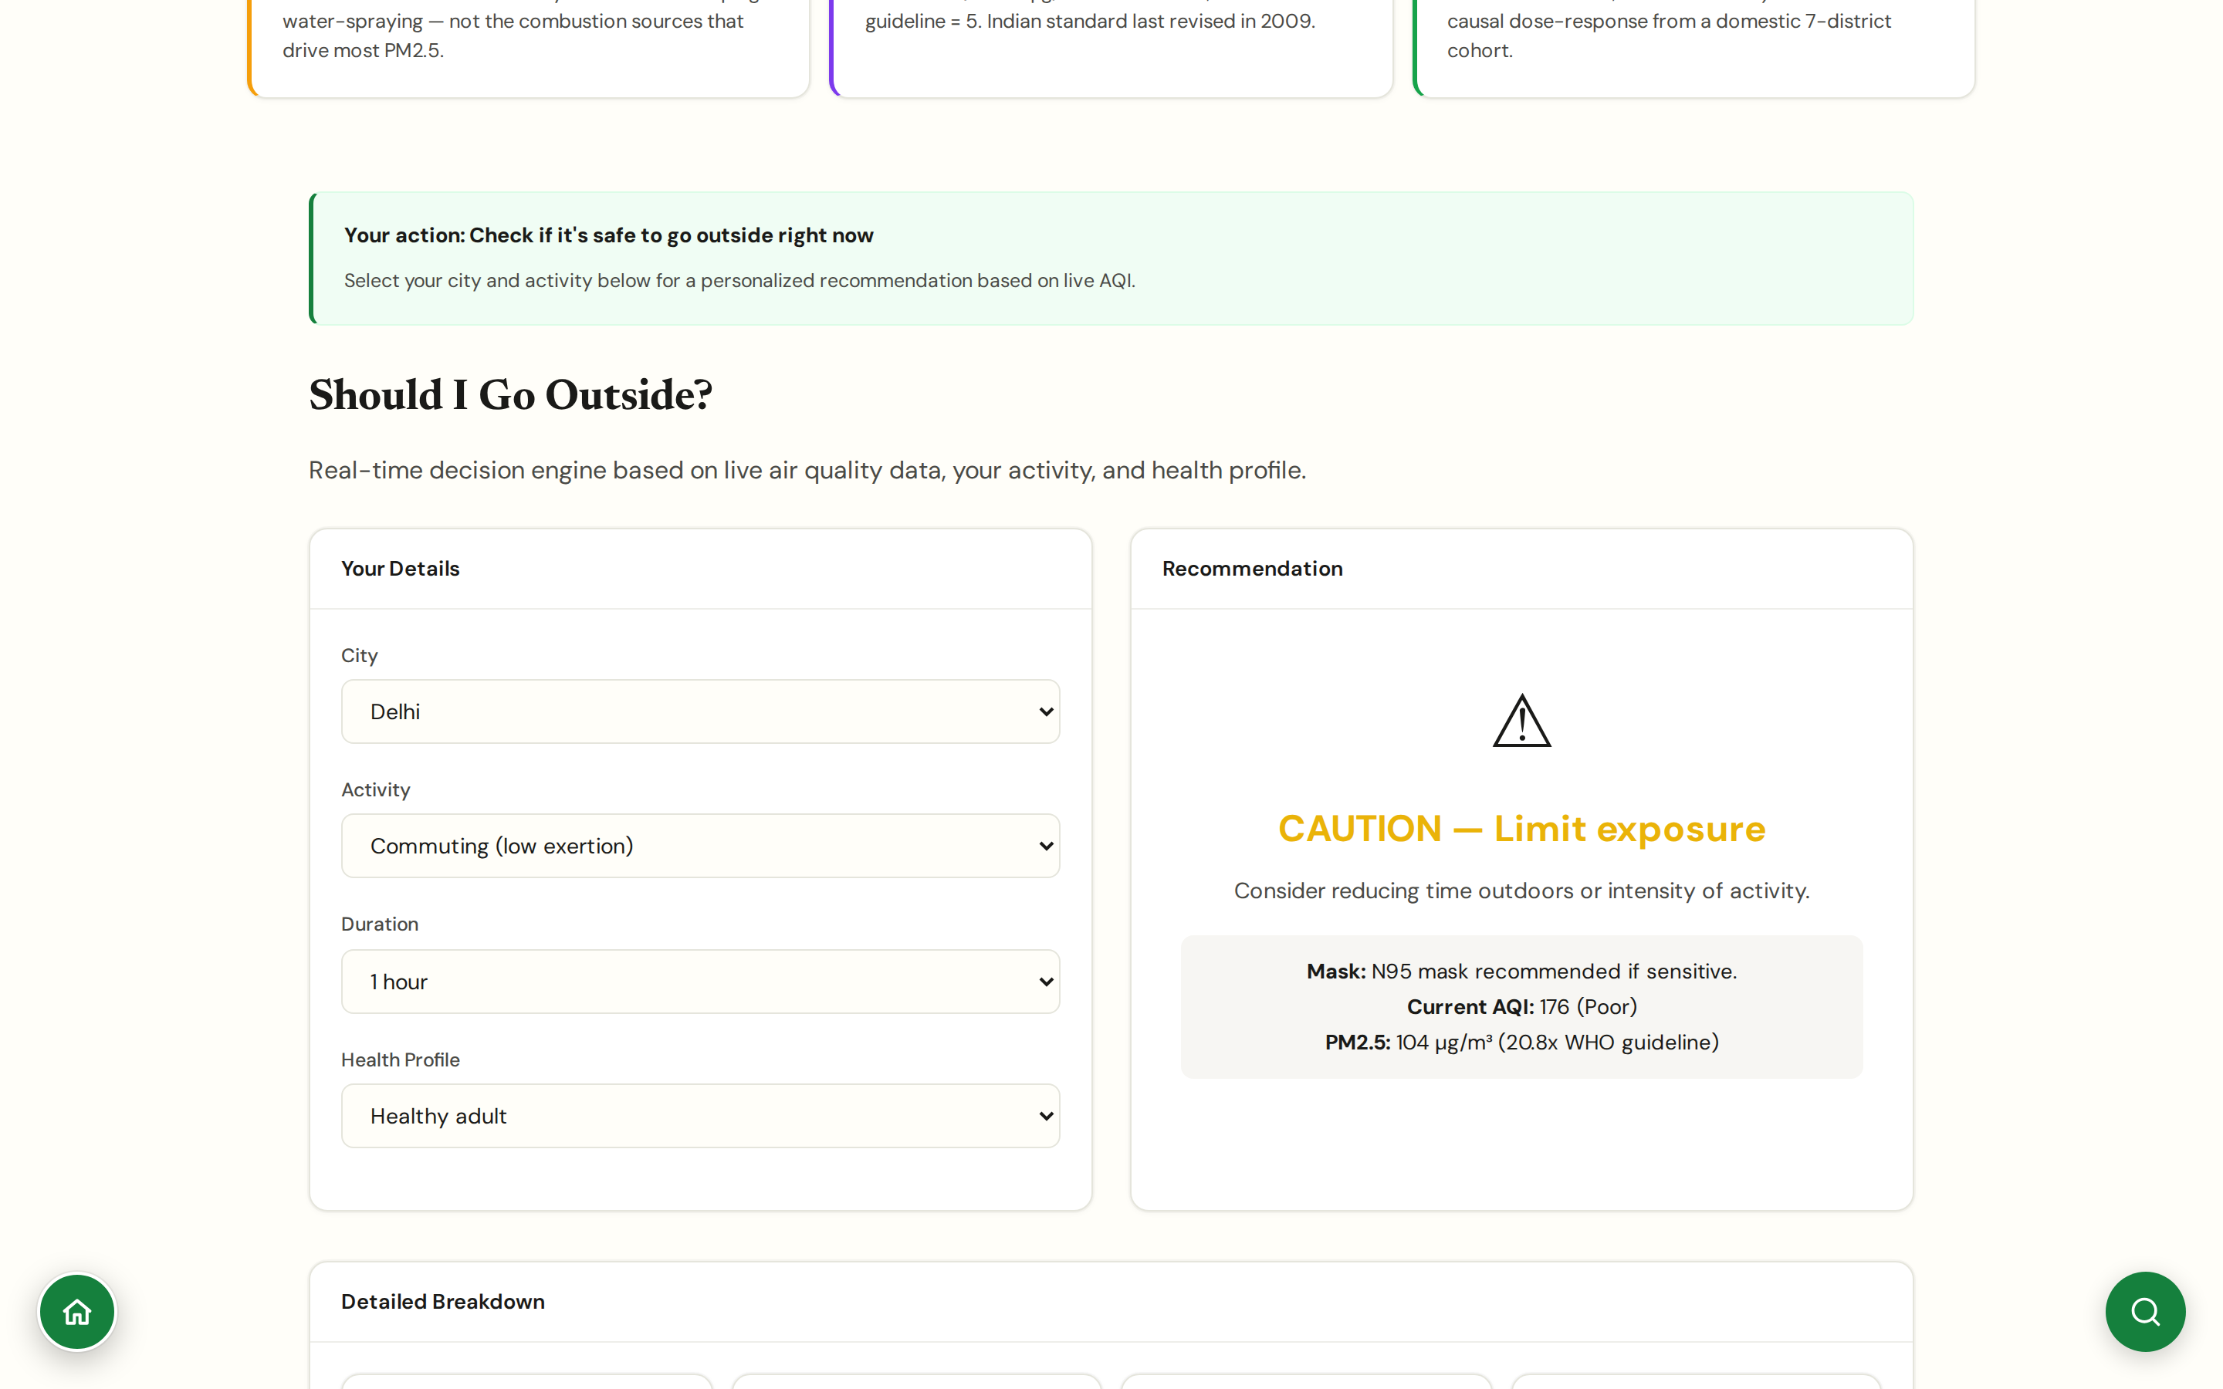
CHAPTER 3 · HEALTH & EXPOSURE
#go-outside
Should I Go Outside?
The one-question version, for everyday decisions
Single input, your city, produces a clear yes / yes-with-mask / no / absolutely-not answer.
Tailored by age, condition (asthma, pregnant, elderly), and planned activity (walk, jog, full workout).
Designed for parents and carers; copy is non-technical and decision-ready.
Hindi version available; uses everyday phrasing rather than μg/m³.
CHAPTER 3 · HEALTH & EXPOSURE
JanVayu · janvayu.in · Walkthrough
Notes:
This panel is the only one of its kind in Indian air-quality tools as far as I can find. Most existing tools present a number and leave the interpretation to the user. The decision a parent actually makes is: 'should I let my child play outside this afternoon?' This panel gives that answer directly, calibrated to age, pre-existing condition, and intensity of activity. The reasoning is shown below the answer so it does not feel like a black box.

Slide 26
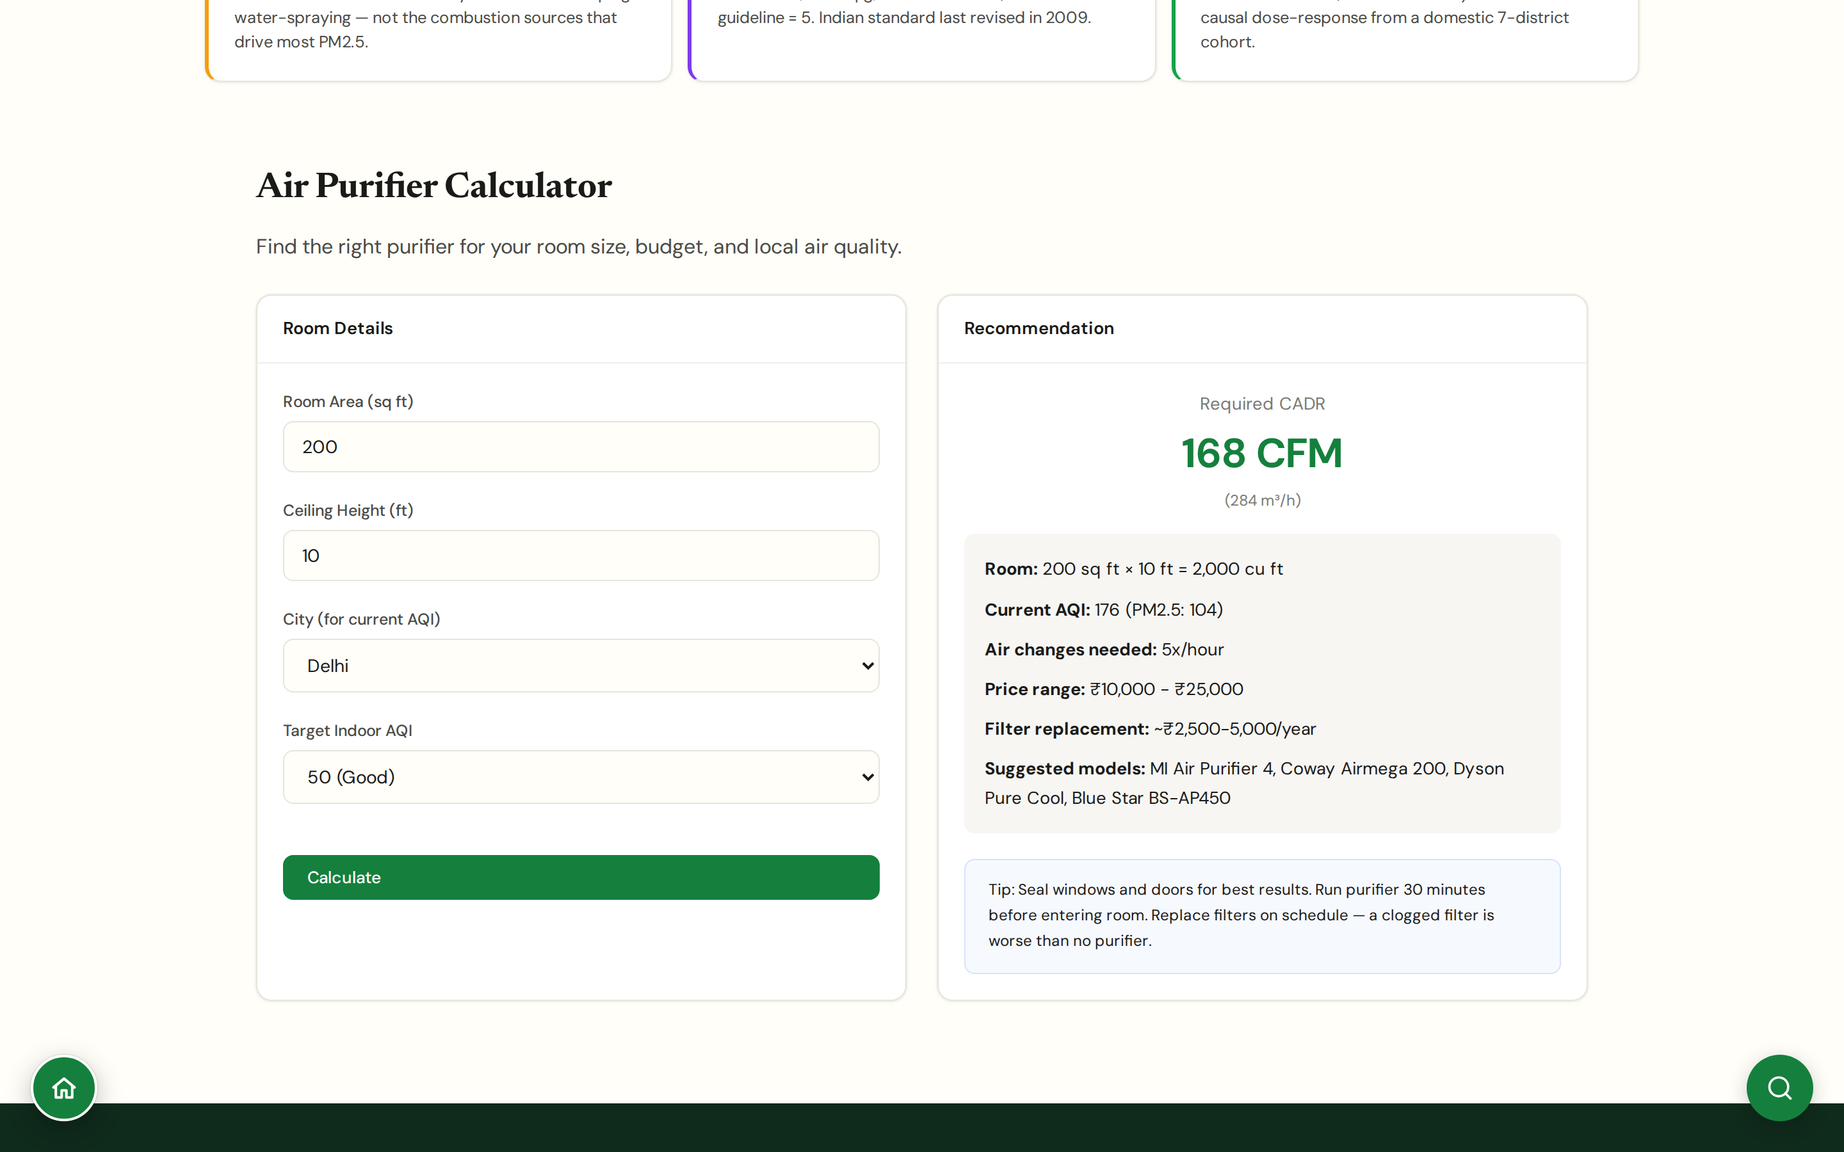
CHAPTER 3 · HEALTH & EXPOSURE
#purifier-calc
Purifier Calculator
How big a purifier, how many rooms, how long?
Inputs: room size (m³), outdoor PM2.5, hours of use, ACH (air changes per hour) targeted.
Output: minimum CADR (m³/h) required, recommended purifier capacity bands, electricity cost estimate.
Honest about limits: no purifier replaces source control; protects from chronic, not acute, exposure.
Includes guidance for low-cost alternatives (Corsi-Rosenthal boxes for institutional settings).
CHAPTER 3 · HEALTH & EXPOSURE
JanVayu · janvayu.in · Walkthrough
Notes:
The purifier industry has not been honest with Indian buyers. CADR ratings on the box are usually for clean-room conditions; real-room ACH at Indian PM2.5 levels often runs at half or a third of marketed numbers. The calculator builds in that derating. We also surface the Corsi-Rosenthal box approach as an institutional alternative for schools and clinics, a 20x box-fan-and-filter rig at a fraction of branded purifier cost.

Slide 27
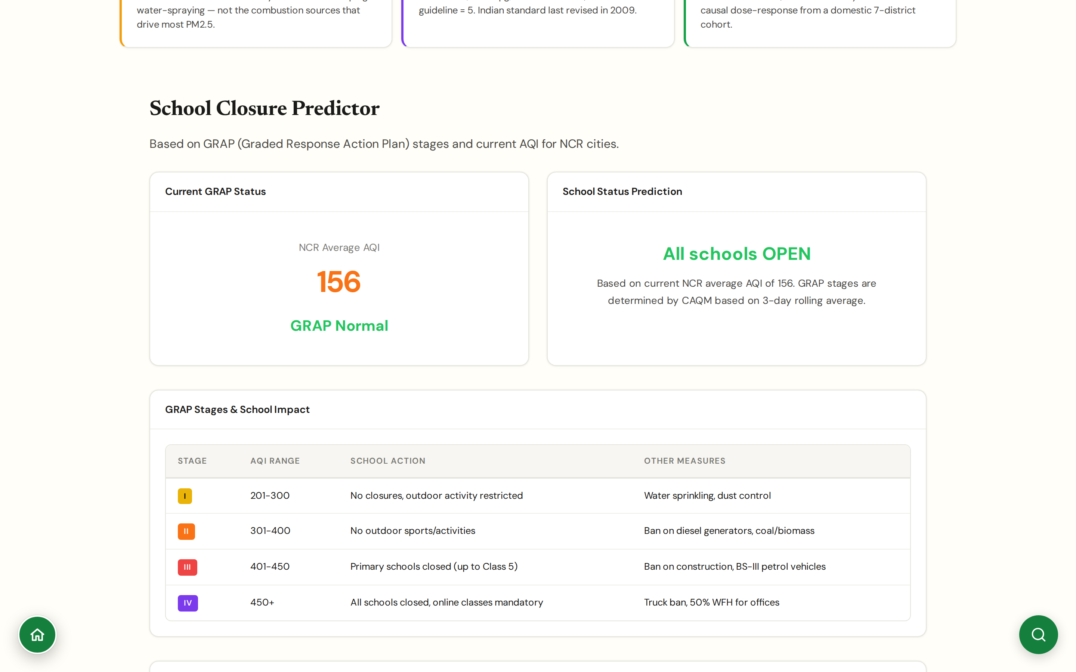
CHAPTER 3 · HEALTH & EXPOSURE
#school-closure
School Closures
A live GRAP-driven predictor, not just a closure tracker
Live NCR average AQI feeds a per-stage prediction: open / no outdoor sport / primary closed / all closed; today's status visible at the top of the panel.
Full GRAP stages table laid out: Stage I (AQI 201-300) no closures but outdoor activity restricted, Stage II (301-400) no outdoor sport, Stage III (401-450) primary schools shut, Stage IV (450+) all schools shut, online classes mandatory.
NCR city grid shows current AQI per city alongside its category (Delhi, Gurgaon, Noida, Faridabad, Ghaziabad), surfacing the unevenness inside the metro.
Decisions are taken by CAQM on a 3-day rolling average, so the panel exposes both the live snapshot and the rolling figure that actually triggers an order.
CHAPTER 3 · HEALTH & EXPOSURE
JanVayu · janvayu.in · Walkthrough
Notes:
This panel is more useful than its name suggests. The headline is a real-time prediction of school status under current air quality, calibrated to the actual CAQM trigger logic (3-day rolling, not instantaneous). The NCR city grid below it is the part journalists use most: when Noida is at 259 and Gurgaon is at 93, it's clear the trigger should be city-specific rather than NCR-wide. The structural failure remains that thresholds are reactive, schools close only after AQI is past 400, which is well into 'severe' territory by any health framework. The panel surfaces both the live status and the implicit gap between what triggers a closure and what a health-driven framework would set.

Slide 28
CHAPTER
Chapter 4
Economic cost & migration
What air pollution costs employers, GDP, and the people who have to move to escape it.

Slide 29
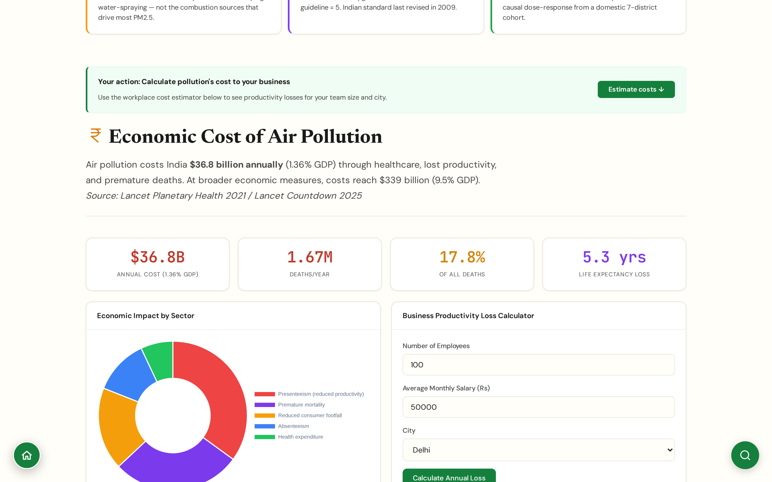
CHAPTER 4 · ECONOMIC & MIGRATION
#economic
Economic Cost
Workforce productivity loss calculator for employers
Inputs: headcount, average annual salary, city. Output: annual productivity loss in INR.
Built on Dalberg-style absenteeism + presenteeism estimates by PM2.5 band, sector-tunable.
Designed to give CSR and HR teams a credible number for purifier deployment business cases.
National aggregate: ~$95B productivity loss / year (Dalberg 2021); $339.4B all-in (Lancet Countdown 2025, 9.5% GDP).
CHAPTER 4 · ECONOMIC & MIGRATION
JanVayu · janvayu.in · Walkthrough
Notes:
The economic cost calculator gives an employer a concrete number for what their workforce loses each year to bad air. It uses absenteeism + presenteeism rates (presenteeism is when someone is at work but functioning at reduced capacity, a much larger loss than outright absence). The aggregate numbers behind it are Dalberg's 2021 productivity work and the Lancet Countdown 2025 9.5%-of-GDP figure, which is broader because it includes premature mortality and lost lifetime earnings.

Slide 30
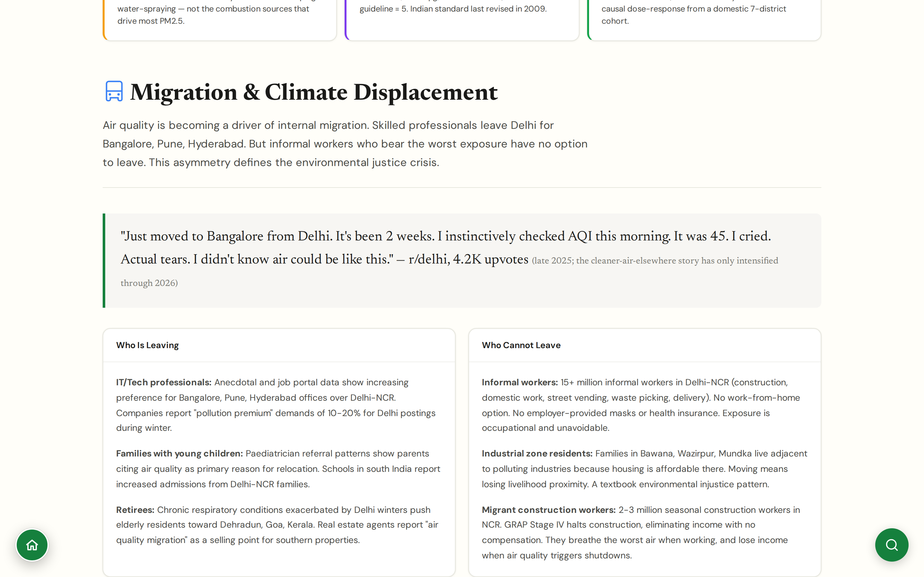
CHAPTER 4 · ECONOMIC & MIGRATION
#migration
Migration & Displacement
When people leave because they cannot breathe, and when they cannot
Who leaves: IT/tech professionals choosing Bangalore, Pune, Hyderabad over Delhi-NCR; job-portal data shows 10-20% 'pollution premium' demands for winter Delhi postings.
Who stays: 15+ million informal-sector workers in Delhi-NCR (construction, domestic, street vending, delivery, waste-picking) with no work-from-home option, no employer-provided masks, no health insurance.
Industrial-zone residents in Bawana, Wazirpur, Mundka are doubly trapped: they cannot leave because housing is affordable adjacent to polluting industries, and GRAP Stage IV halts construction with no compensation.
The asymmetry is the environmental justice frame: voluntary migration as adaptive capacity, involuntary exposure as the cost of poverty.
CHAPTER 4 · ECONOMIC & MIGRATION
JanVayu · janvayu.in · Walkthrough
Notes:
Air-quality-driven migration is the under-studied piece of the air quality story in India. The numbers are still uncertain because internal migration is hard to attribute to a single cause, but the pattern is now well-documented: IT companies report 10-20 percent pollution-premium demands for Delhi winter postings; paediatrician referral patterns show parents citing air quality as the primary reason for relocation; real estate agents in Dehradun, Goa, and Kerala explicitly market 'air quality migration'. The justice frame is the harder argument: 15-plus million informal workers in Delhi-NCR cannot leave, GRAP Stage IV halts their work without compensation, and their workplace is the most polluted street in the country. This is climate-style displacement but at a sub-national scale, and the people who can move are by definition the ones with resources.

Slide 31
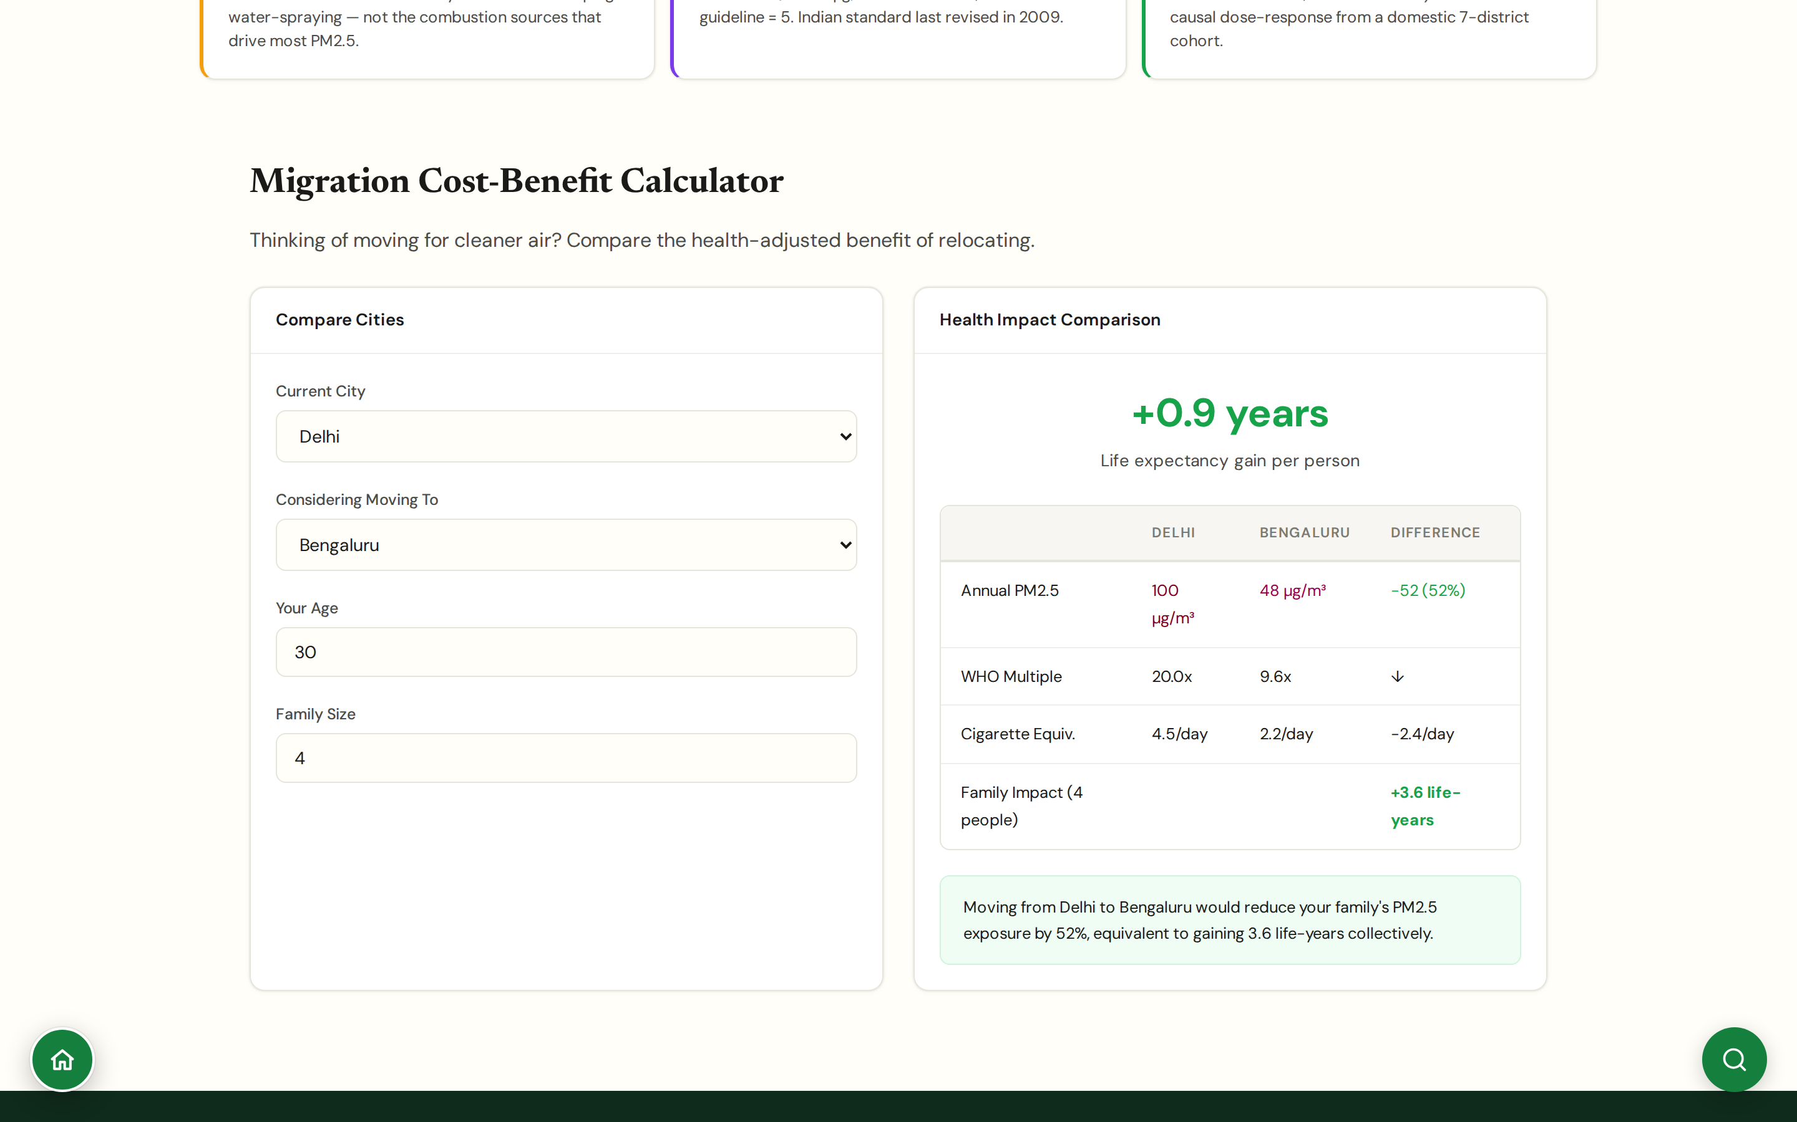
CHAPTER 4 · ECONOMIC & MIGRATION
#migration-calc
Migration Calculator
Would moving cities actually help your family?
Input: current city, candidate city, years of expected residence.
Output: change in cumulative PM2.5 exposure, change in expected life-years (GEMM), commute/cost framing.
Honest framing: most cities still exceed WHO; the question is by how much.
Useful for families weighing job-driven moves; for teachers it is a teaching tool on exposure differentials.
CHAPTER 4 · ECONOMIC & MIGRATION
JanVayu · janvayu.in · Walkthrough
Notes:
The migration calculator is unusual in that it tells people honestly when moving will help and when it won't. Moving from Delhi to Bengaluru: meaningful, several life-years preserved over a long residence. Moving from Mumbai to Chennai: marginal, neither city is close to safe. The point is to translate exposure differentials into something a household can use to make a real decision, rather than letting 'move to a less polluted city' remain abstract advice.

Slide 32
CHAPTER
Chapter 5
Policy & accountability
The political teeth of the platform. Where money goes, what is announced versus what works, who is responsible, and how to ask harder questions.

Slide 33
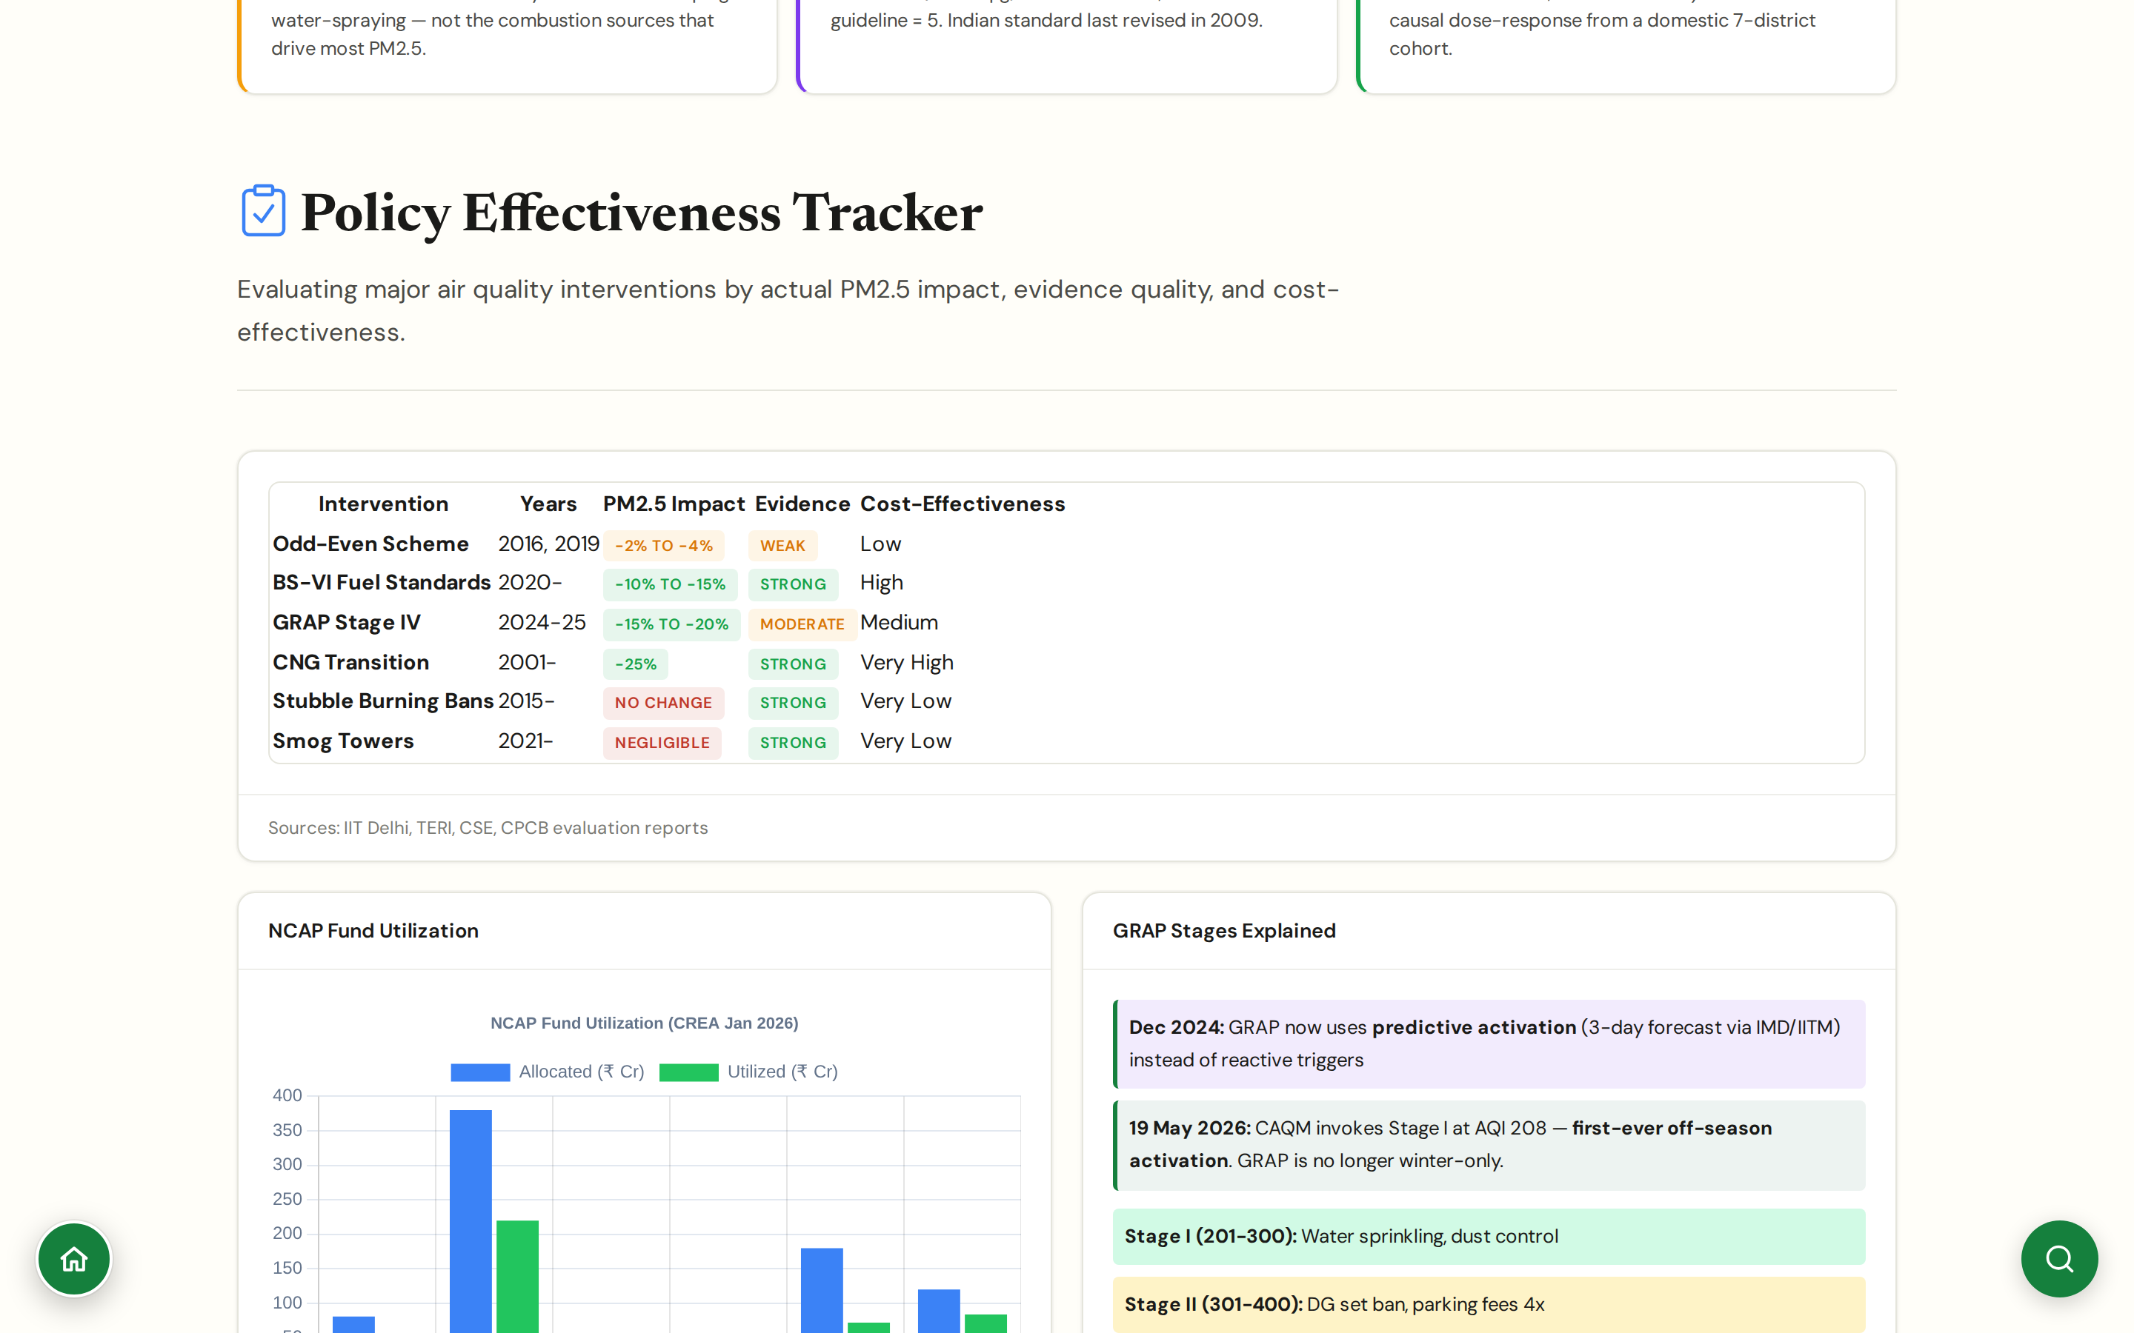
CHAPTER 5 · POLICY & ACCOUNTABILITY
#policy
Policy Tracker
Evidence-graded effectiveness of every major intervention
Headline table: Odd-Even (-2 to -4%, weak evidence), BS-VI Fuel Standards (-10 to -15%, strong), GRAP Stage IV (-15 to -20%, moderate), CNG Transition (-25%, strong), Stubble Burning Bans (no change, strong), Smog Towers (negligible, strong).
GRAP since Dec 2024 uses predictive activation via 3-day IMD/IITM forecasts rather than reactive triggers; CAQM invoked Stage-I off-season for the first time on 19 May 2026.
Each row links to its underlying source (IIT Delhi, TERI, CSE, CPCB evaluation reports) so a journalist can cite the original work rather than the table.
Citizen-side recommendations on the same panel: 72-hour persistence rule for GRAP stages to stop yo-yo lifting; tighter NCR-vs-city triggering.
CHAPTER 5 · POLICY & ACCOUNTABILITY
JanVayu · janvayu.in · Walkthrough
Notes:
The Policy Tracker is the single most useful panel for policy memos. The headline is the table: every major intervention with a PM2.5 impact range, an evidence-quality flag, and a cost-effectiveness rating. The structural finding is uncomfortable: the interventions with the strongest evidence base are not the ones receiving the most NCAP funding. CNG transition and BS-VI fuel standards have the strongest evidence and have moved the needle 10-25%, but they were one-time structural shifts. Smog towers (₹20 Cr per unit) have strong evidence that they do nothing measurable at city scale. Odd-even has been tested twice and the effect was 2-4%, well below the political claims. The GRAP change in December 2024 to predictive activation is the most consequential under-reported policy shift: it moves trigger decisions from reactive (after the spike) to anticipatory (24-72 hours before), which is structurally a much better design but depends entirely on forecast accuracy, which the Forecast panel shows is poor at the 3-day horizon.

Slide 34
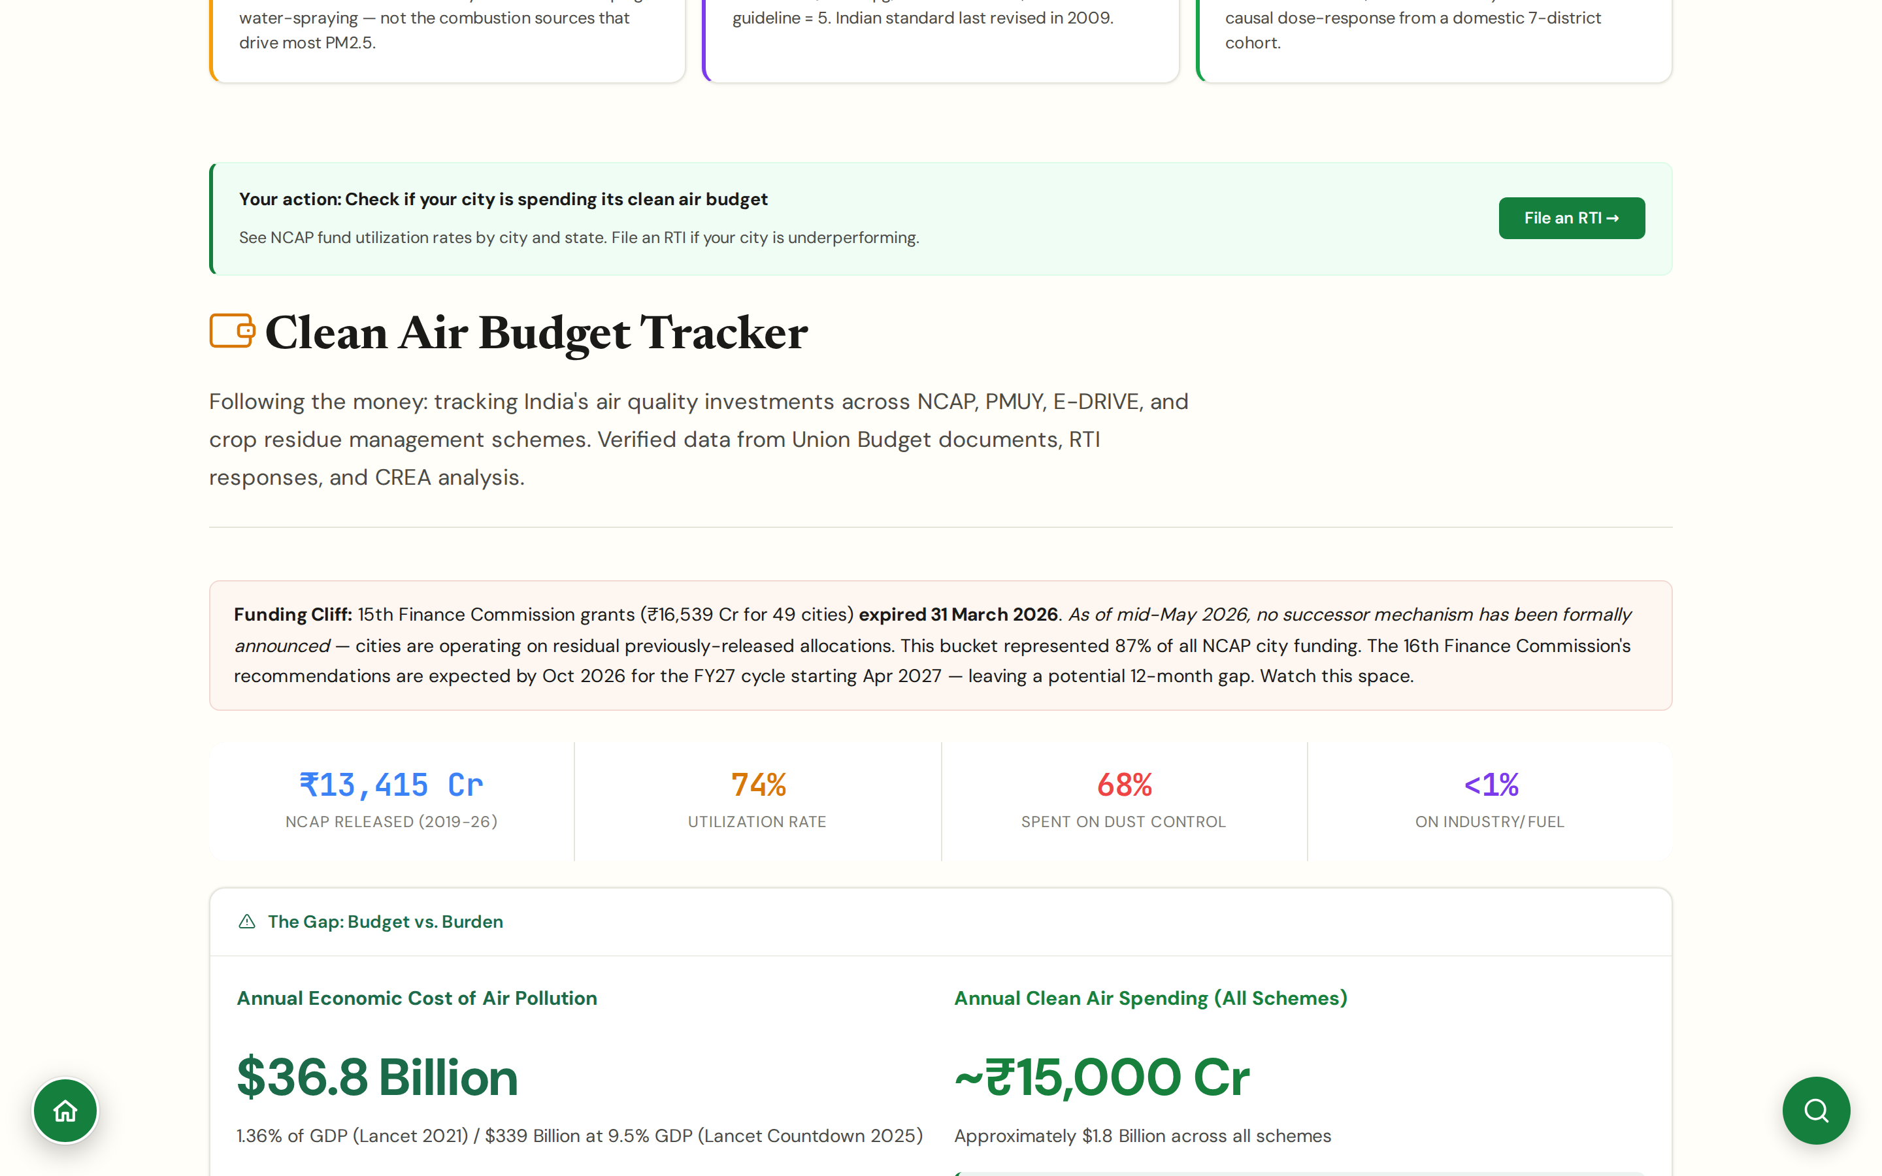
CHAPTER 5 · POLICY & ACCOUNTABILITY
#budget
Budget Tracker
Following the money, every air quality scheme, every rupee
Funding cliff: 15th Finance Commission ₹16,539 Cr grants for 49 cities expired 31 March 2026; no successor framework announced.
NCAP released ₹13,415 Cr (2019-26); utilisation rate 74%; 68% of spending on dust control, less than 1% on industry/fuel switching.
Mismatch surfaced: annual economic cost ~$36.8B (Lancet 2021) versus annual clean air spending ~₹15,000 Cr (~$1.8B).
Verified data from Union Budget documents, RTI responses, CREA analysis.
CHAPTER 5 · POLICY & ACCOUNTABILITY
JanVayu · janvayu.in · Walkthrough
Notes:
The Budget Tracker is the panel I most often direct policy people to. The headline is the funding cliff: the 15th Finance Commission grants of ₹16,539 Cr, 87 percent of NCAP city funding, expired on 31 March 2026 and no successor mechanism has been formally announced. The 16th Finance Commission's recommendations are expected by October 2026, with funding flowing from April 2027 at earliest. That leaves a 12-month gap. The composition story is just as important: 68 percent of NCAP spending went to road dust suppression, water trucks and street sweepers, and under one percent to industrial or transport-fuel emission control, which is where the actual PM2.5 sources sit. CSE's April 2026 review put the dust-suppression share at 64 percent. Either way the spending was decoupled from the source apportionment evidence.

Slide 35
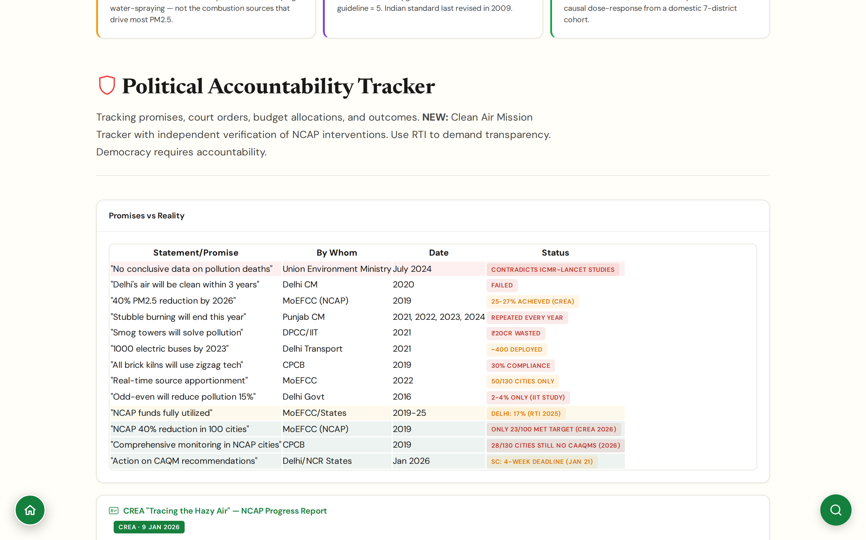
CHAPTER 5 · POLICY & ACCOUNTABILITY
#accountability
Political Accountability
Promises vs reality, named and dated
Promises-vs-reality table: '40% PM2.5 reduction by 2026' (NCAP, 2019) → only 23/100 cities hit target; 'No conclusive data on pollution deaths' (Union Env Ministry, July 2024) → contradicts ICMR-Lancet studies; 'Stubble burning will end this year' (Punjab CM, 2021, 2022, 2023, 2024) → repeated every year; 'NCAP funds fully utilized' → Delhi at 17% per 2025 RTI.
Each row carries the speaker, date, and a current-status flag (FAILED / CONTRADICTED / PARTIAL / WASTED); linked to the original press release or RTI response.
Anchors the CREA 'Tracing the Hazy Air' NCAP progress report (9 Jan 2026): 103/231 cities still exceed PM2.5 standards, 28/130 NCAP cities still lack continuous monitoring after seven years.
Non-partisan by design: the same evidence frame applies to every state and party.
CHAPTER 5 · POLICY & ACCOUNTABILITY
JanVayu · janvayu.in · Walkthrough
Notes:
Political accountability is the panel that needs the most care editorially. The Promises vs Reality table is the part that gets shared on social, and every row has to be defensible. The 'no conclusive data on pollution deaths' line from the Union Environment Ministry in July 2024 is the most consequential because it directly contradicts the ICMR-Lancet Commission's published evidence; we cite both. The 'stubble burning will end this year' repeated by the Punjab CM in 2021, 2022, 2023, and 2024 is the cleanest example of the accountability gap, four identical promises, four identical outcomes. Non-partisan stance means the same frame applies to every state and every party, that's the only credibility we have in this domain.

Slide 36
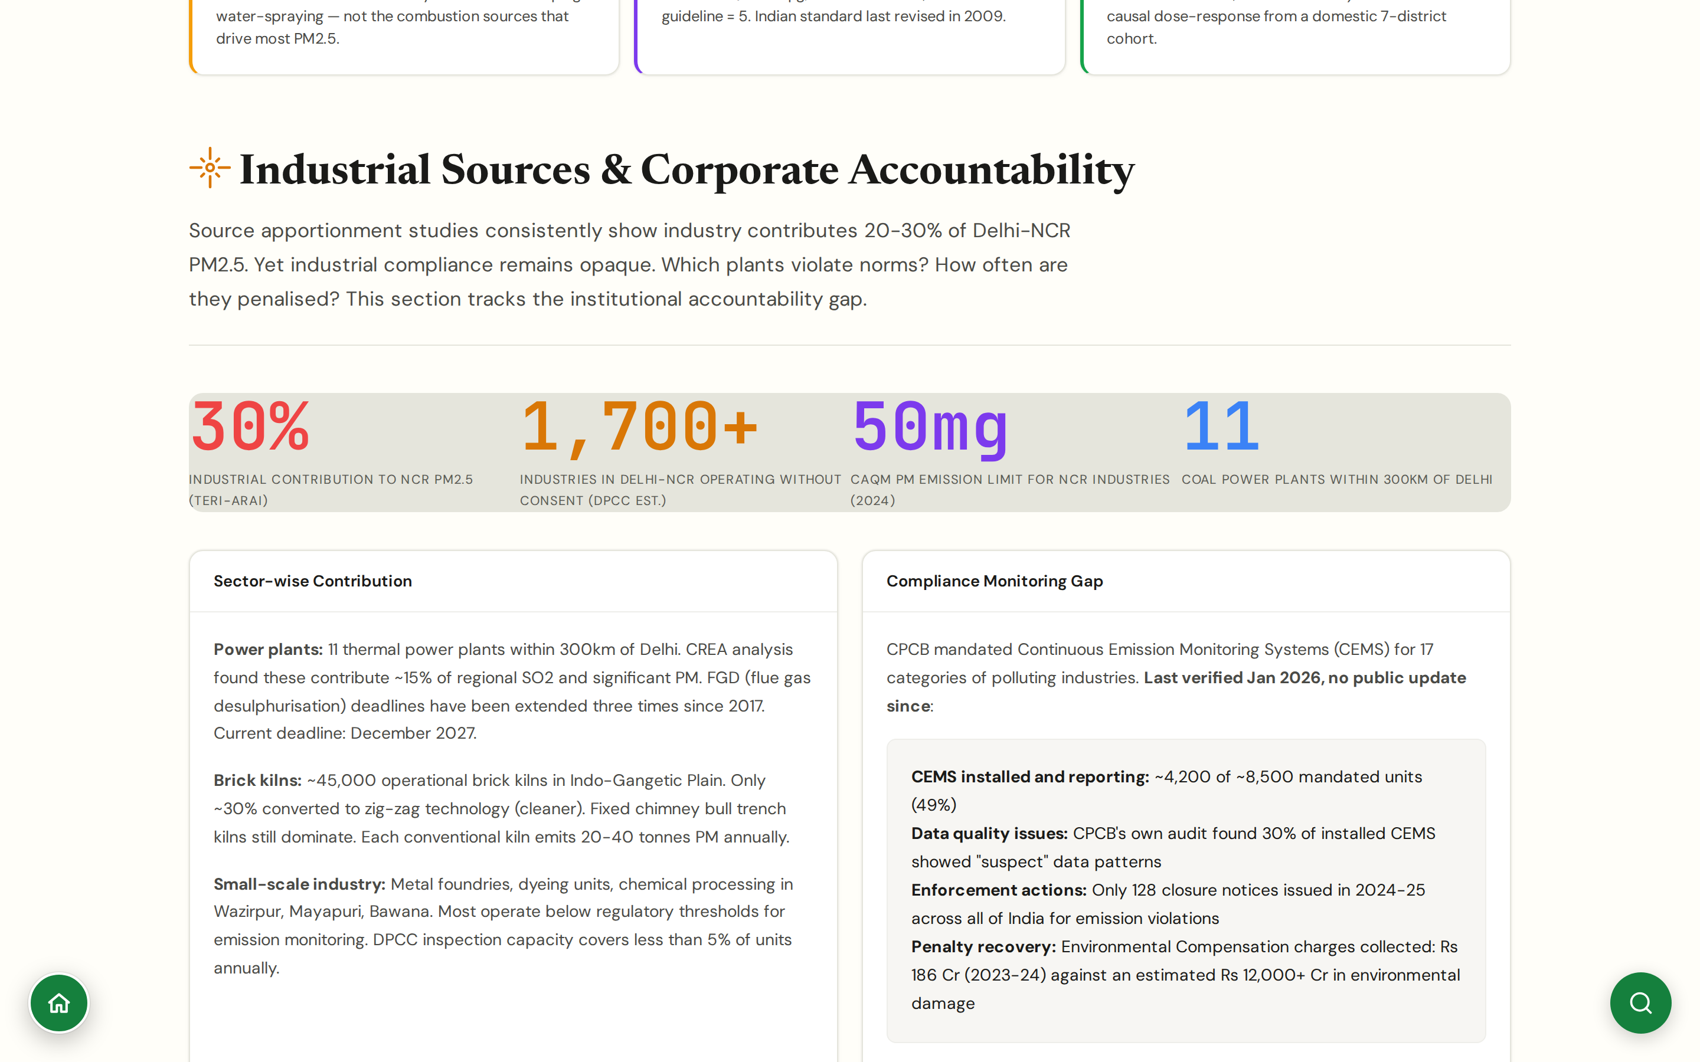
CHAPTER 5 · POLICY & ACCOUNTABILITY
#corporate
Industrial Sources
The compliance gap, in numbers
30% industrial contribution to NCR PM2.5 (TERI-ARAI); 1,700+ industries in Delhi-NCR operating without consent (DPCC); 11 coal power plants within 300km of Delhi.
~45,000 brick kilns across the Indo-Gangetic Plain; only ~30% converted to cleaner zig-zag technology; conventional bull-trench kilns emit 20-40 tonnes PM annually each.
Continuous Emission Monitoring Systems (CEMS) installed at only ~4,200 of ~8,500 mandated industrial units (49%); CPCB's own audit found 30% of installed CEMS show 'suspect' data patterns.
Enforcement: only 128 closure notices issued in 2024-25 across all of India for emission violations; FGD deadlines for thermal plants extended three times since 2017 (current: December 2027).
CHAPTER 5 · POLICY & ACCOUNTABILITY
JanVayu · janvayu.in · Walkthrough
Notes:
Industrial source accountability is harder than it should be because the data is fragmented across CPCB consent registers, state pollution control board records, and EIA appendices. JanVayu pulls these together. The headline numbers tell the structural story: 1,700-plus industries operating in Delhi-NCR without consent, 51 percent of mandated CEMS units still uninstalled, 30 percent of the installed ones showing suspect data, and only 128 closure notices nationally in 2024-25. The brick kiln number, 45,000 across the Indo-Gangetic Plain with only 30 percent converted to zig-zag, is the source category where regulatory intent has been clearest and implementation pace has been slowest. The FGD deadline-extension count, three times since 2017 for thermal plants, is the single cleanest demonstration of the enforcement gap.

Slide 37
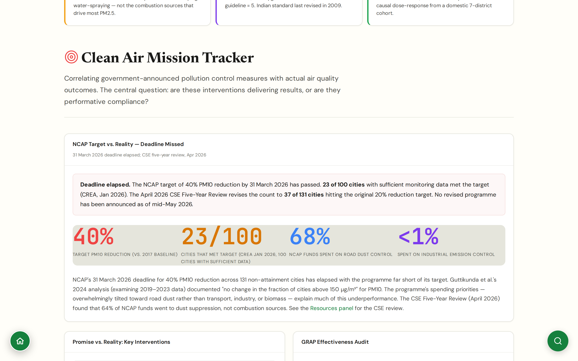
CHAPTER 5 · POLICY & ACCOUNTABILITY
#mission-tracker
Mission Tracker (E1–E5)
Evidence-graded scoring of every announced intervention
Original framework: every government intervention rated E1 (announced) to E5 (operational with measurable outcome).
Promise vs reality, with verdicts: Anti-Smog Guns (200 deployed, ₹58 Cr) reduce AQI 5-10 points in immediate vicinity only, IIT Delhi called them 'cosmetic'; road mechanised sweeping (68% of NCAP budget) tackles dust but not the primary PM2.5 sources; e-bus procurement is the bright spot but Delhi's 6,000-by-Dec-2026 target is running behind.
NCAP deadline elapsed: 40% target, 23/100 cities hit (CREA Jan 2026), 37/131 at 20% (CSE Apr 2026); Guttikunda et al. 2024 documented 'no change in the fraction of cities above 150 µg/m³' between 2019 and 2023.
Headline indictment: 64% of NCAP funds went to road-dust suppression (CSE Five-Year Review), not the combustion sources that drive most PM2.5.
CHAPTER 5 · POLICY & ACCOUNTABILITY
JanVayu · janvayu.in · Walkthrough
Notes:
The Mission Tracker uses the E1 to E5 framework I developed for this platform, a five-level evidence grade for any announced intervention. E1 is announcement only. E2 is implementation begun. E3 is verifiable activity logs. E4 is operational with internal audit. E5 is operational with peer-reviewed external evidence of outcome. The discipline forces us to ask, for every government claim, what level of evidence we actually have. Most NCAP city plans sit at E2 or E3. The three intervention examples on the slide tell the structural story: anti-smog guns are cosmetic but visible and politically attractive, road sweeping captured 68 percent of the budget despite not being the main source, e-bus procurement is the strongest intervention but procurement pace is too slow. Each diesel bus replaced is roughly 25 tonnes CO2 per year plus significant PM reduction, but Delhi needs to move from 3,600 to 6,000 e-buses by December 2026, and we're not on pace.

Slide 38
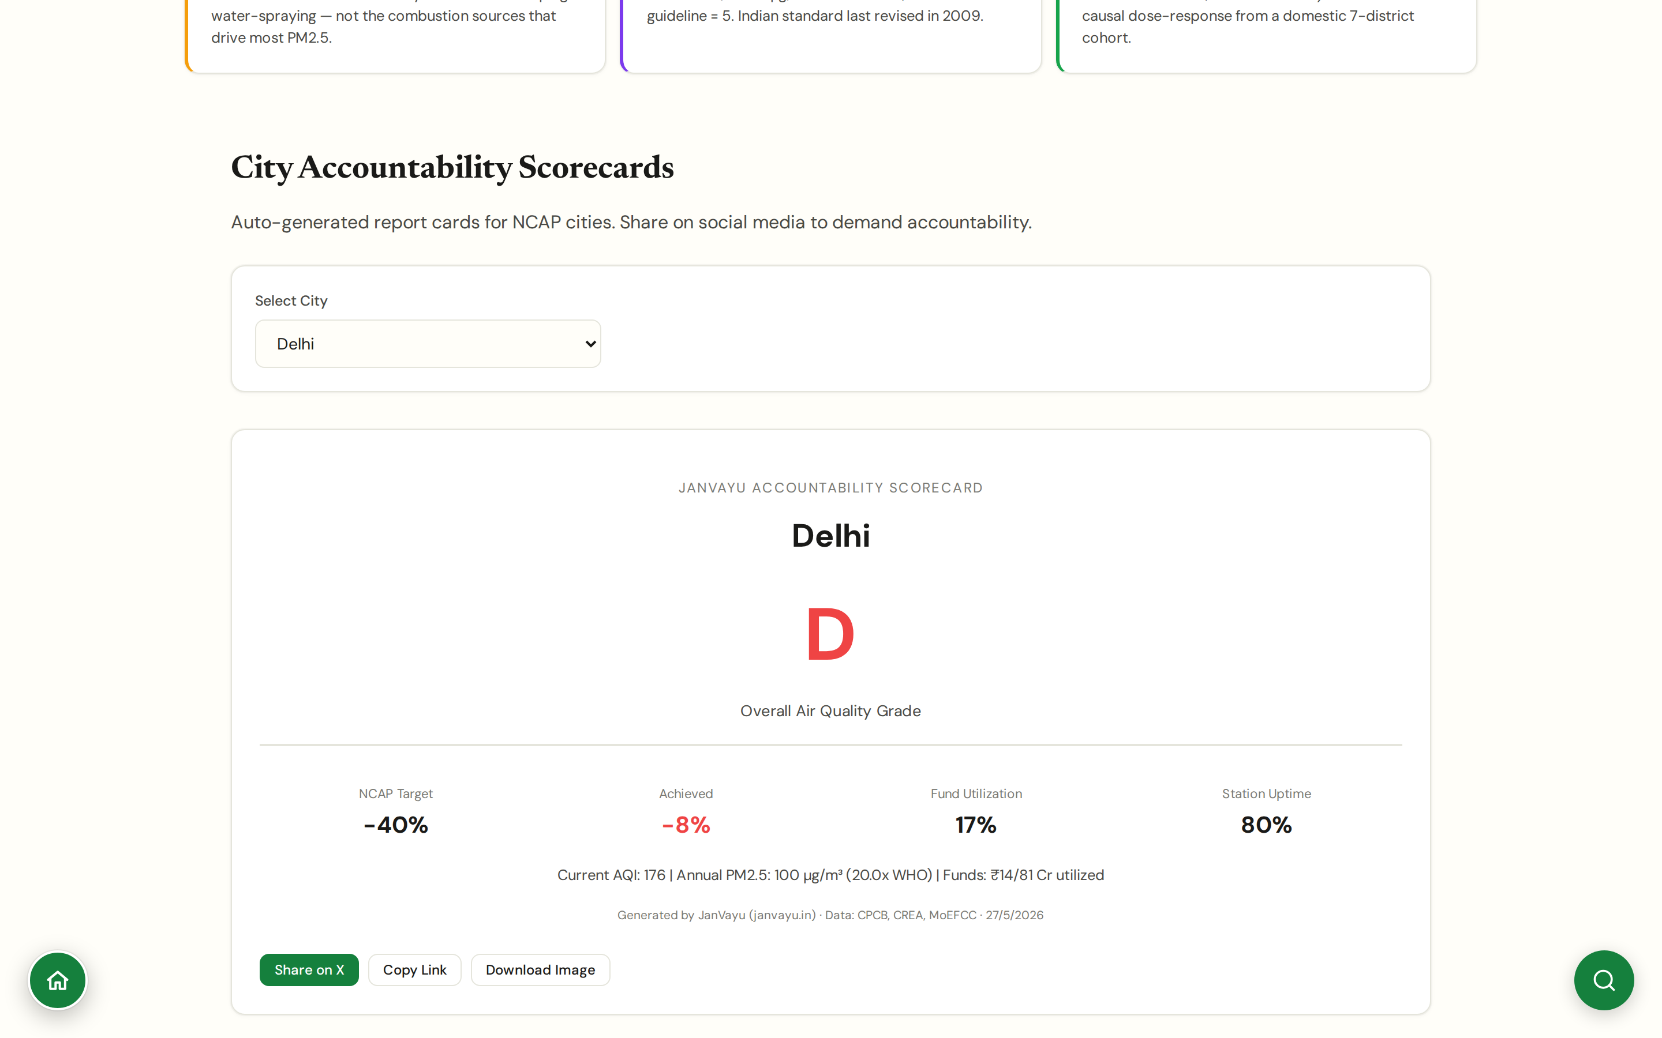
CHAPTER 5 · POLICY & ACCOUNTABILITY
#scorecards
City Scorecards
City and state report cards in one page each
Per city/state: current and historical PM2.5, NCAP fund utilisation, scheme rollout, accountability flags.
Designed for one-click sharing with journalists, councillors, and parliamentarians.
Letter grades synthesise the underlying evidence, but each grade links to its supporting data.
Updated monthly; revision dates shown explicitly.
CHAPTER 5 · POLICY & ACCOUNTABILITY
JanVayu · janvayu.in · Walkthrough
Notes:
Scorecards are the press-release-ready synthesis layer. Every grade, A through F, links back to the underlying evidence on JanVayu, so when a city pushes back on its grade the conversation can move quickly to specifics. The monthly revision cadence is important: a city making real progress should see its grade move, otherwise the scorecard becomes static and loses credibility.

Slide 39
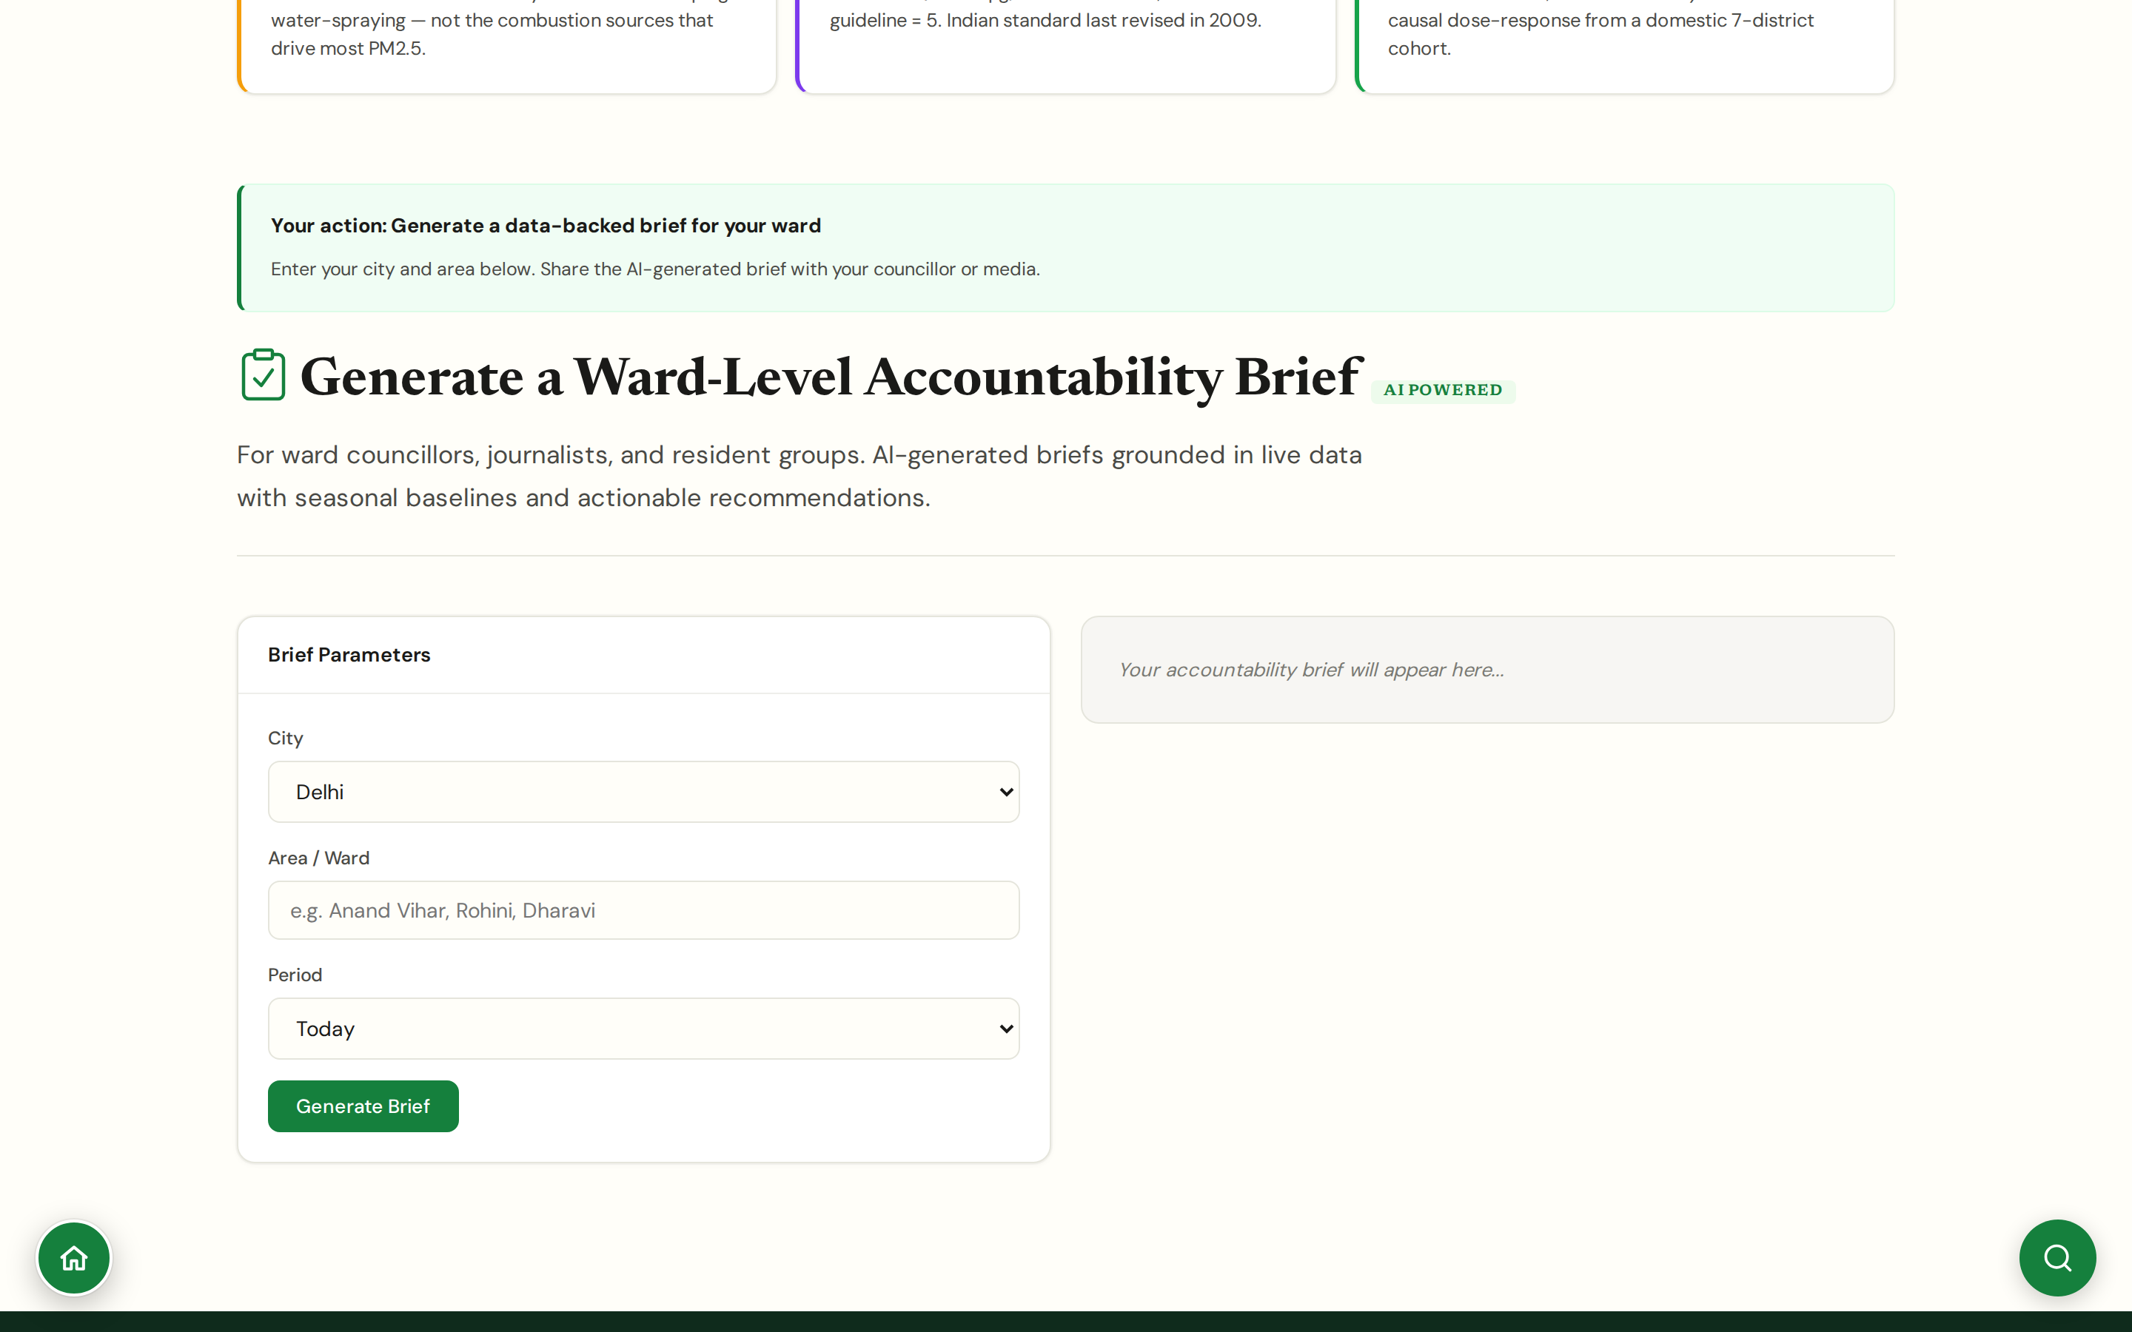
CHAPTER 5 · POLICY & ACCOUNTABILITY
#accountability-brief
Accountability Brief
AI-generated, ward-level briefs for councillors, journalists, and resident groups
Input the city plus the ward or area; the AI generates a localised brief with live AQI, seasonal baseline comparison, and actionable recommendations.
Designed to be shareable: a councillor gets a ward-specific summary; a journalist gets a tip-sheet with citations; an RWA gets a memo for the next meeting.
Grounded in live data with primary-source citations (CPCB, IQAir, Lancet Countdown, AQLI, CREA); the AI composes, it does not invent numbers.
Pulls from RTI responses, CPCB notices, NGT orders, and parliamentary questions in the background so the brief carries documentary evidence, not just commentary.
CHAPTER 5 · POLICY & ACCOUNTABILITY
JanVayu · janvayu.in · Walkthrough
Notes:
The Accountability Brief is the AI panel I am most cautious about, because AI summarisation can slip toward confabulation. The discipline is that every claim in the brief must link to a primary source. The use case shifted in late May from a daily-wire scan toward a ward-level brief generator, which is more useful for the actual end users: a Delhi ward councillor doesn't need yesterday's air-quality news, she needs a one-pager on her ward's air for the next ward-committee meeting, with the numbers and the responsible authority named. The output format is press-ready: about 400 words with two stat blocks and three actionable recommendations, all citing primary sources. Treat it as a starting point for further reporting and outreach, not a finished piece.

Slide 40
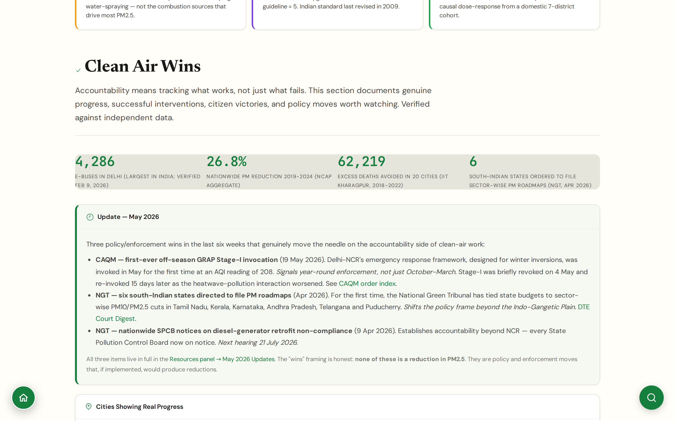
CHAPTER 5 · POLICY & ACCOUNTABILITY
#progress
Clean Air Wins
What's actually moved the needle: verified, not press-released
4,286 e-buses in Delhi (largest fleet in India, verified Feb 9 2026); 26.8% nationwide PM reduction in NCAP cities 2019-2024 (NCAP aggregate); 62,219 excess deaths avoided across 20 cities 2018-2022 (IIT Kharagpur).
Varanasi is the NCAP top performer: 76.4% PM10 reduction. Caveat: 84% of Varanasi's pollution was dust; PM2.5 from combustion sources remains stubbornly high.
May 2026 policy wins: CAQM's first off-season GRAP Stage-I (19 May 2026); NGT directs six south-Indian states to file sector-wise PM roadmaps (Apr 2026); NGT nationwide notices to SPCBs on diesel-generator retrofit non-compliance (9 Apr 2026).
Honest about what 'wins' means: none of these is itself a measured PM2.5 reduction; they are policy and enforcement moves that, if implemented, would produce reductions.
CHAPTER 5 · POLICY & ACCOUNTABILITY
JanVayu · janvayu.in · Walkthrough
Notes:
The Clean Air Wins panel is a deliberate credibility move. If JanVayu only ever criticises, we end up dismissed as ideological. The numbers that earn their place: 4,286 e-buses in Delhi as of February 2026, the largest fleet in India; 26.8 percent aggregate PM reduction across NCAP cities 2019-2024; the IIT Kharagpur finding of 62,219 excess deaths avoided in 20 cities. Varanasi at 76.4 percent PM10 reduction is the NCAP top performer, with the honest caveat that 84 percent of Varanasi's pollution was dust. The three May 2026 policy items are wins of a different kind: CAQM invoking Stage-I GRAP off-season for the first time signals year-round enforcement; the NGT's order to six south-Indian states (TN, Kerala, Karnataka, AP, Telangana, Puducherry) to file PM roadmaps shifts the policy frame beyond the Indo-Gangetic Plain; the nationwide diesel-generator retrofit notices put every State Pollution Control Board on notice. None of these is a measured PM2.5 reduction yet, but they are the structural moves that produce reductions.

Slide 41
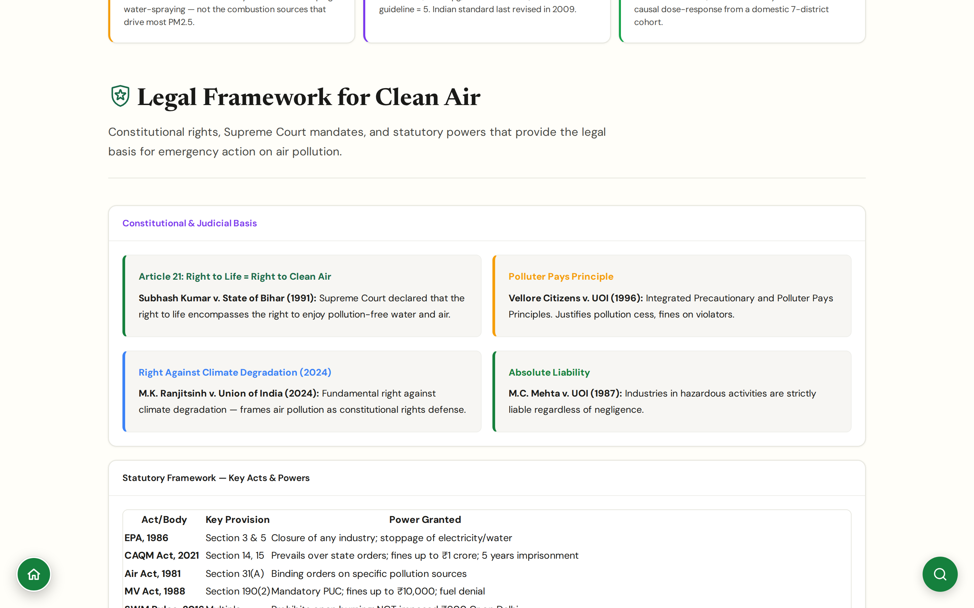
CHAPTER 5 · POLICY & ACCOUNTABILITY
#legal
Legal Framework
Constitutional rights, key judgments, and the statutory powers actually available
Article 21 → Right to Clean Air: traced from Subhash Kumar v. State of Bihar (1991) through the M.C. Mehta line (1987 absolute liability), with Vellore Citizens v. UoI (1996) establishing Polluter Pays.
M.K. Ranjitsinh v. Union of India (2024) reframes the question: there is now a fundamental right against climate degradation, which folds air pollution into the constitutional rights frame.
Statutes that actually carry teeth: EPA 1986 §3 & §5 (closure of any industry), CAQM Act 2021 §14 & §15 (overrides state orders, fines up to ₹1 Cr, 5 years imprisonment), Air Act 1981 §31(A), MV Act 1988 §190(2).
GRAP itself is judicially mandated: the Supreme Court structures Delhi-NCR's emergency response and reviews CAQM enforcement on a continuing basis.
CHAPTER 5 · POLICY & ACCOUNTABILITY
JanVayu · janvayu.in · Walkthrough
Notes:
The Legal Framework panel is the one I have most fun maintaining as a lawyer. The constitutional argument is now well-settled: the Supreme Court has read Article 21's Right to Life to include a Right to Clean Air, building on the MC Mehta line from 1987. The 2024 M.K. Ranjitsinh v. Union of India case is the most important recent development: it establishes a fundamental right against climate degradation, which by extension covers air pollution and gives the Supreme Court a clearer constitutional anchor for ordering structural relief. On the statutory side, the panel surfaces the sections that actually carry teeth: EPA Section 3 and 5 (closure of any industry, stoppage of electricity/water), CAQM Act 2021 Sections 14 and 15 (overrides state pollution control boards, fines up to one crore, five years imprisonment). The panel is the spine of the argument for anyone framing a fresh PIL on air quality.

Slide 42
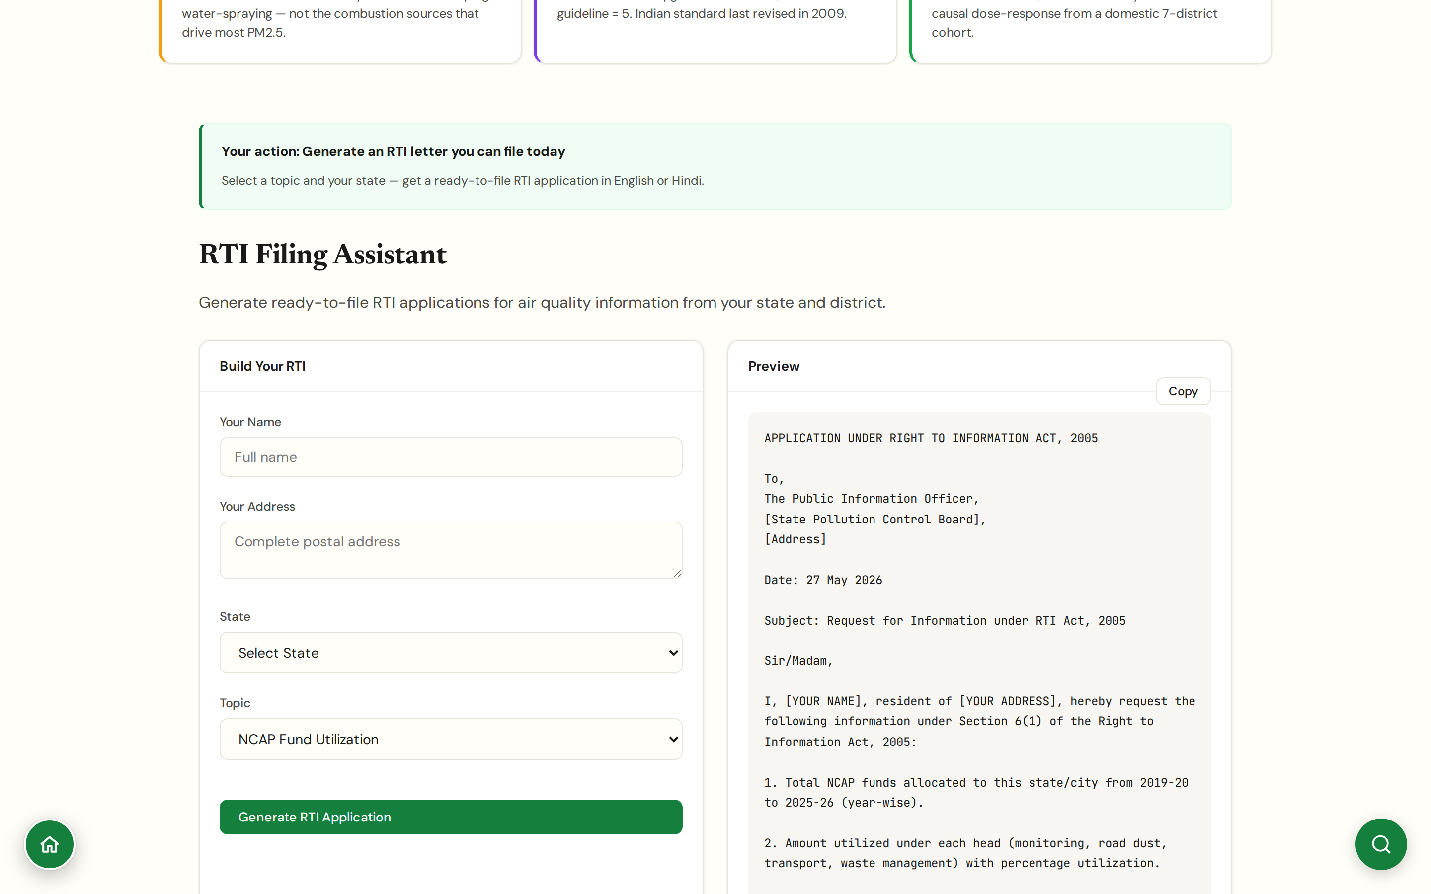
CHAPTER 5 · POLICY & ACCOUNTABILITY
#rti-assistant
RTI Assistant
Pre-built RTI templates for air quality accountability
Templates for: NCAP city action plan utilisation, GRAP enforcement records, industrial consent compliance, school closure decisions.
Each template is structured to the right authority (CPCB, SPCB, ULB, MoEFCC) and includes the relevant legal citation.
Output is a downloadable RTI ready to post or upload, with the fee and address pre-filled.
Companion panel to Mission Tracker: when a claim is E1, the RTI template is the path to E2.
CHAPTER 5 · POLICY & ACCOUNTABILITY
JanVayu · janvayu.in · Walkthrough
Notes:
The RTI Assistant exists because the gap between 'I should file an RTI' and 'I have filed an RTI' is where most citizen-led accountability dies. Pre-filled templates with the right authority, the right legal citation, and the right structured questions remove the threshold. The templates are the result of about two years of refinement, RTI applications that are too broad get rejected; ones that are too narrow miss the real question.

Slide 43
CHAPTER
Chapter 6
Citizen action
From data to motion. The advocacy, organising, education, and communication side of the platform.

Slide 44
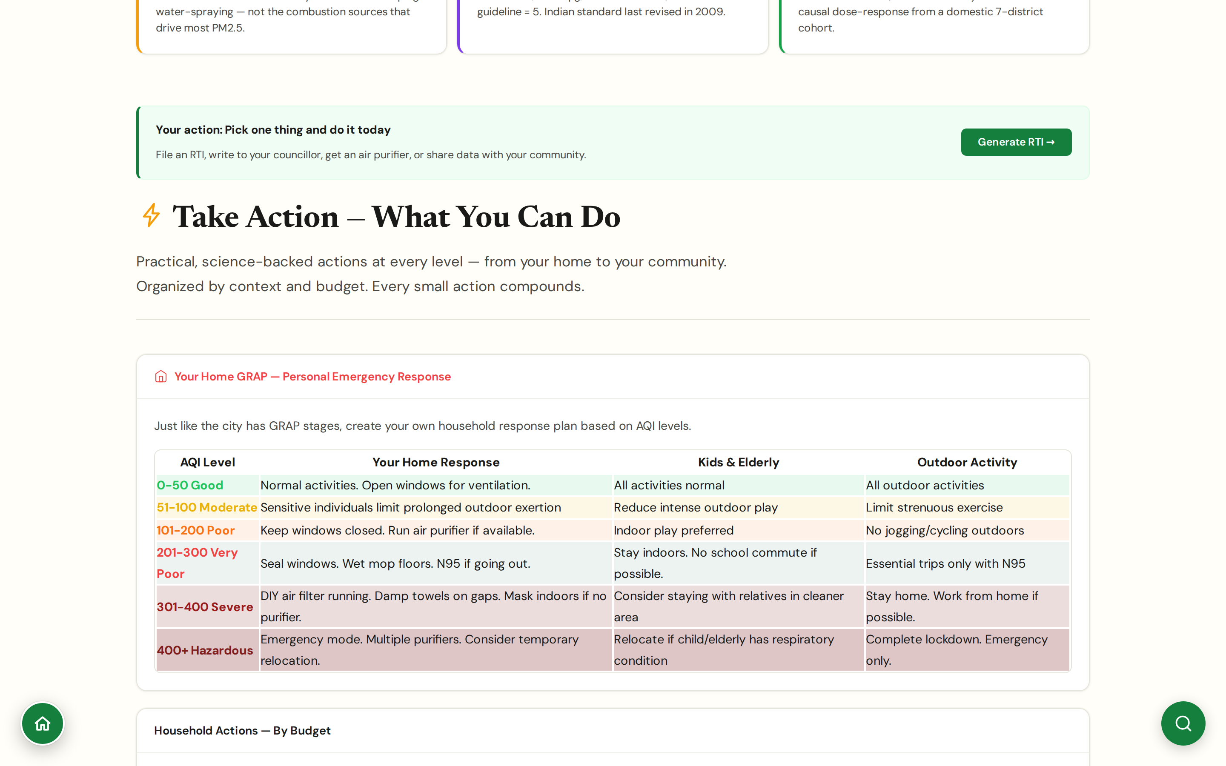
CHAPTER 6 · CITIZEN ACTION
#actions
Take Action
From data to motion: actions sized to context and budget
Your-Home-GRAP framework: a household response plan keyed to AQI bands (0-50 to 400+), with concrete actions for each level for the home, for kids and elderly, and for outdoor activity.
Actions organised by budget tier: ₹0 (wet mopping cuts indoor PM by 20-30%, sealing gaps, cooking-timing); ₹1-5K (N95 masks, DIY Corsi-Rosenthal box); ₹5-50K (HEPA purifier per room, sealed windows).
Each action links to the JanVayu panel or template that completes it (RTI, scorecards, exposure report) rather than free-floating advice.
Tracked-action metrics (anonymised) build social proof: RTIs filed, scorecards downloaded, alerts subscribed.
CHAPTER 6 · CITIZEN ACTION
JanVayu · janvayu.in · Walkthrough
Notes:
Take Action is the bridge from the data panels to the doing panels. The Your-Home-GRAP framework is the new structural element: it mirrors the city's GRAP staged response with a household-level analogue, so a parent who knows the city is at GRAP Stage III knows what their home response should be (DIY filter running, damp towels on gaps, mask indoors if no purifier). The budget tiers matter because most existing 'air quality advice' presumes you can spend ₹30,000 on a purifier. The zero-cost tier, wet mopping, sealing, cook-time shifting, is what most users can actually do this week. The discipline is to never use exhortation language: no 'demand change', no 'raise your voice'. Every listed action is concrete and uses a tool already on the site.

Slide 45
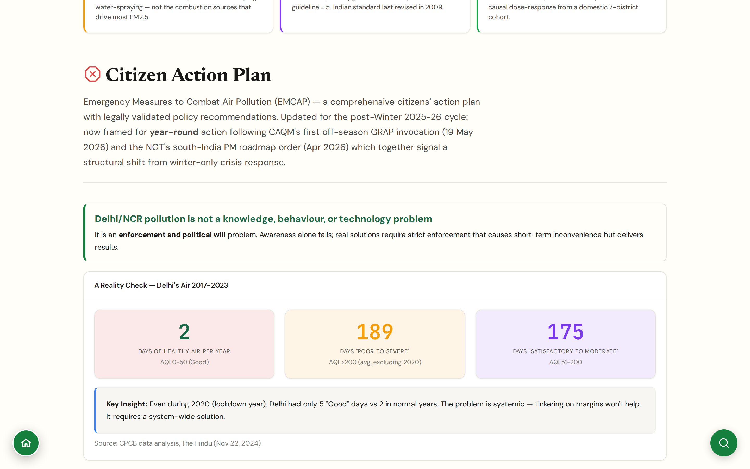
CHAPTER 6 · CITIZEN ACTION
#citizen-action
Citizen Plan
EMCAP: Emergency Measures to Combat Air Pollution, citizen edition
Reframed in May 2026 as year-round after CAQM's first off-season GRAP-I (19 May) and the NGT's south-India PM roadmaps order (Apr 2026).
Reality-check anchor: Delhi 2017-2023 averaged 2 days of healthy air per year (AQI 0-50), 189 days 'poor to severe', 175 days 'satisfactory to moderate' (CPCB / The Hindu, Nov 2024).
Source apportionment for Delhi internal sources: vehicles 34%, biomass and domestic 22%, dust 18%, industry 14%, other 12%. Externals add to that during winter inversion.
Position: 'Delhi/NCR pollution is not a knowledge, behaviour, or technology problem; it is an enforcement and political-will problem.' Awareness alone fails.
CHAPTER 6 · CITIZEN ACTION
JanVayu · janvayu.in · Walkthrough
Notes:
The Citizen Plan is renamed EMCAP, Emergency Measures to Combat Air Pollution, and was reframed for year-round action after CAQM's May 19 off-season GRAP and the NGT's April south-India roadmaps order. The reality-check numbers are sobering: Delhi averaged two days of healthy air per year across 2017 to 2023. Even the 2020 lockdown year produced only five Good days versus the normal two. The point of the panel is to push past the 'awareness' framing that dominates Indian air-quality discourse and to name the problem honestly: this is an enforcement and political-will problem, not a knowledge or technology one. The source-apportionment breakdown for Delhi's internal sources, vehicles 34 percent, biomass and domestic 22 percent, dust 18 percent, industry 14 percent, is the spine of any serious policy argument.

Slide 46
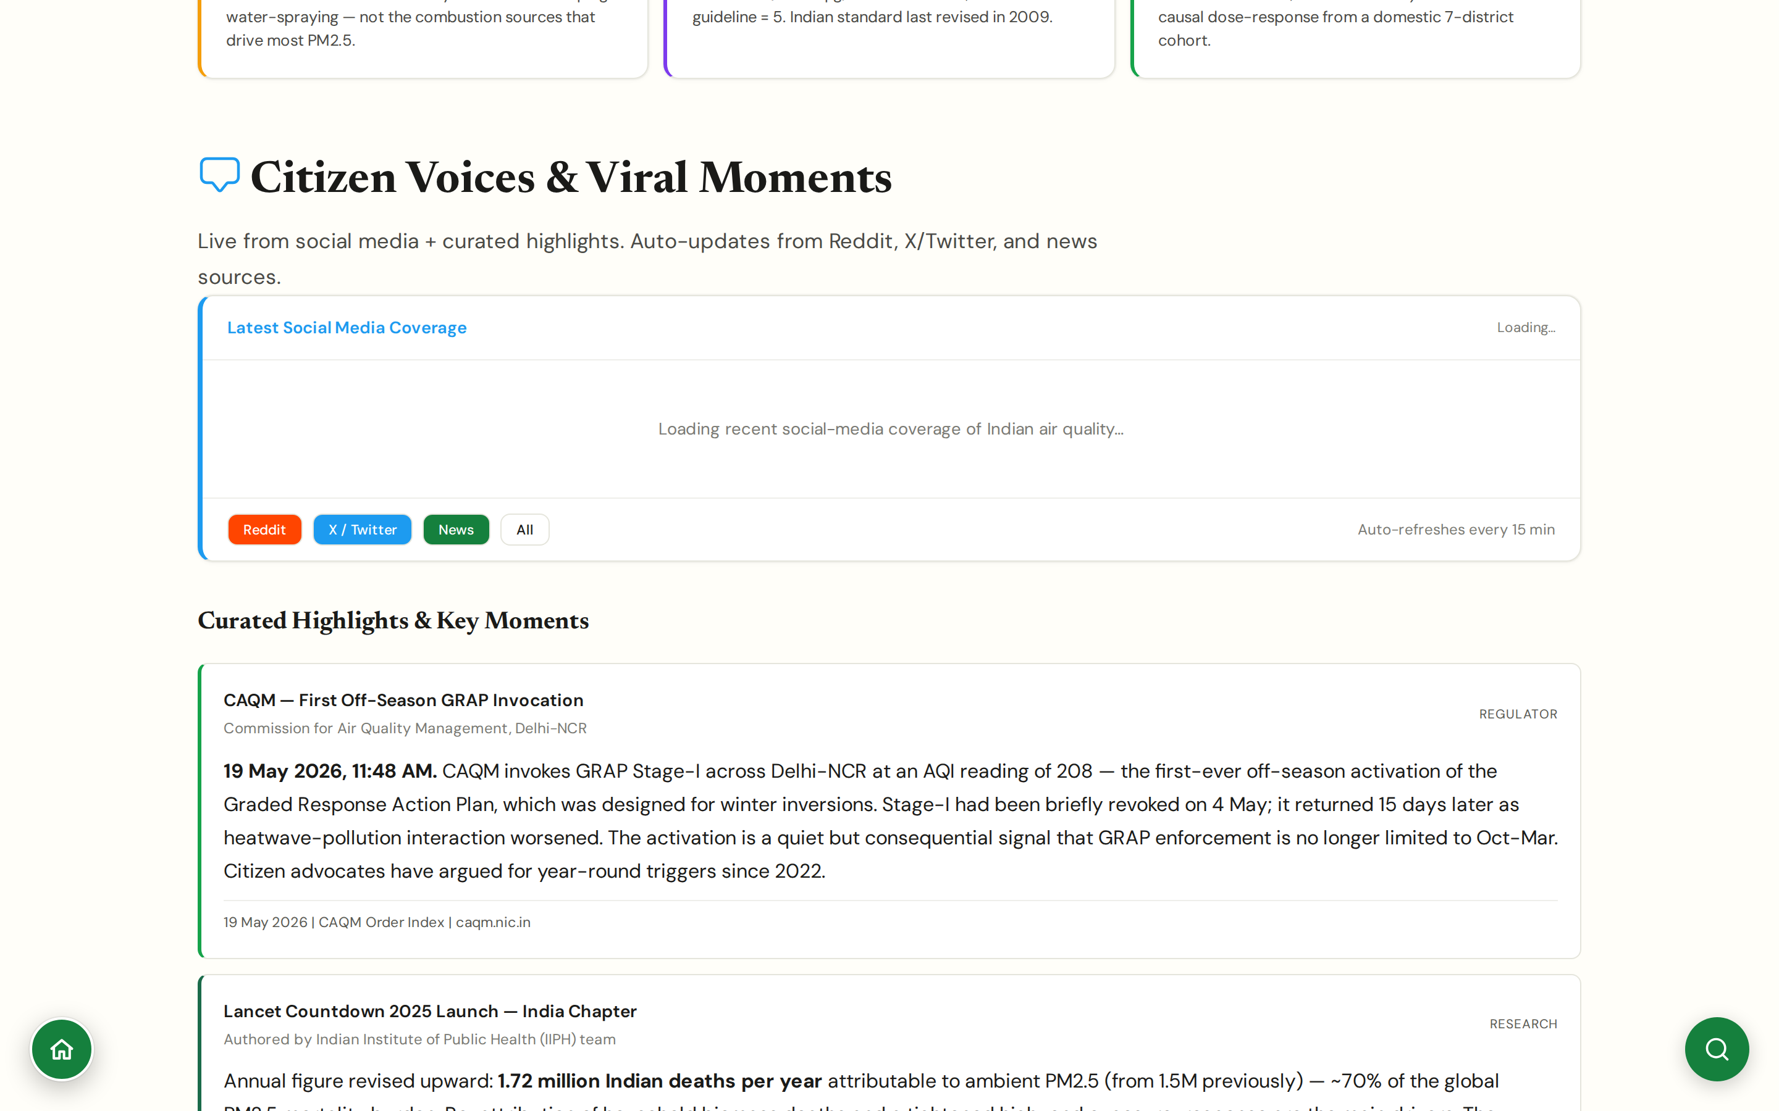
CHAPTER 6 · CITIZEN ACTION
#voices
Citizen Voices & Viral Moments
Live social-media coverage plus tracked voices and a curated archive
Auto-pulls Reddit, X/Twitter, and news every 15 minutes; surfaces searches for #DelhiAirPollution, #DelhiSmog, #AirPollutionIndia by default.
Tracks key individual voices in the field: Anumita Roychowdhury (CSE), Sunil Dahiya (CREA), and other named researchers and journalists.
Curated archive: hand-picked stories that crystallised a moment (CAQM's first off-season GRAP-I, Lancet Countdown 2025 India release, Loni topping IQAir).
Filterable by source type (regulator notice, research finding, citizen post, journalist piece) and by date.
CHAPTER 6 · CITIZEN ACTION
JanVayu · janvayu.in · Walkthrough
Notes:
Citizen Voices does two things at once. The live feed shows what people are saying right now: useful for journalists hunting tip-offs and for researchers mapping the rise and fall of public attention. The tracked-voices addition is recent and more curated: Anumita Roychowdhury at CSE, Sunil Dahiya at CREA, and a handful of others whose work consistently moves the discourse. We're not endorsing every post; we're surfacing the people whose threads on this topic are worth following. The curated archive is the enduring contribution: a manually maintained record of the moments that crystallised the air quality discourse. The 19 May 2026 CAQM off-season GRAP-I invocation is a good example, easy to miss, structurally important, now permanently logged.

Slide 47
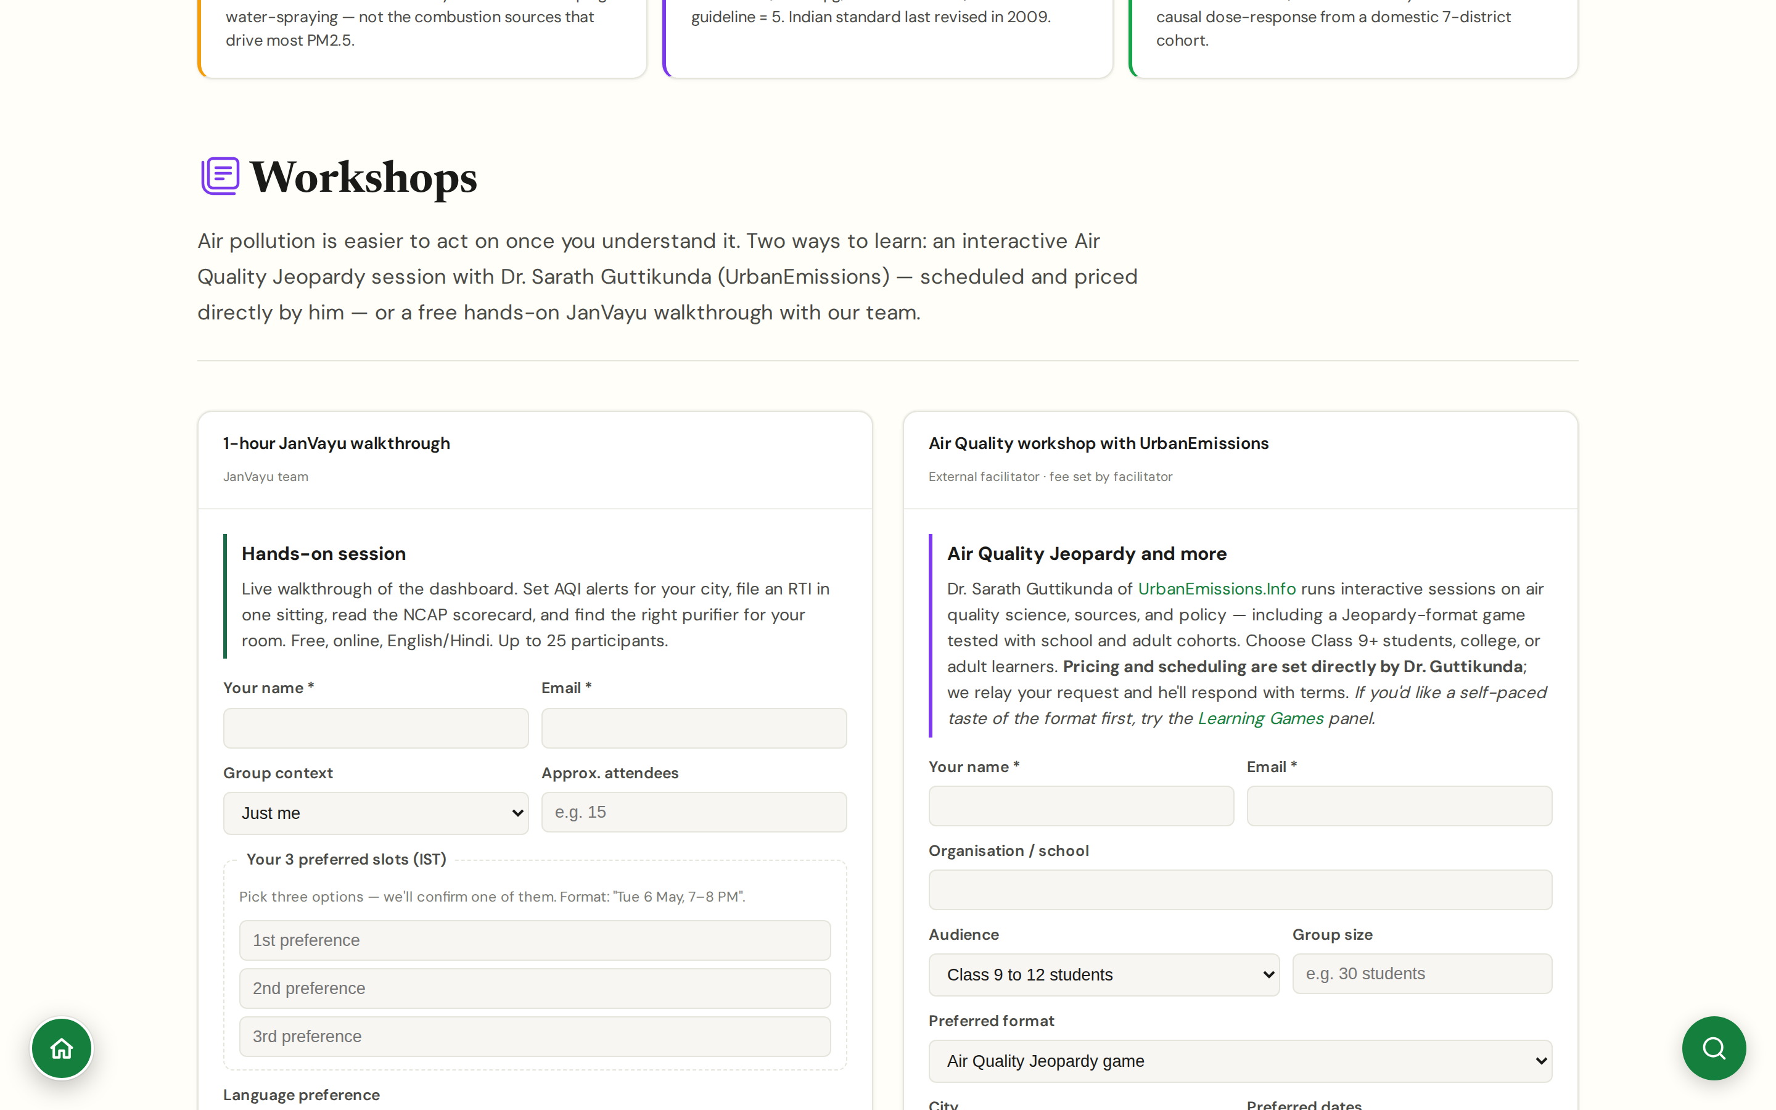
CHAPTER 6 · CITIZEN ACTION
#workshops
Workshops
Two routes: Dr Sarath Guttikunda's external sessions or a free JanVayu walkthrough
External Air Quality Jeopardy and lecture sessions by Dr Sarath Guttikunda (UrbanEmissions.info), priced and scheduled directly by him; the request form on the panel relays your details and audience type.
Free hands-on JanVayu walkthrough run by the platform team: how to read AQI, how to file an RTI, how to set up a school dashboard.
Audience presets: Class 9-12 students, college, adult cohorts (RWA, NGO, professionals), educators, mixed groups. Formats range from the Jeopardy game to lecture to hands-on JanVayu data work.
Companion to the Learning Games panel, which packages the same content for self-study and classroom use without a facilitator.
CHAPTER 6 · CITIZEN ACTION
JanVayu · janvayu.in · Walkthrough
Notes:
Workshops is the panel that converts a one-time engagement into ongoing capability. Two routes. The Air Quality Jeopardy sessions are run by Dr Sarath Guttikunda of UrbanEmissions.info, the same person whose 40-by-2040 calculator and source-apportionment work anchors much of the platform's analytical content. He runs them for school students from Class 9 up, college cohorts, and adult audiences (RWAs, NGOs, corporate teams); pricing and dates are set by him directly, JanVayu just relays the request. The second route is a free hands-on walkthrough run by us, covering how to read an AQI report, file an RTI, set up a basic school AQI dashboard. The school-dashboard workshop is the most used: a teacher can build a simple display showing live PM2.5 alongside the day's outdoor activity recommendation.

Slide 48
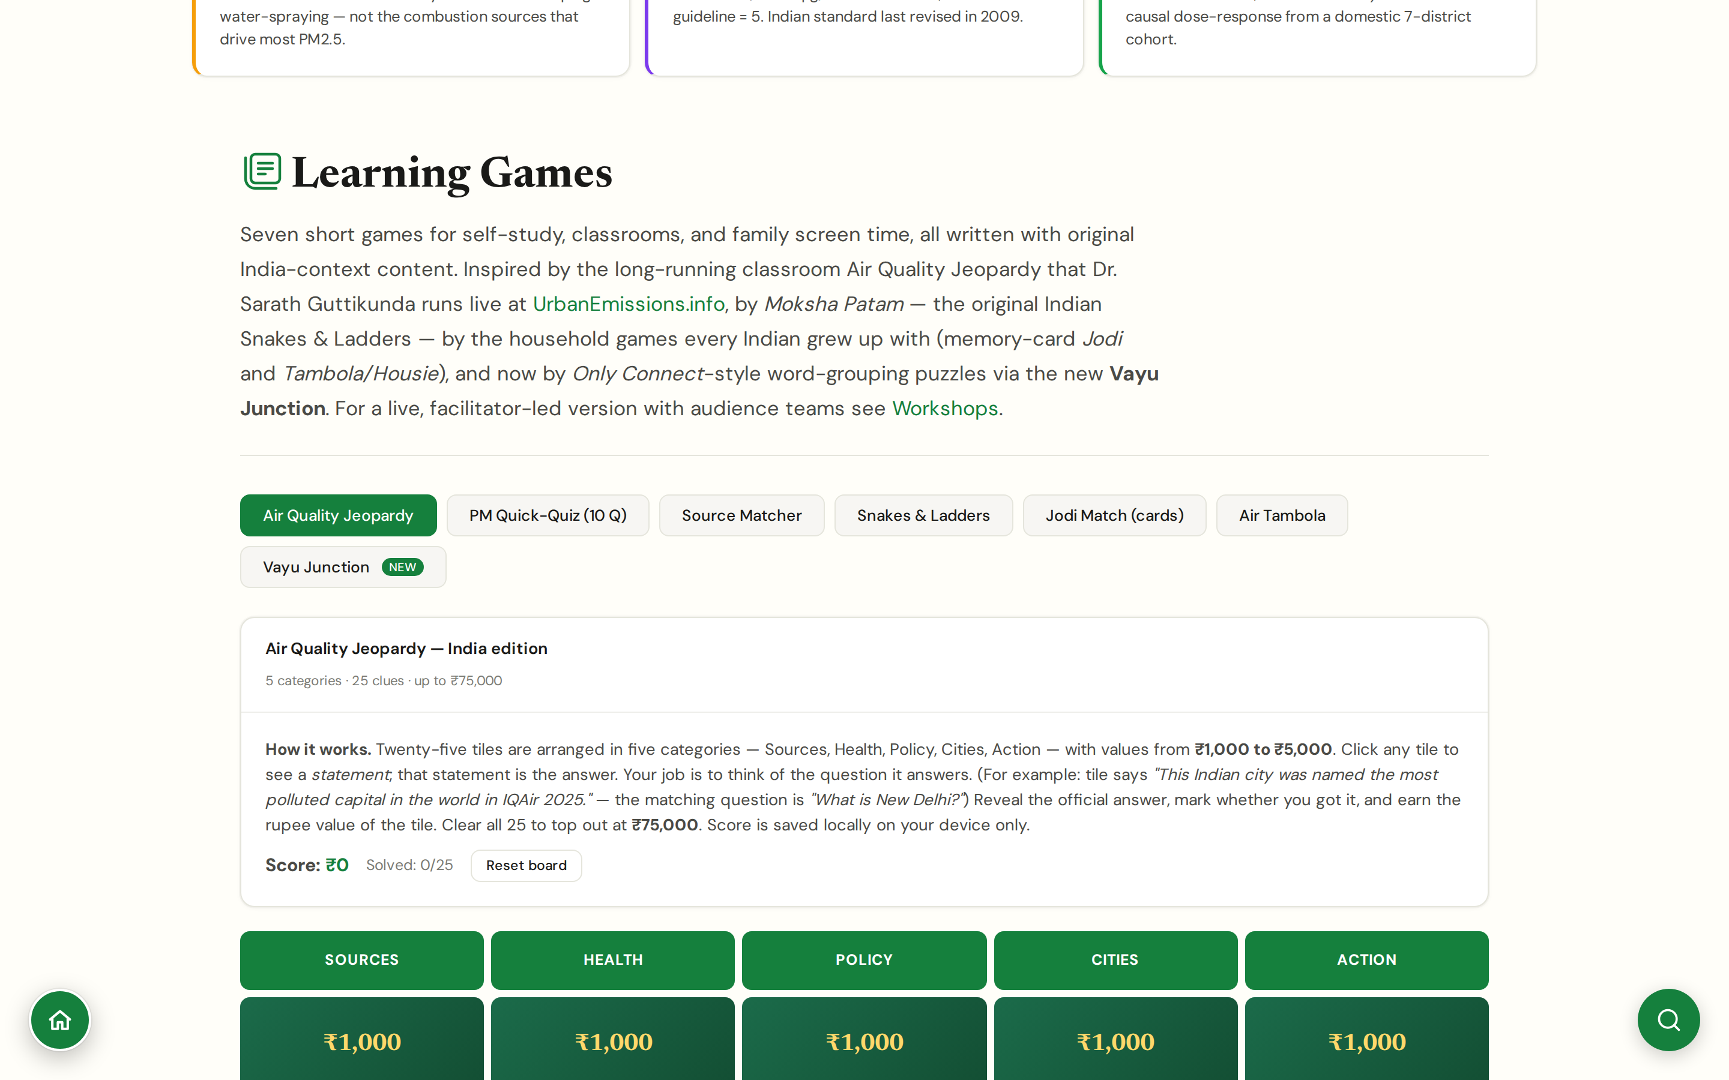
CHAPTER 6 · CITIZEN ACTION
#games
Learning Games
Seven games, original India-context content, browser-playable
Seven-game suite: Air Quality Jeopardy (India edition, 5 categories × 25 clues, ₹75,000 max), PM Quick-Quiz (10 questions), Source Matcher, Snakes & Ladders (Moksha Patam-style), Jodi Match memory cards, Air Tambola (Housie), and the new Vayu Junction word-grouping puzzle.
Inspired by the long-running classroom Air Quality Jeopardy Dr Guttikunda runs live; by Moksha Patam (the original Indian Snakes & Ladders); by the household games every Indian grew up with; and Only Connect-style word grouping for Vayu Junction.
Designed for school and college audiences; aligned to CBSE/state environmental studies syllabi; works on low-bandwidth connections with no install or account required.
Vayu Junction (newest, May 2026) seeds the pollutant, policy, and source vocabulary that the rest of the site uses.
CHAPTER 6 · CITIZEN ACTION
JanVayu · janvayu.in · Walkthrough
Notes:
Learning Games is the panel I get the most surprised positive feedback on. The original hypothesis was that teachers needed a curriculum hook for air quality; the result is that students stay on the page for 20-30 minutes per session, voluntarily. Jeopardy is the centrepiece, modelled on Dr Guttikunda's long-running facilitator-led sessions, ported to a self-paced format. Vayu Junction, the newest game added in May 2026, is a word-grouping puzzle modelled loosely on the Only Connect/NYT Connections format but with pollutant, policy, and source vocabulary; it seeds the words that the rest of the site uses. The cultural anchors matter: framing the snakes-and-ladders game as Moksha Patam, and Tambola as the household-Housie format, makes the games feel native rather than imported.

Slide 49
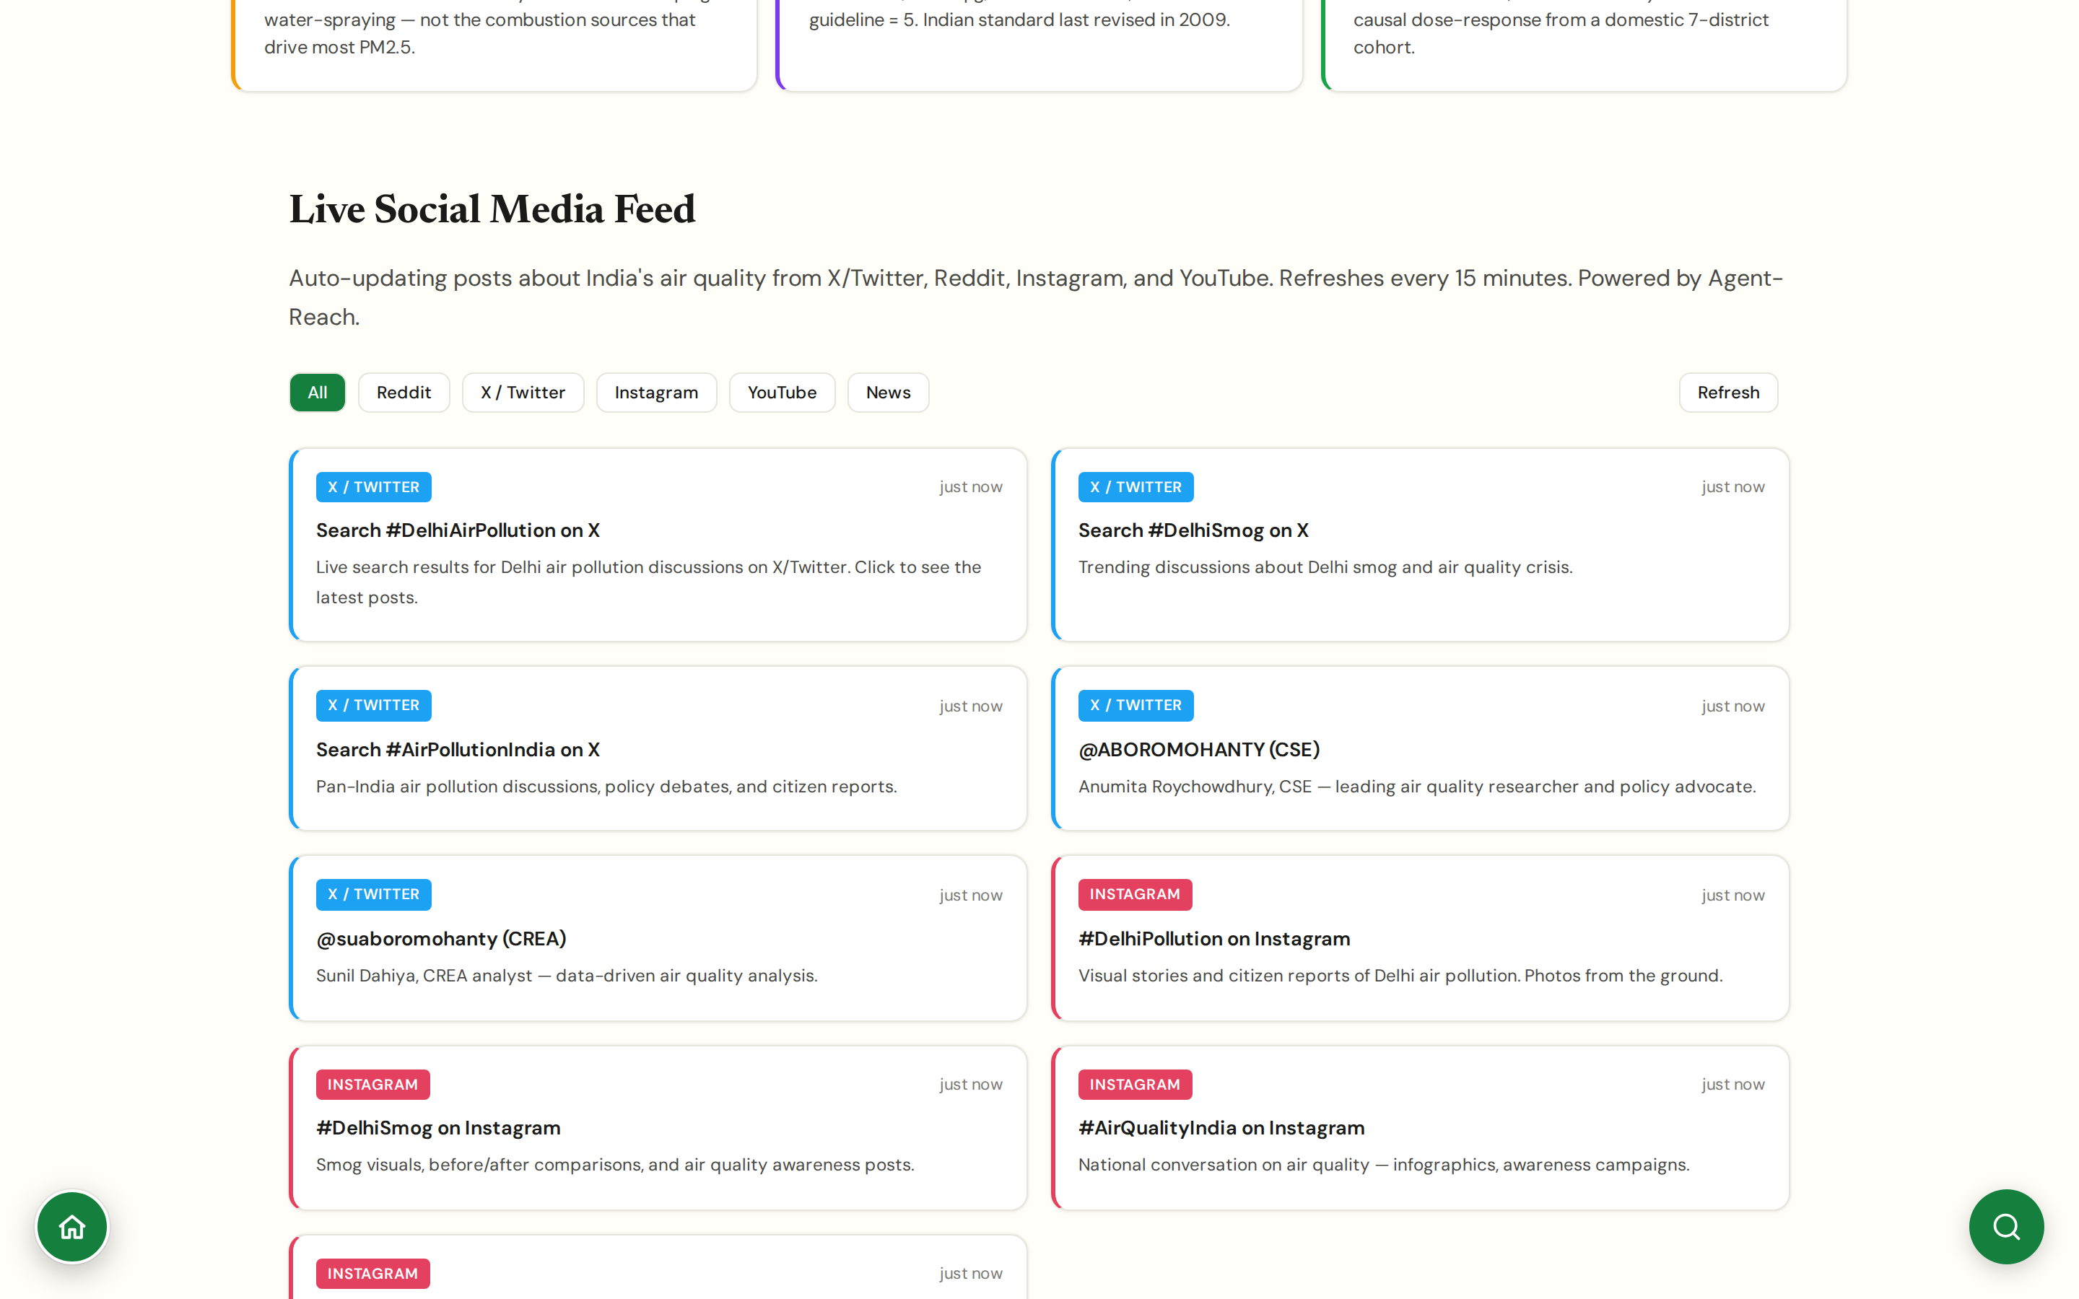
CHAPTER 6 · CITIZEN ACTION
#social-feed
Social Media Feed
Live, filterable, multi-platform air quality coverage
Aggregates posts from X/Twitter, Reddit, and Bluesky on Indian air quality, refreshing every 15 minutes.
Filters: city, source type (citizen, regulator, NGO, journalist), language.
Useful as an early-warning system: regional fire events and inversions often surface on social first.
All posts cite the original source; JanVayu does not repost or scrape content without attribution.
CHAPTER 6 · CITIZEN ACTION
JanVayu · janvayu.in · Walkthrough
Notes:
Social feed is the panel I use personally as an early-warning system. A spike in posts from Faridabad RWA accounts on a Tuesday morning will often precede the CPCB station data by an hour. Attribution is strict: every post shown carries its original handle and a link back; JanVayu does not strip attribution or rewrite content.

Slide 50
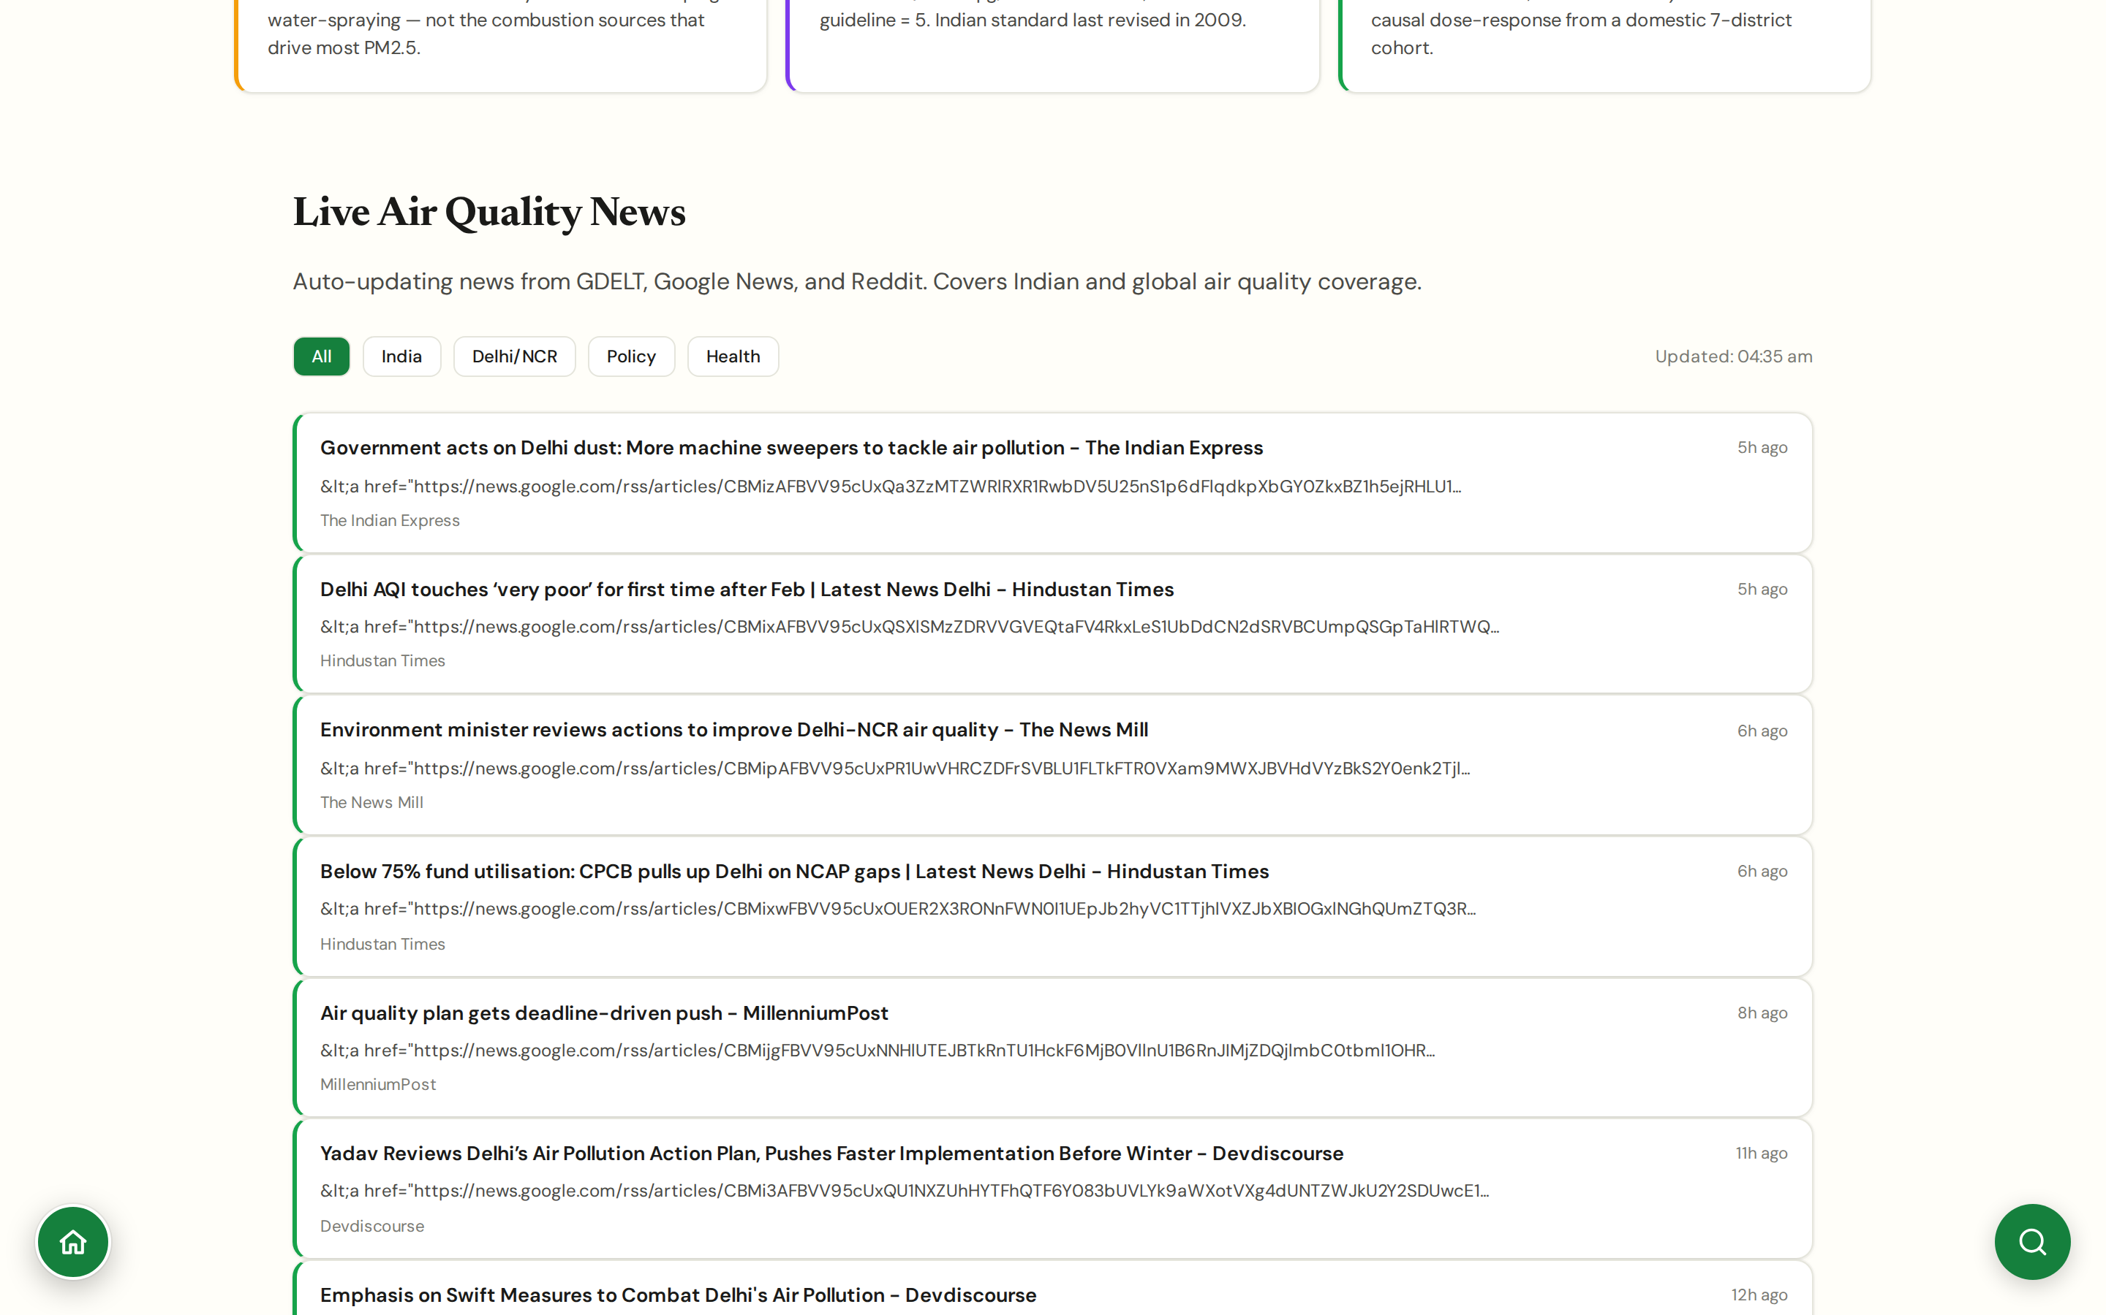
CHAPTER 6 · CITIZEN ACTION
#live-news
Live News
Air-quality news from Indian and international press
Curated news feed pulling from PIB, The Hindu, Indian Express, Times of India, Reuters, AP, and others.
Filtered to substantive coverage; tags applied (policy, health, science, court, local government).
Auto-refreshes every 4 hours; cached headlines work offline.
For anyone producing media reviews this saves an hour a day of manual scanning.
CHAPTER 6 · CITIZEN ACTION
JanVayu · janvayu.in · Walkthrough
Notes:
Live News is the most heavily used time-saver among the team using JanVayu internally. The aggregator pulls structurally, a Hindu story about NGT directions gets tagged 'court' automatically, so a media review for the week starts from a tagged list rather than from open-ended Google News searches.

Slide 51
CHAPTER
Chapter 7
Tools & knowledge
The reference layer: AI assistant, embeddable widgets, glossary, research library, downloads, and the open data archive.

Slide 52
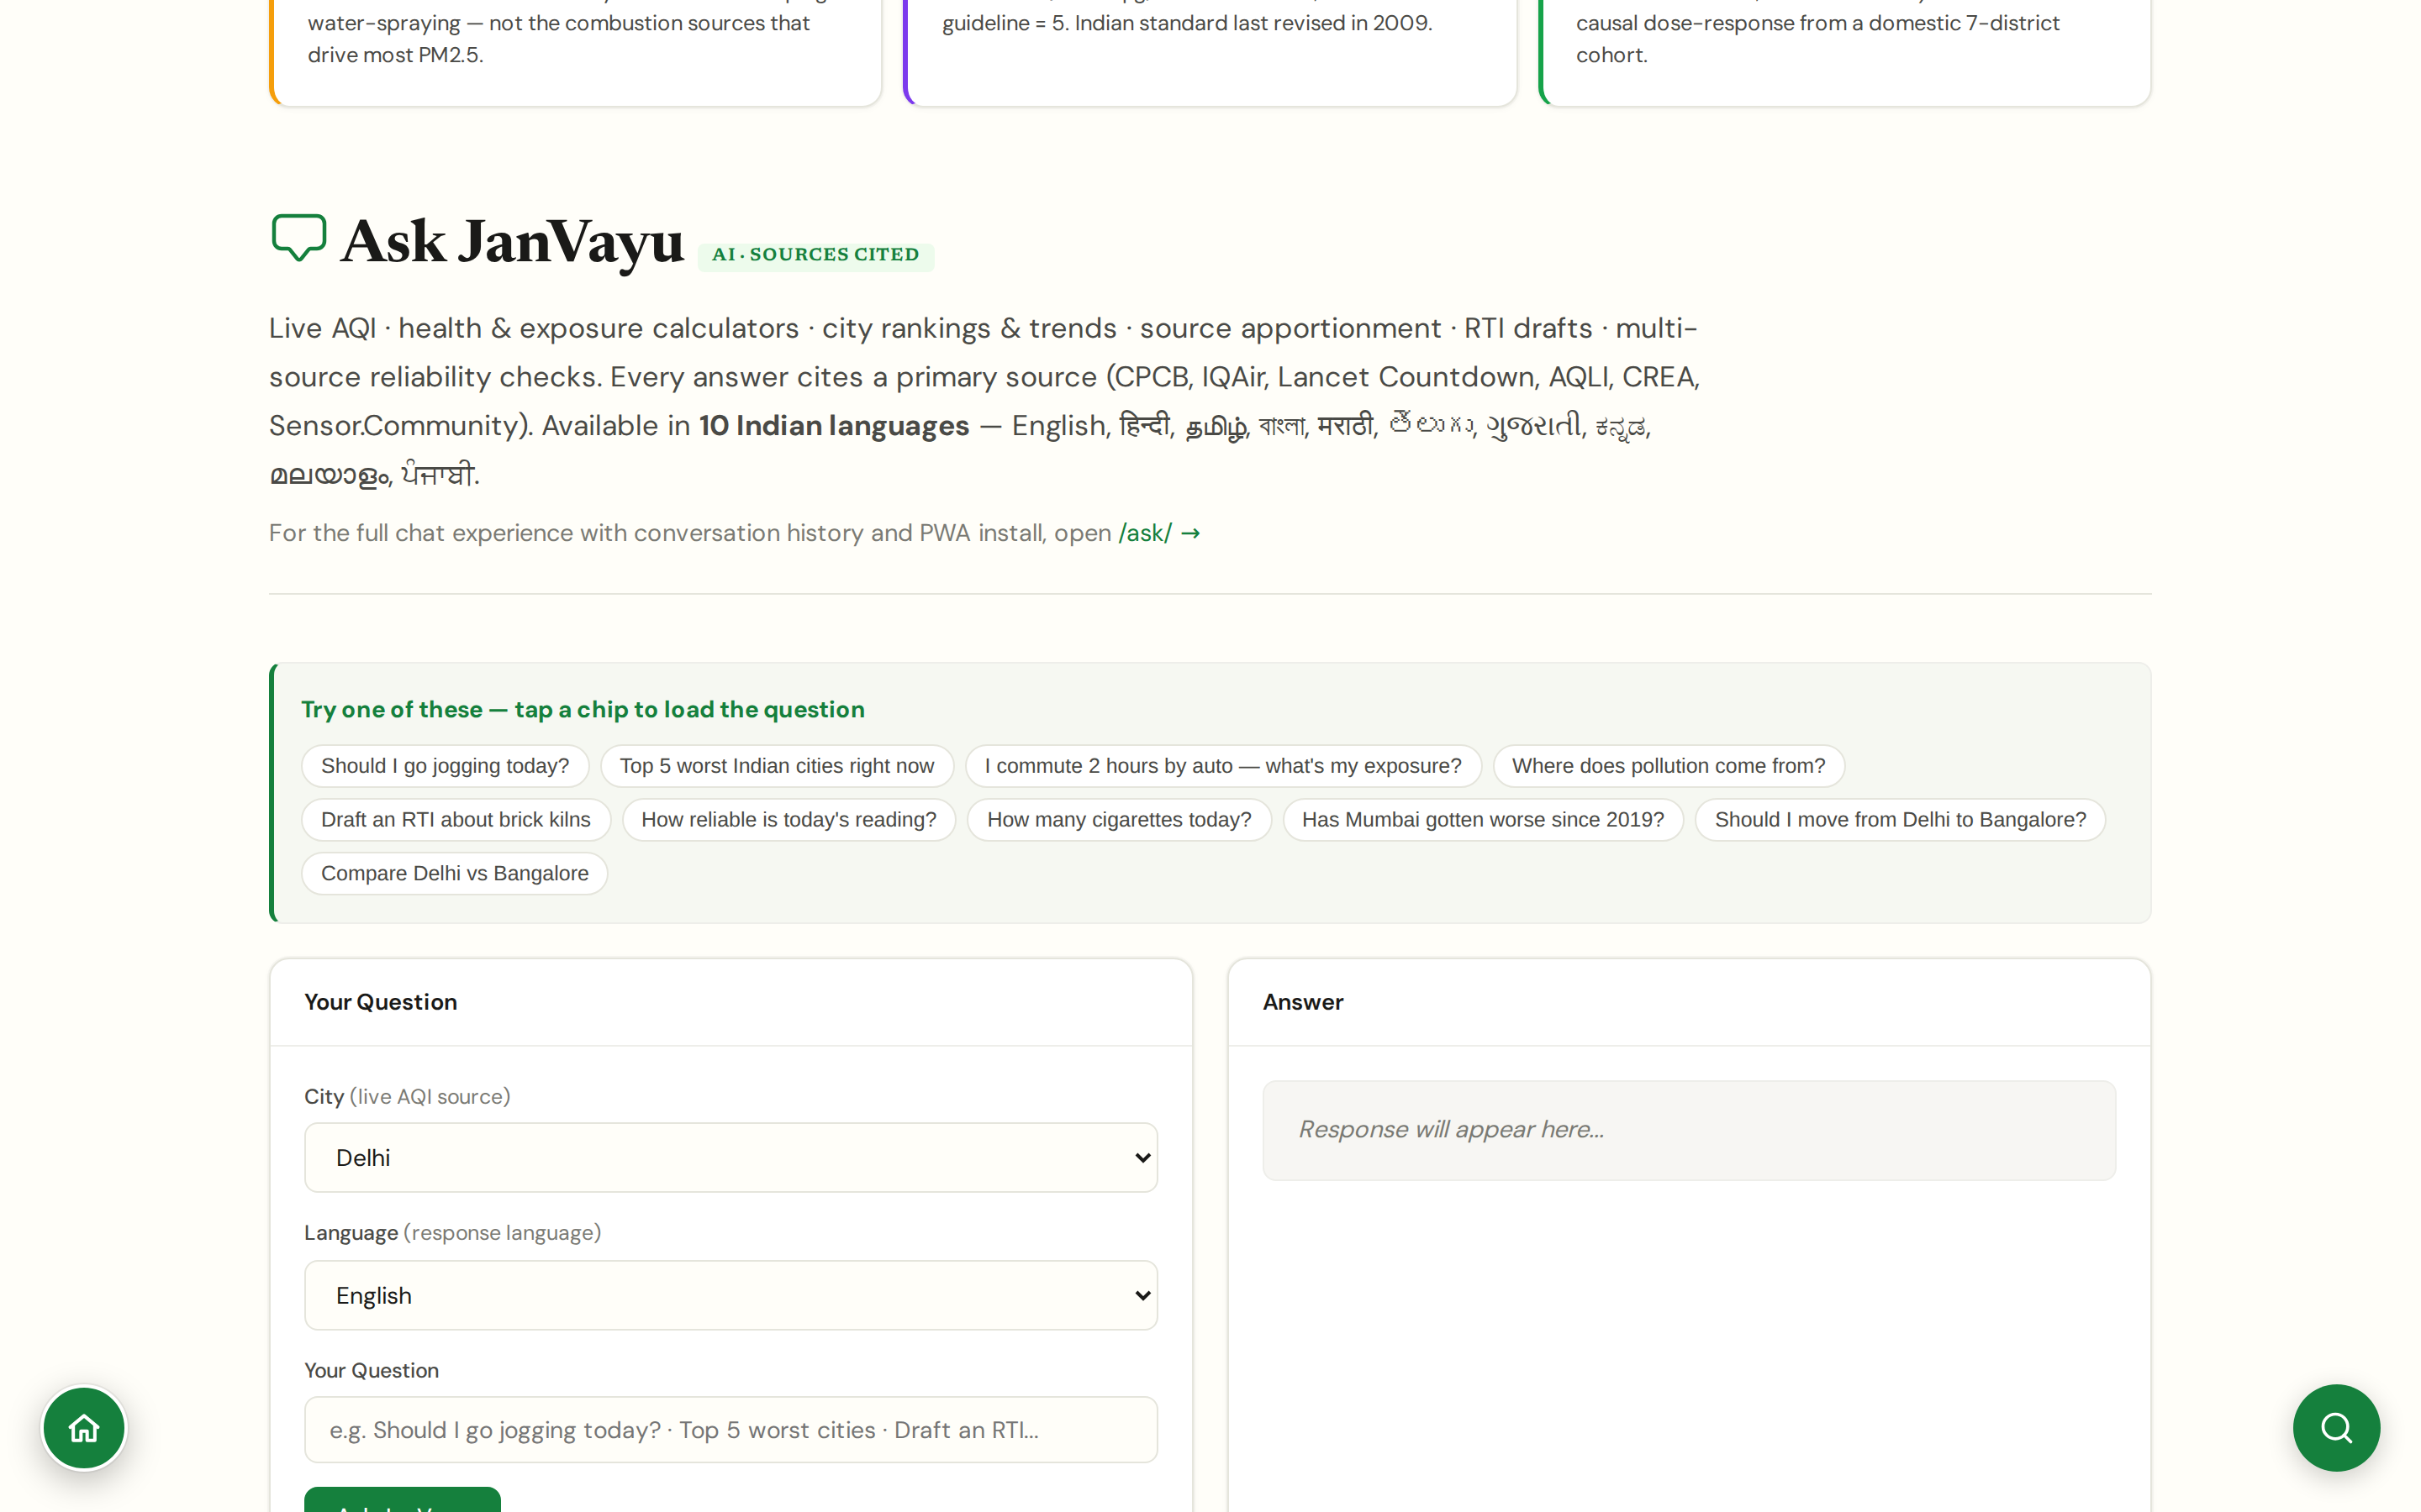
CHAPTER 7 · TOOLS & KNOWLEDGE
#ask-janvayu
Ask JanVayu (AI)
Live-data-grounded chatbot in 10 Indian languages, citing primary sources
Ten Indian languages selectable inline: English, हिन्दी, தமிழ், বাংলা, मराठी, తెలుగు, ગુજરાતી, ಕನ್ನಡ, മലയാളം, ਪੰਜਾਬੀ. Covers roughly 95% of mother-tongue speakers.
Wires four live data sources (live AQI, rankings, historical trends, community sensors); runs seven deterministic calculators (cigarette equivalence, mortality risk, life-years lost, migration benefit, transport exposure, purifier CADR, school closure forecast); drafts six RTI templates.
Every answer cites a primary source (CPCB, IQAir, Lancet Countdown, AQLI, CREA, Sensor.Community); methodology block addresses 'why do two sources disagree' (CPCB vs US EPA AQI, WAQI vs CPCB network, Krishna 1.5M vs Lancet 1.72M).
Built on Llama 3.3 70B via Groq; in-page widget plus a standalone PWA at janvayu.in/ask/ with conversation history.
CHAPTER 7 · TOOLS & KNOWLEDGE
JanVayu · janvayu.in · Walkthrough
Notes:
Ask JanVayu had four iteration phases in May: Phase A wired three more data endpoints, Phase B added seven deterministic calculators (cigarette equivalence per Berkeley Earth, mortality risk per Krishna et al. 2024, life-years lost per AQLI 2025, migration benefit, transport exposure, purifier CADR per AHAM formula, school closure forecast per GRAP), Phase C added the source apportionment and RTI drafting datasets for ten cities and six template categories, Phase D added multi-source spread analysis with divergence flagging (intra-city spread, WAQI vs Sensor.Community community sensors, today-vs-IQAir-baseline anomaly ratio). The discipline is that every number must come from a tool call or a calculator output, not the LLM. Ten languages now, covering ~95% of Indian mother-tongue speakers. The standalone PWA at /ask/ keeps conversation history; the in-page widget is for one-off queries.

Slide 53
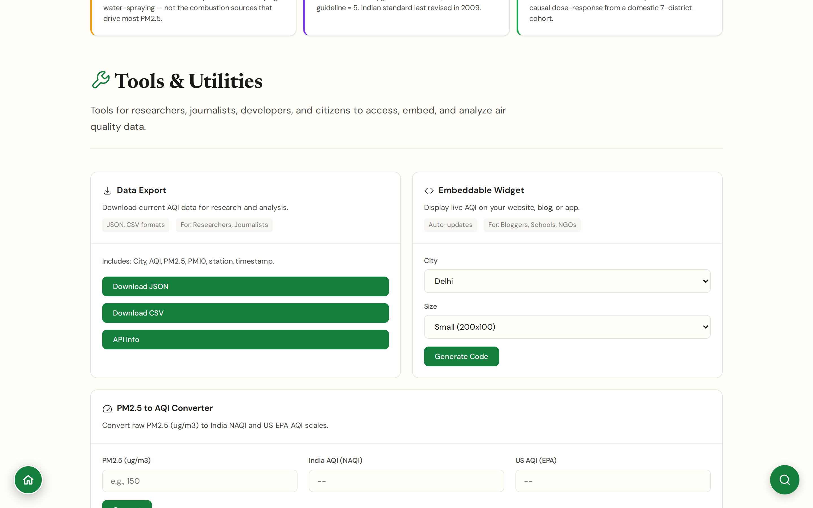
CHAPTER 7 · TOOLS & KNOWLEDGE
#tools
Tools
Embeddable widgets, PM2.5/AQI converters, exporters
Embed widget generator: choose a city and a size; receive an iframe snippet for school sites, RWA pages, blogs.
PM2.5 to AQI converters for both Indian NAAQS and US EPA AQI formulae, both are used in citation.
Data export: download any panel's underlying data as CSV/JSON for further analysis.
API endpoint documented for developers building on top of JanVayu.
CHAPTER 7 · TOOLS & KNOWLEDGE
JanVayu · janvayu.in · Walkthrough
Notes:
Tools is the panel that makes JanVayu reusable. The embed widget is the most-used feature, a school can drop a one-line iframe into its website and have a live PM2.5 display calibrated to their city. The PM2.5-to-AQI converter exists because Indian and US AQI use different break-points and people switch confusedly between them; this tool makes the conversion explicit. The CSV export is what most research uses get into.

Slide 54
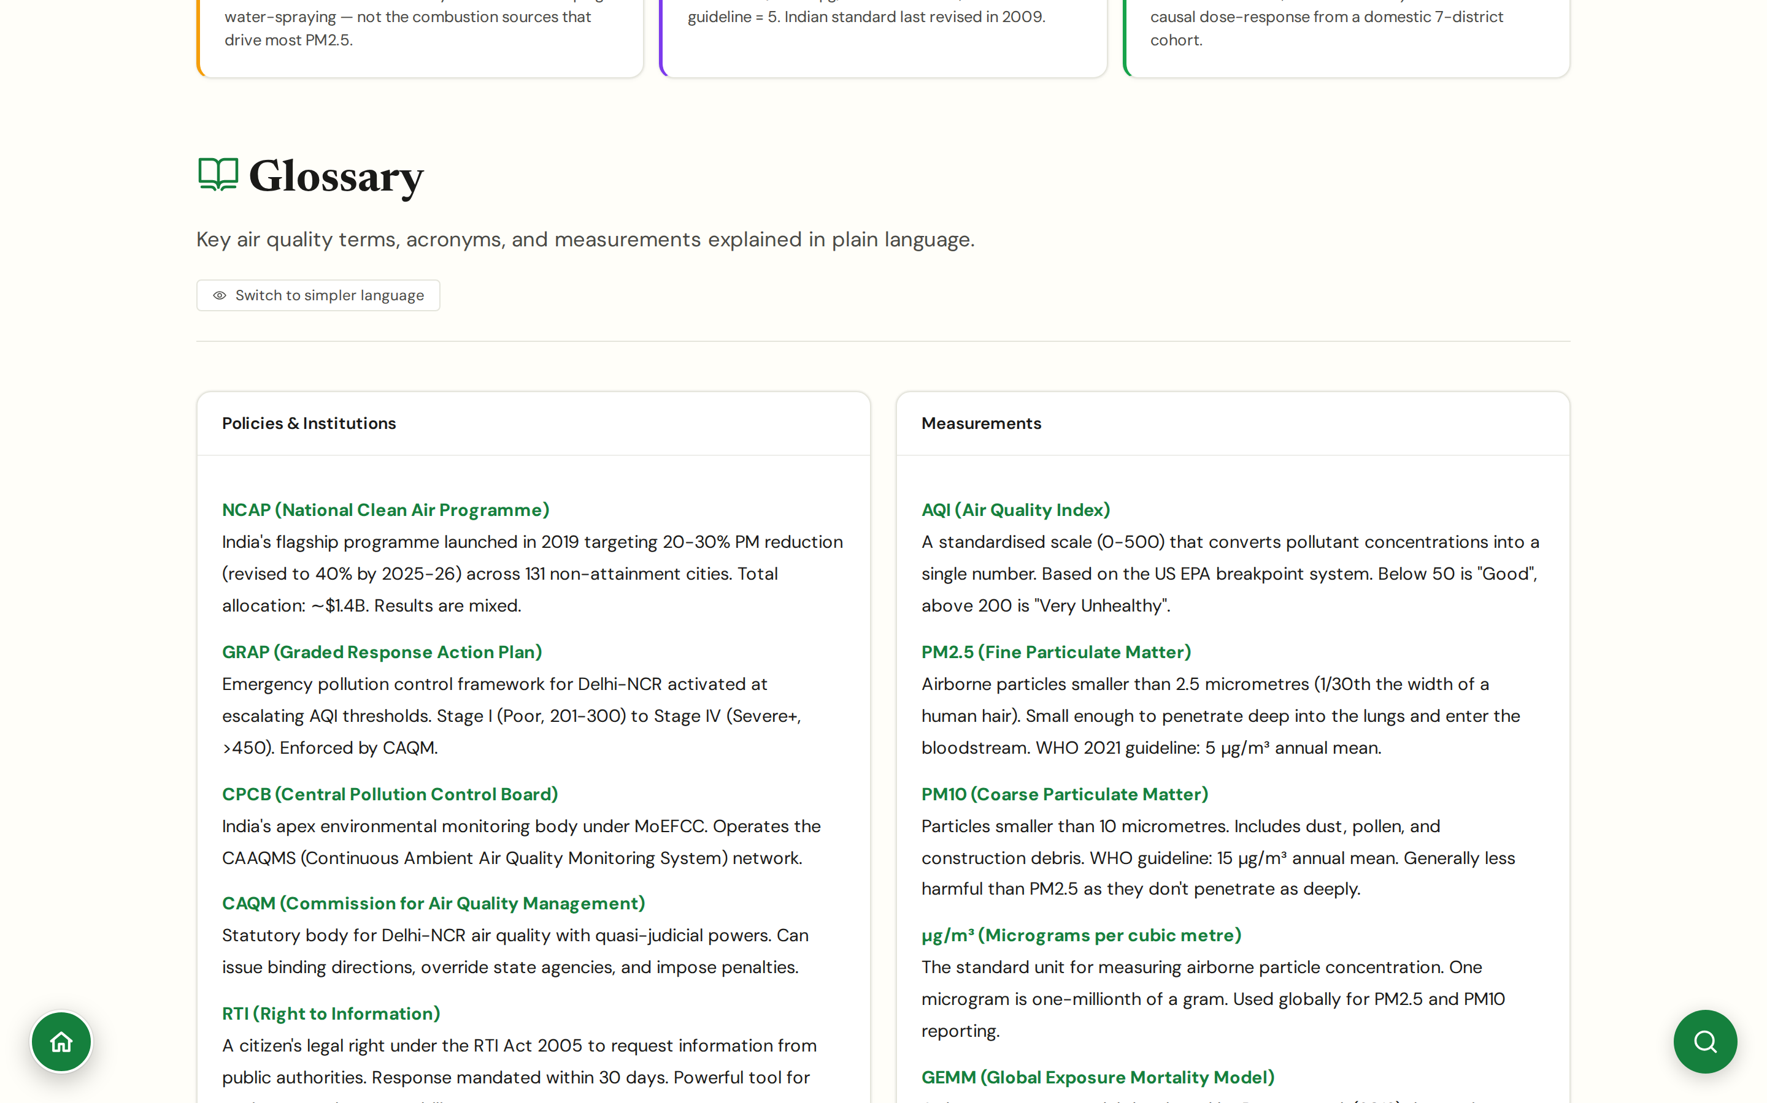
CHAPTER 7 · TOOLS & KNOWLEDGE
#glossary
Glossary
Every air-quality term, plainly defined, with a 'simpler language' toggle
Categorised entries: Measurements (PM2.5, PM10, μg/m³, AQI, GEMM), Policies & Institutions (NCAP, GRAP, CPCB, CAQM, NAAQS, PRANA), Methods (FIRMS, AOD, source apportionment).
A 'Switch to simpler language' toggle rewrites each entry into one-line plain English, useful for school and RWA outreach.
Keyboard-shortcut accessible (Ctrl+K) from any panel; entries cross-link to source papers and to the JanVayu panels where each term is used.
Anchors AQI definitions to US EPA breakpoints (0-500 scale) since that's what WAQI publishes; PM2.5 anchored to WHO 2021 (5 μg/m³ annual, 15 μg/m³ 24-hour).
CHAPTER 7 · TOOLS & KNOWLEDGE
JanVayu · janvayu.in · Walkthrough
Notes:
The glossary started as a single Hindi-English crib sheet I kept while drafting copy. It is now a fully cross-linked dictionary, every panel that uses a term links to the glossary entry, and every glossary entry links to the panels that use the term. The 'Switch to simpler language' toggle is the recent addition: it strips the technical definition and replaces it with a one-line plain-English version, useful for school workshops and for RWA-meeting handouts where the audience hasn't read about boundary-layer height. The Ctrl+K keyboard shortcut from any panel is the fastest path to clarification when you don't recognise a term mid-reading.

Slide 55
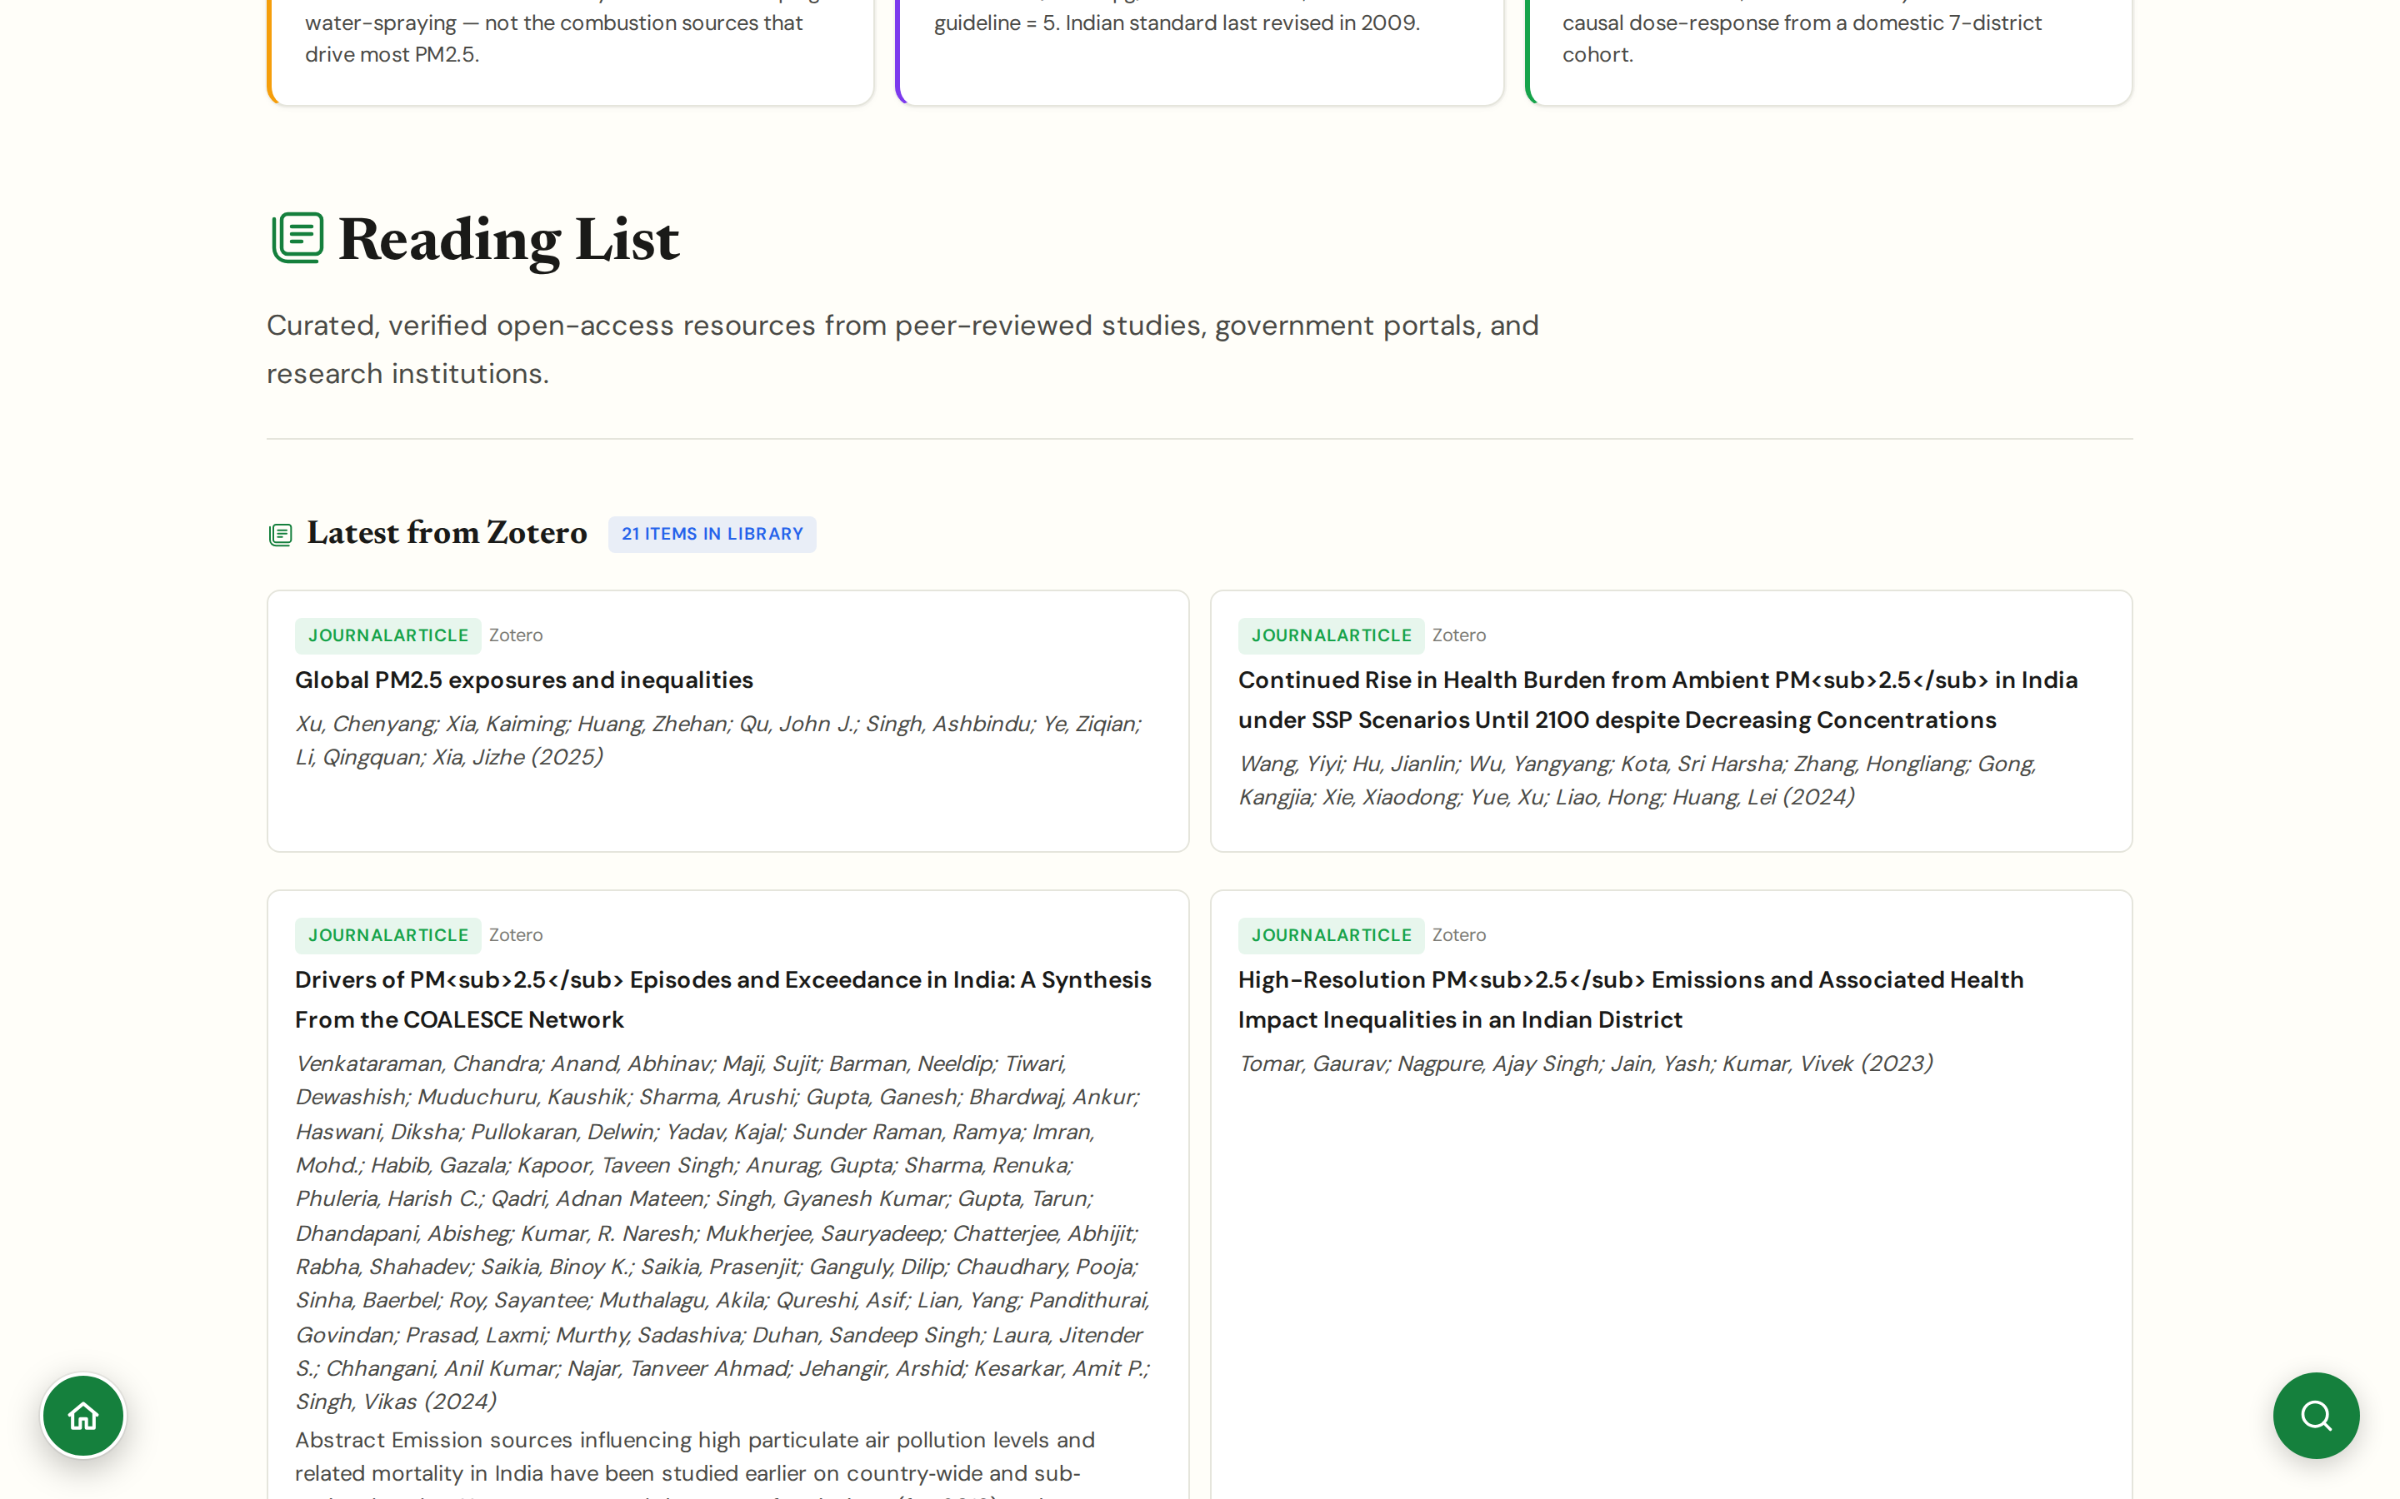
CHAPTER 7 · TOOLS & KNOWLEDGE
#resources
Reading List
Zotero-backed open library of papers, reports, and datasets
Currently 21 curated entries pulled live from Zotero: Lancet Countdown India, GBD, CREA, CSE, COALESCE network synthesis (Venkataraman et al. 2024), IIT-K source apportionment, UrbanEmissions.info.
Each entry carries full bibliographic metadata plus abstract; searchable by topic, author, source-type, year.
Every panel on JanVayu links to the subset of Reading List entries it relies on, and vice versa.
Auto-syncs with Zotero so the canonical bibliography lives there, not in the panel; users can fork the collection.
CHAPTER 7 · TOOLS & KNOWLEDGE
JanVayu · janvayu.in · Walkthrough
Notes:
The Reading List, renamed from Research Library in May, is now backed by Zotero rather than a hand-maintained list. There are 21 entries in the collection today and it grows weekly; the panel reads the Zotero library live, so a paper added in Zotero appears here automatically. The standout entries to know: Venkataraman et al. 2024 from the COALESCE network is the most rigorous recent India source-apportionment work, finding that primary organic matter and coal fly-ash drive both annual and episodic PM2.5 levels, with residential combustion as the dominant primary source even in 'cleaner' airsheds. Sarath Guttikunda's UrbanEmissions.info is heavily represented including the 40-by-2040 calculator. The library is also the resource I direct researchers and journalists to first.

Slide 56
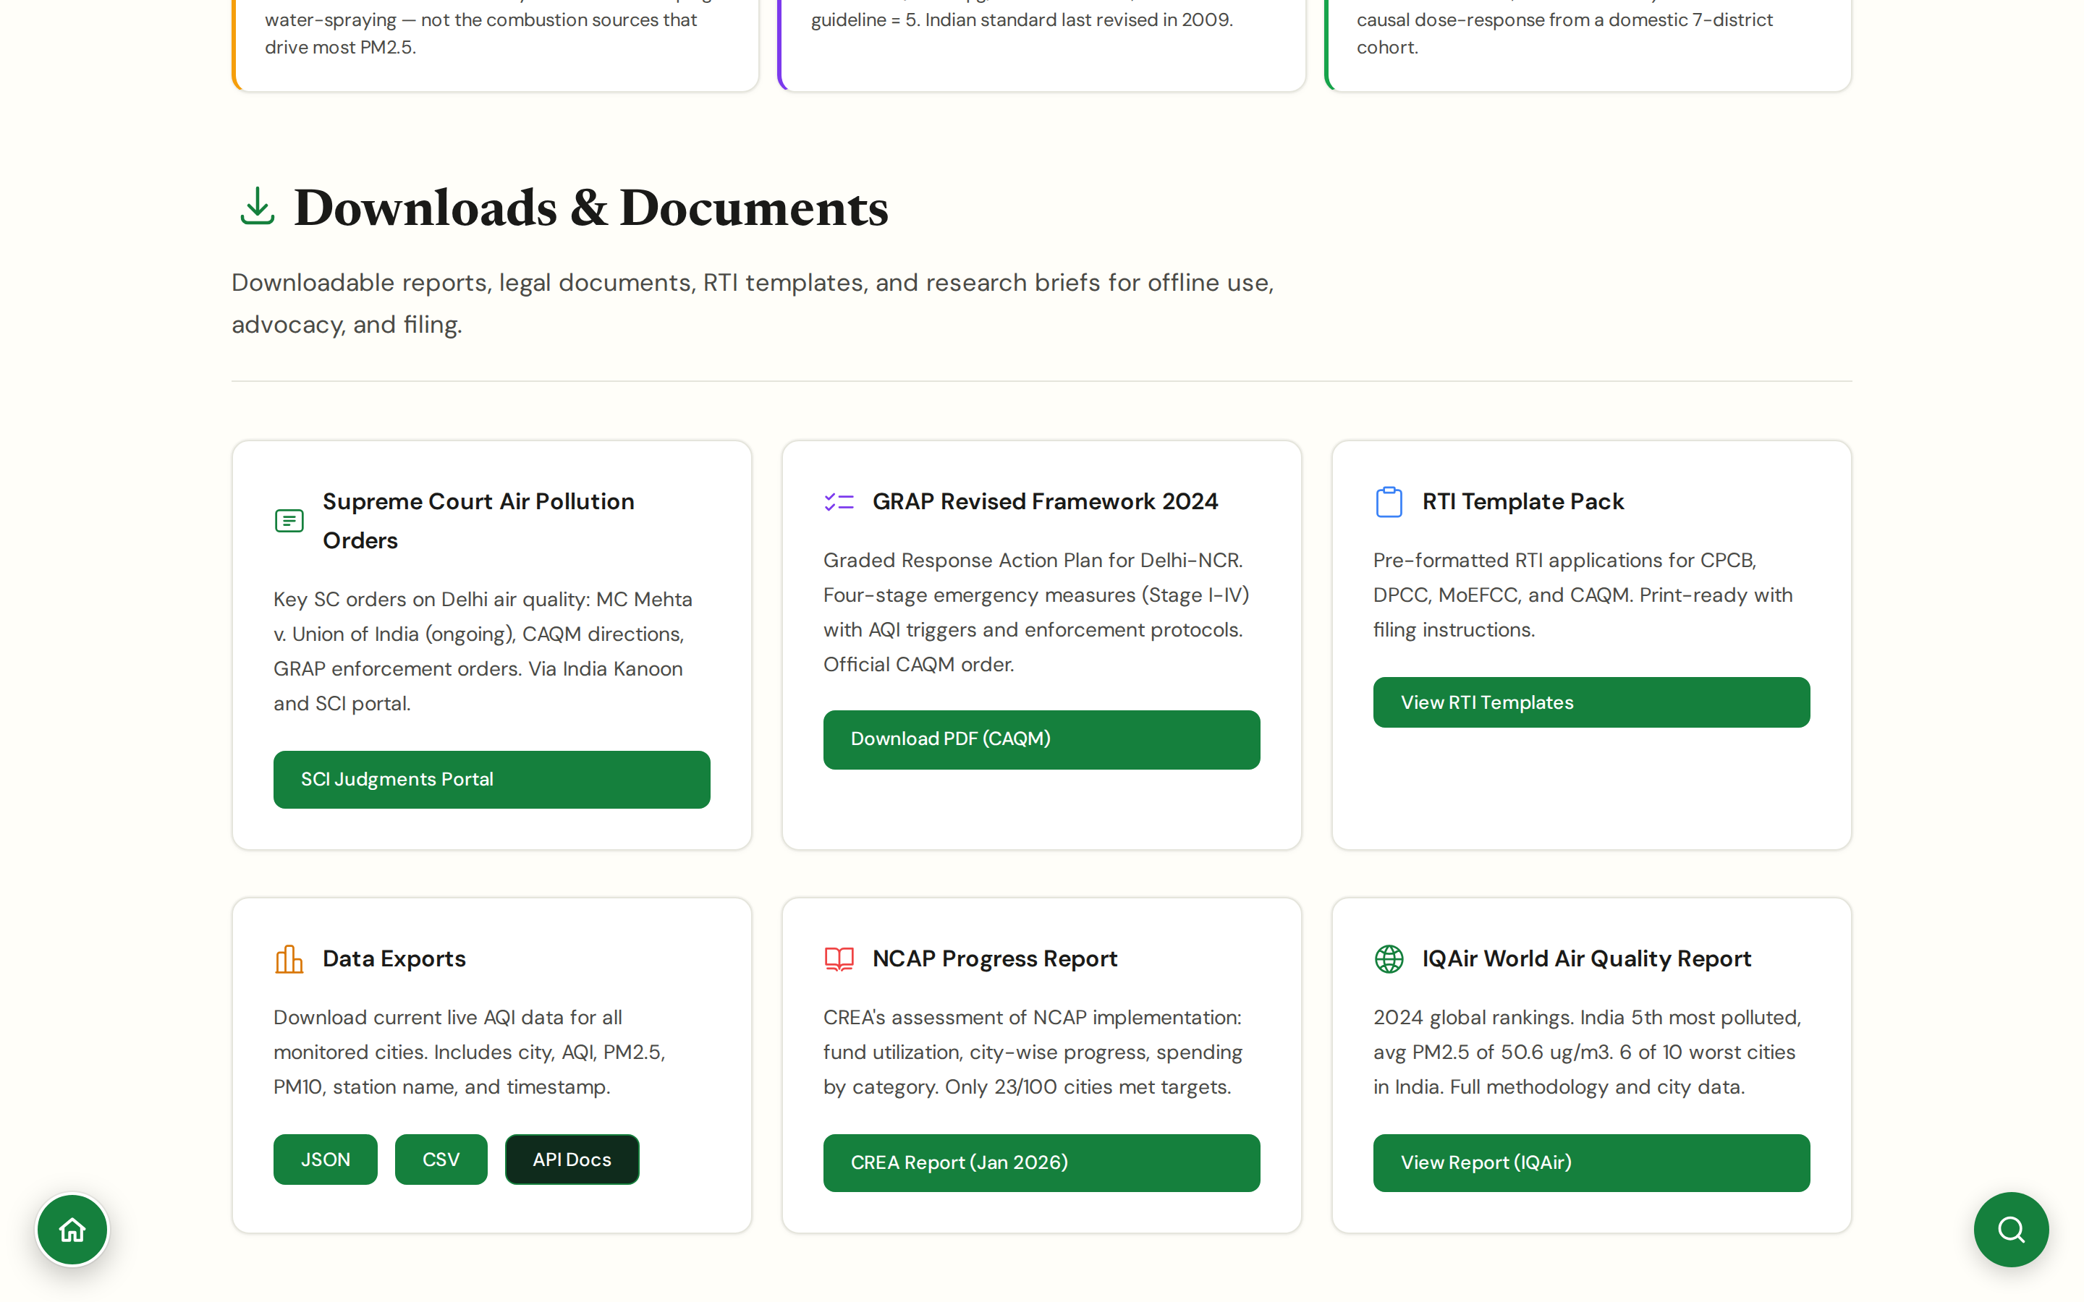
CHAPTER 7 · TOOLS & KNOWLEDGE
#downloads
Downloads
Slide decks, briefs, datasets, scorecard PDFs
Ready-made decks for: school assemblies, RWA presentations, councillor briefings, journalist primers.
Pre-built briefs by topic (NCAP, GRAP, school closures, occupational exposure) with citations.
Bulk dataset downloads for researchers (historical CPCB, derived ×WHO series, scorecard exports).
Everything CC BY-NC-SA 4.0, free to reuse with attribution, non-commercial.
CHAPTER 7 · TOOLS & KNOWLEDGE
JanVayu · janvayu.in · Walkthrough
Notes:
Downloads is the panel that addresses the 'I need to use this in my work tomorrow' user. The pre-built decks are sized for the audiences they actually encounter: school assemblies, RWAs, ward councillors, newsroom editors. Each deck is on the same evidence base as the panels, so someone presenting one isn't using a freshly assembled set of slides, the underlying claims have been peer-reviewed within the platform.

Slide 57
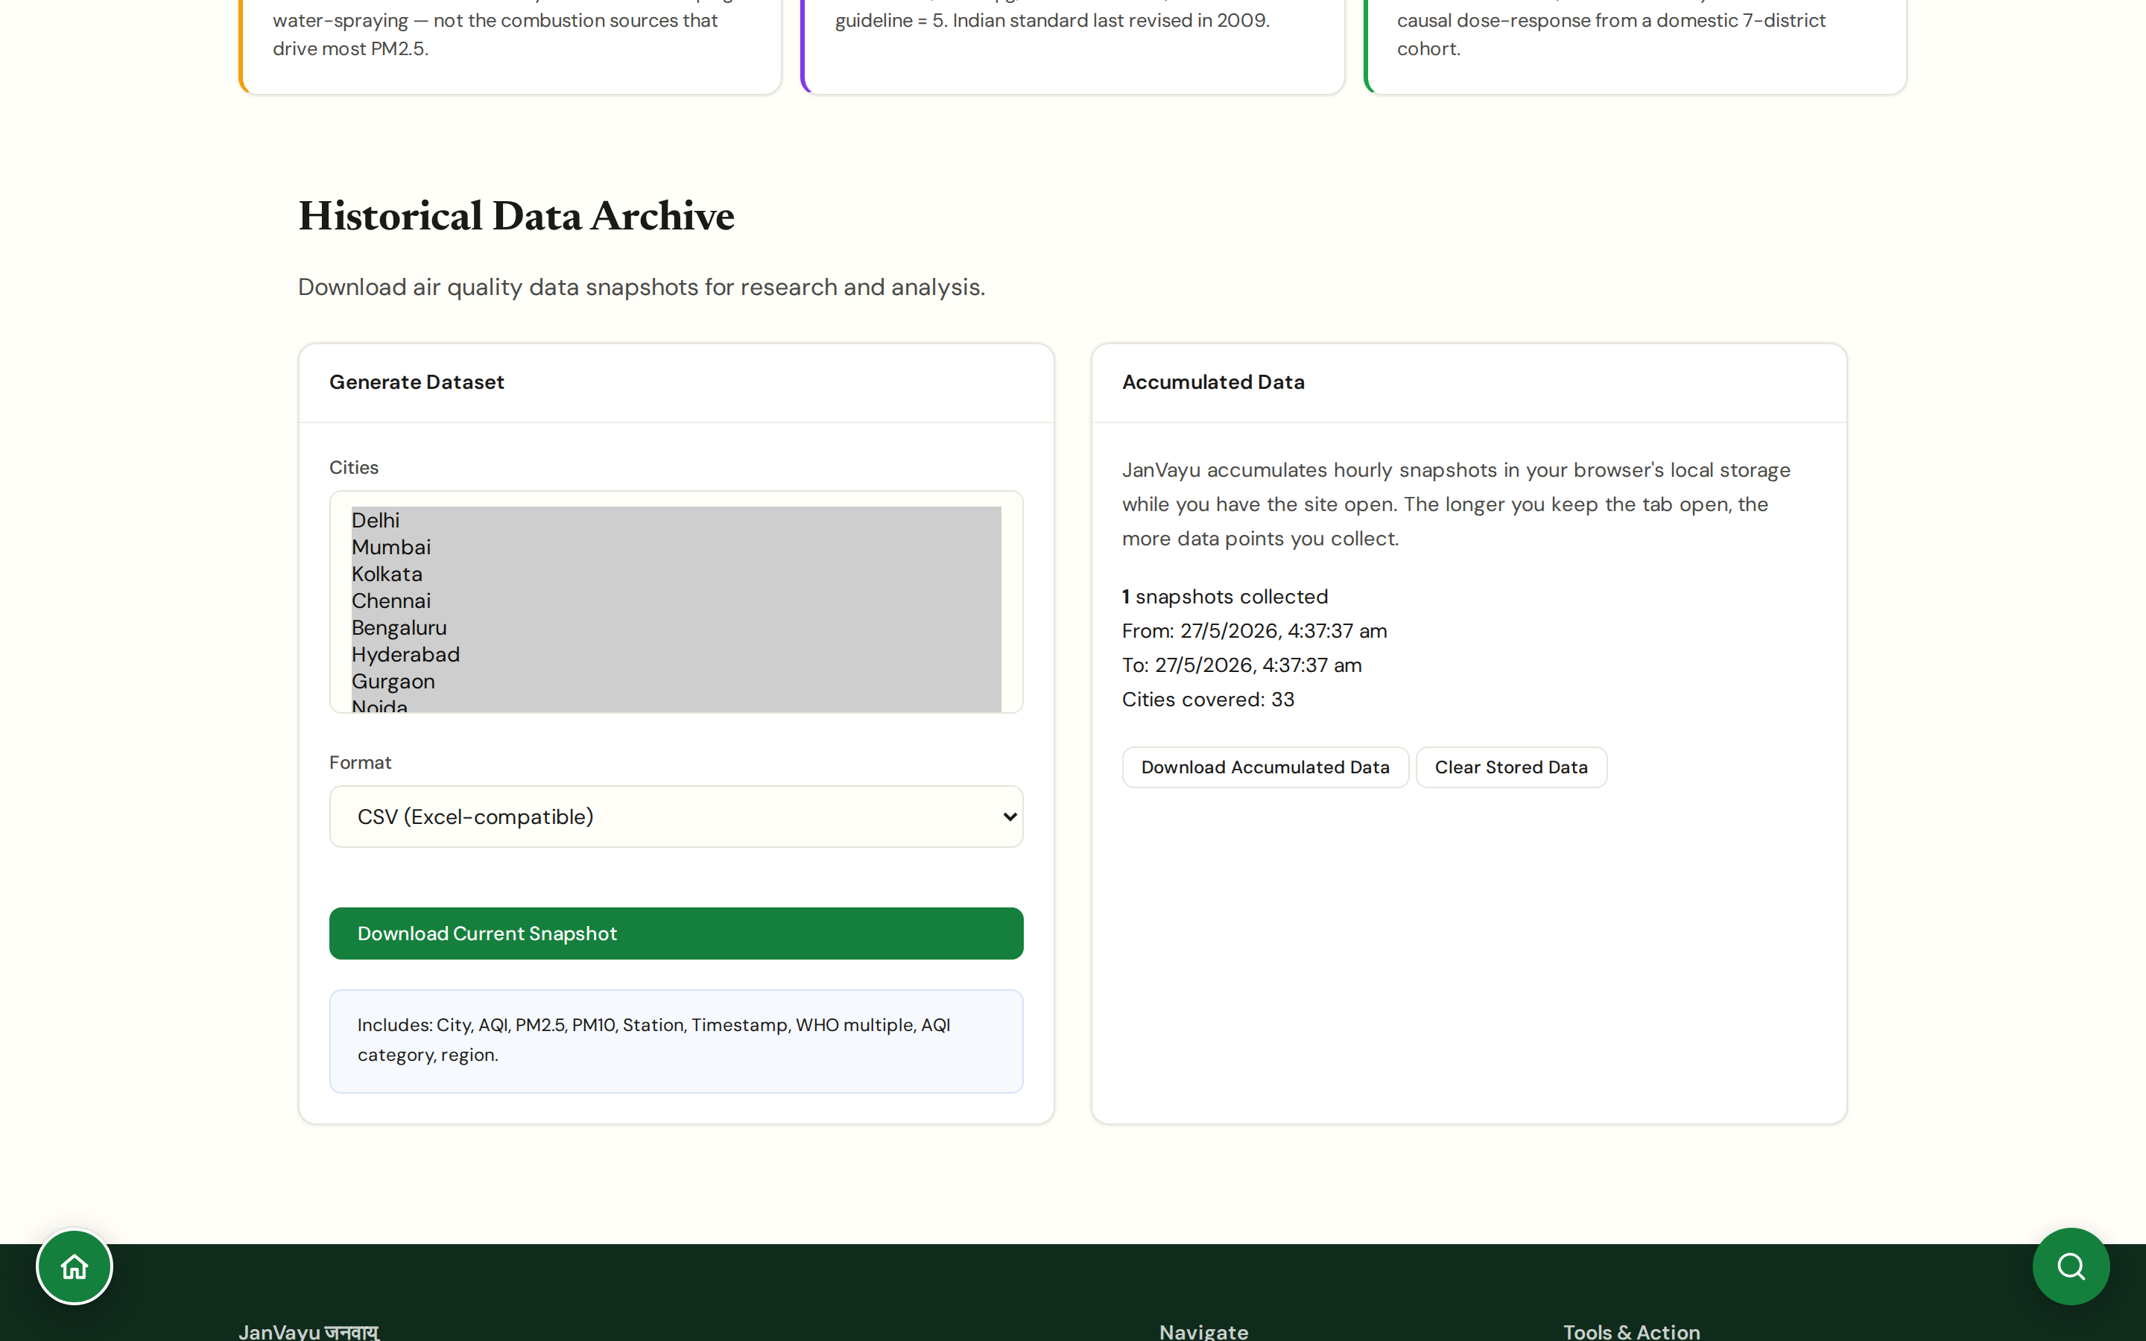
CHAPTER 7 · TOOLS & KNOWLEDGE
#data-archive
Data Archive
Raw and processed time series, openly accessible
Long-run station-level PM2.5/PM10 series sourced from CPCB CAAQMS and curated.
Derived series: city-level daily means, ×WHO multipliers, scorecard inputs, GEMM calculations.
Versioned: every dataset has a release date, a methodology note, and a citation suggestion.
Useful for graduate research and for replicating any specific claim shown on the platform.
CHAPTER 7 · TOOLS & KNOWLEDGE
JanVayu · janvayu.in · Walkthrough
Notes:
The Data Archive is the panel I'm most insistent on, methodologically. Every dataset has a release version, a methodology document, and a suggested citation. If a paper using JanVayu data is published, we can point back to the exact version of the exact dataset used. CPCB's own data has been known to revise silently, keeping versioned mirrors is part of how we maintain independence from upstream changes.

Slide 58
CHAPTER
Chapter 8
About, footer, and legal compliance
Provenance, licensing, disclaimers, and the legal architecture beneath every page.

Slide 59
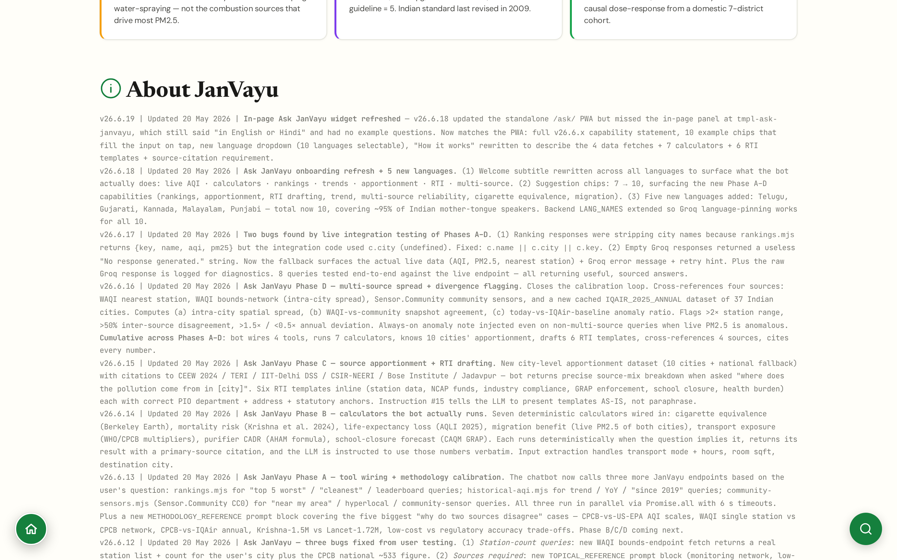
CHAPTER 8 · ABOUT
#about
About
Who built JanVayu, who funds it, who maintains it
Built by a group of independent researchers and civic technologists, not a registered NGO or company.
Independently funded by contributor effort; no government, corporate, or partisan funding.
Source code: MIT licensed, public GitHub repository. Content: CC BY-NC-SA 4.0.
Lead maintainer: Varna Sri Raman (Communications and Insights). Tech contributors credited on the page.
CHAPTER 8 · ABOUT
JanVayu · janvayu.in · Walkthrough
Notes:
The About panel is the page I expect the most external scrutiny on. The funding model is explicit because partisan and corporate readers will look for an angle. We are a group of independent contributors, not a registered entity, not a vehicle for any political position, not a vehicle for any product. The MIT licence on code and CC BY-NC-SA on content mean the platform can be forked, mirrored, and adapted; the non-commercial clause is the only restriction. The lead maintainer is named because someone needs to be accountable when claims are wrong.

Slide 60
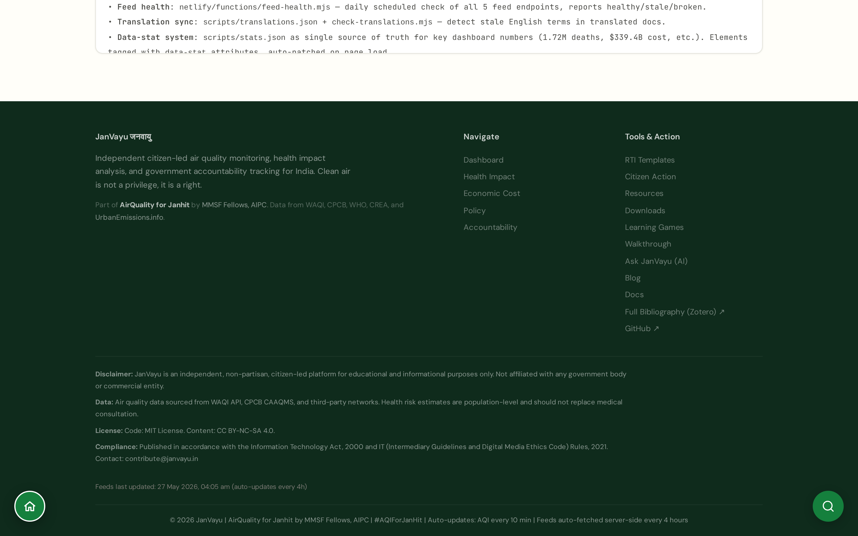
CHAPTER 8 · COMPLIANCE
#footer (every page)
Footer & legal compliance
Disclaimer, data accuracy, license, IT Act compliance, all four sections present
Disclaimer: independent, non-partisan, citizen-led platform; for educational and informational purposes; not affiliated with any government or commercial entity.
Data accuracy: PM2.5 from WAQI / CPCB CAAQMS / third-party networks; health risk estimates are population-level and do not replace medical consultation.
Licence: code under MIT; content under CC BY-NC-SA 4.0.
Compliance: published in accordance with the IT Act 2000 and the IT (Intermediary Guidelines and Digital Media Ethics Code) Rules 2021. Contact: contribute@janvayu.in.
CHAPTER 8 · COMPLIANCE
JanVayu · janvayu.in · Walkthrough
Notes:
The footer is the legal contract between JanVayu and its users. The four sections, disclaimer, data accuracy, licence, compliance, must always be present. When an earlier version briefly dropped them during a redesign the platform lost its safety net, so the four-section footer is now a documented invariant of the site. The IT Act 2000 and the 2021 Intermediary Guidelines Rules together cover everything a Indian digital publication needs to comply with; explicit naming in the footer is the protective move. The contact email is monitored personally.

Slide 61
CHAPTER
Chapter 9
Using JanVayu in your work
Concrete ways researchers, journalists, lawyers, and advocates can use the platform in their daily work.

Slide 62
CHAPTER 9 · FOR USERS
How to use JanVayu in your work
Research
Data Archive → versioned datasets → cite with the version tag.
Reading List → backing literature.
Pollution Correlations → exploratory analysis.
data-archive · resources · correlations
Writing
City Scorecards for one-page synthesis. Mission Tracker for evidence-graded claims.
Accountability Brief for daily wire scan.
scorecards · mission-tracker · accountability-brief
Advocacy
RTI Assistant for the right RTI to the right authority.
Legal Framework for the constitutional and statutory base.
Clean Air Wins as counterweight in policy conversations.
rti-assistant · legal · progress
Outreach
Workshops for re-runnable training; Learning Games for school engagement.
Ask JanVayu for bilingual Q&A; Tools for embeddable widgets.
workshops · games · ask-janvayu · tools
Personal use
Should I Go Outside; AQI Alerts; Exposure Report.
Purifier Calculator for household decisions; Migration Calculator for bigger ones.
go-outside · aqi-alerts · exposure-report · purifier-calc · migration-calc
CHAPTER 9 · FELLOW USE CASES
JanVayu · janvayu.in · Walkthrough
Notes:
This is the slide I'd leave up during Q&A. Five buckets of how to actually use this in day-to-day work. Research: Data Archive and Reading List. Writing: City Scorecards, Mission Tracker, and the Accountability Brief for daily scans. Advocacy: RTI templates, the Legal Framework, and Clean Air Wins for credibility. Outreach: Workshops, Games, Ask JanVayu in bilingual mode, and embeddable Tools. Personal use: the family-decision panels including Should I Go Outside, AQI Alerts, Exposure Report, Purifier and Migration calculators.

Slide 63
CHAPTER 9 · UNDER THE HOOD
Tech stack and data sources
PLATFORM
DATA SOURCES
Single-page HTML application, no framework lock-in
Vanilla JavaScript + Chart.js (interactive charts)
Leaflet.js for the live map
Typography: DM Sans (UI) · Newsreader (editorial) · JetBrains Mono (data)
Self-hosted variable WOFF2 fonts
Open source: MIT licensed code on public GitHub
WAQI API, live PM2.5 readings across cities
CPCB CAAQMS, Central Pollution Control Board stations
PRANA Portal, NCAP city data
NASA FIRMS, satellite fire-count imagery
IMD, meteorology (wind, temperature, boundary layer)
RTI responses, Union Budget docs, scheme utilisation
Lancet, CREA, CSE, Dalberg, World Bank, IQAir, UrbanEmissions.info
CHAPTER 9 · TECH & DATA
JanVayu · janvayu.in · Walkthrough
Notes:
On the platform side: single-page vanilla HTML, no React or Vue, no framework lock-in. Chart.js for charts, Leaflet for the map. Typography is DM Sans for UI, Newsreader for editorial headings, JetBrains Mono for data, all self-hosted as variable WOFF2 fonts. Code is MIT-licensed on a public GitHub repository. On the data side, WAQI is the live PM2.5 feed, with CPCB CAAQMS as the ground-truth anchor. PRANA is the NCAP-specific data portal. NASA FIRMS gives us the fire-count satellite layer that matters for the stubble-burning conversation. IMD is our meteorology backbone. RTI responses fill in everything that the public APIs do not, including utilisation rates, scheme details, and consent records. And then the literature: Lancet, CREA, CSE, Dalberg, World Bank, IQAir, and Sarath Guttikunda's UrbanEmissions.info.

Slide 64
CHAPTER 9 · ROADMAP
What's next, and how to contribute
Q3 2026
Expand Clean Air Mission Tracker beyond Delhi-NCR (12-week city-by-city roadmap).
Q3 2026
Integrate UrbanEmissions.info resources into the Reading List (7 mapped resources incl. 40 by 2040 calculator).
Q4 2026
Watch the XVI Finance Commission successor framework; NCAP funding cliff dashboard once published.
Ongoing
More multilingual coverage (Marathi, Bengali deepening; Telugu and Kannada on the roadmap).
Ongoing
Workshop kits in vernacular languages for school and RWA outreach.
Contribute · Data, code, or analysis: GitHub PRs welcome · Story leads or RTI tips: contribute@janvayu.in · Workshops in your city: same email
CHAPTER 9 · WHAT'S NEXT
JanVayu · janvayu.in · Walkthrough
Notes:
Three near-term things: expand the Mission Tracker to cities beyond Delhi-NCR, integrate Sarath Guttikunda's UrbanEmissions.info resources into the Reading List, and build a dedicated dashboard around the 16th Finance Commission's NCAP successor framework when it lands later this year. Multilingual coverage continues to expand, Marathi and Bengali deepening, Telugu and Kannada on the roadmap. Workshop kits in vernacular languages are the request I receive most often. If anyone here wants to contribute data, code, or analysis, the GitHub is open and contribute@janvayu.in reaches me directly.

Slide 65
Thank you.
Questions? Things you'd want JanVayu to do that it doesn't yet?
janvayu.in · contribute@janvayu.in · github.com/janvayu
Notes:
Closing slide. Q&A starts here. The two things I most want to know from this cohort: (1) what's a question your work asks that JanVayu doesn't answer yet, and (2) is there a panel that should be cut or merged because it's not pulling its weight. Both are equally useful answers.

