Slide 1
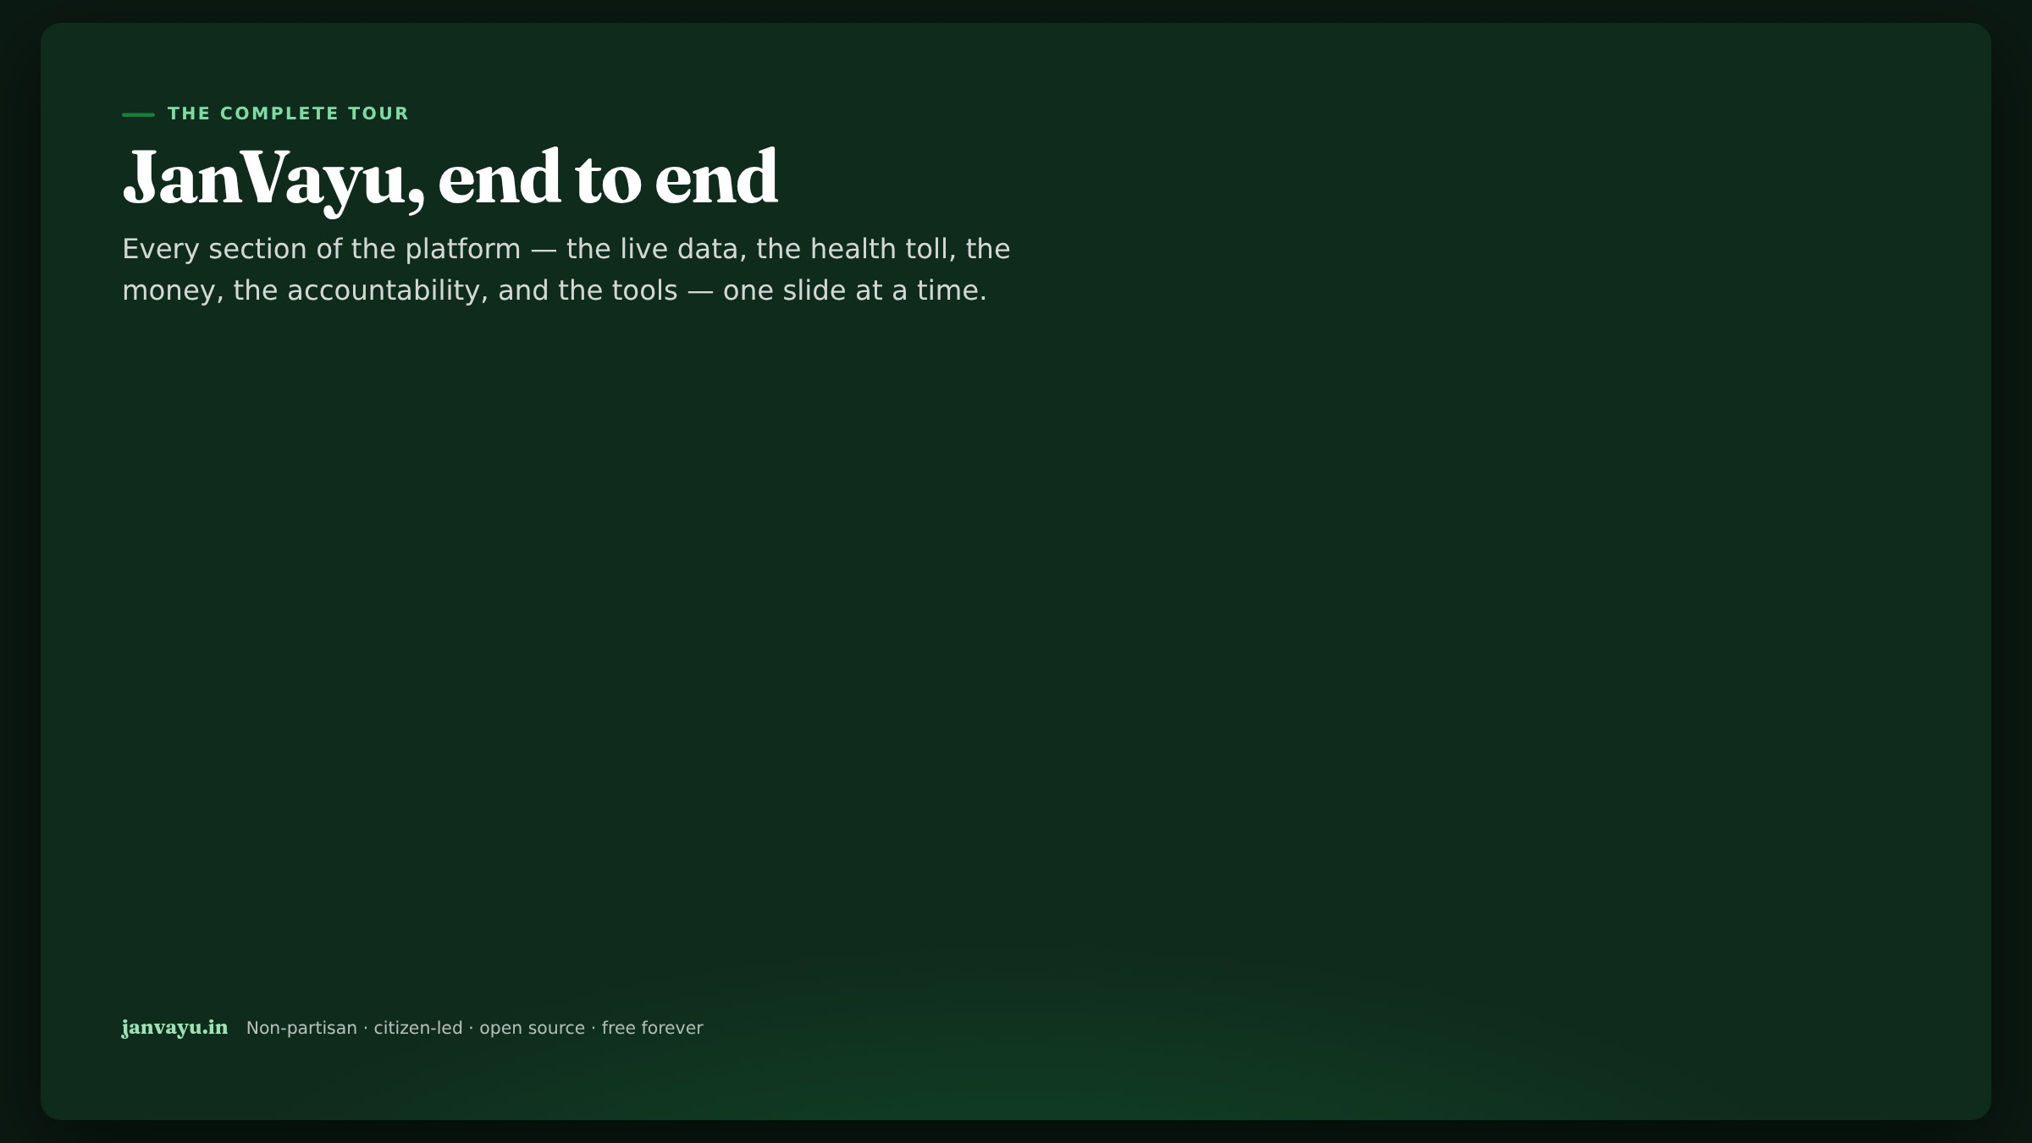
Notes:
This is the long walkthrough: a slide for essentially every panel on the site. Use it to train a newsroom, brief a class, or onboard a collaborator. For a 10-minute overview instead, use the short deck.

Slide 2

Notes:
Chapter 1 — Why it exists. Set the stakes and the stance before touching the product.

Slide 3
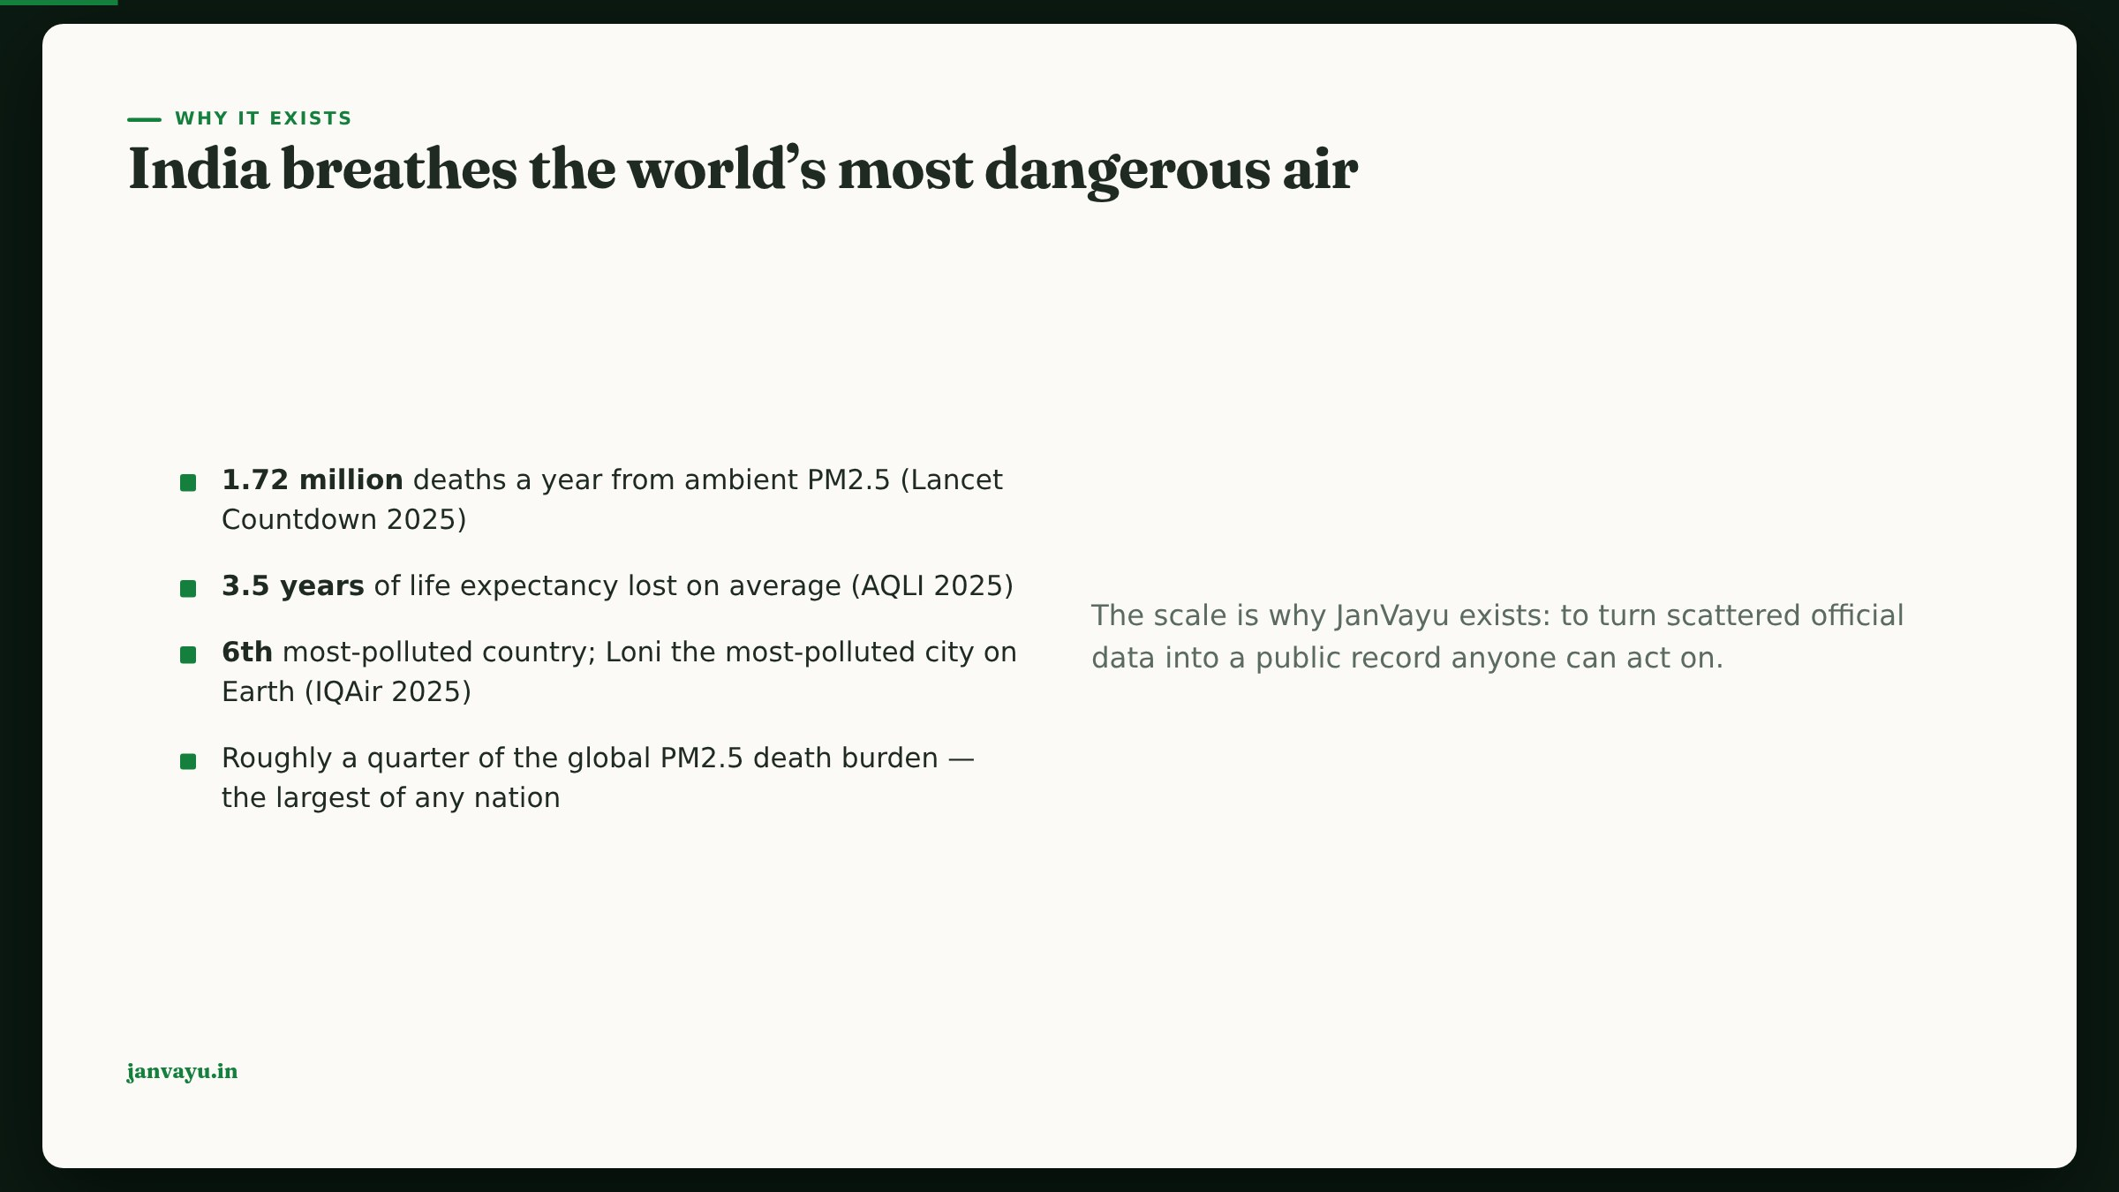
Notes:
Open on the human scale, sourced. These are the anchor numbers repeated across the site, each fact-checked against its primary source.

Slide 4
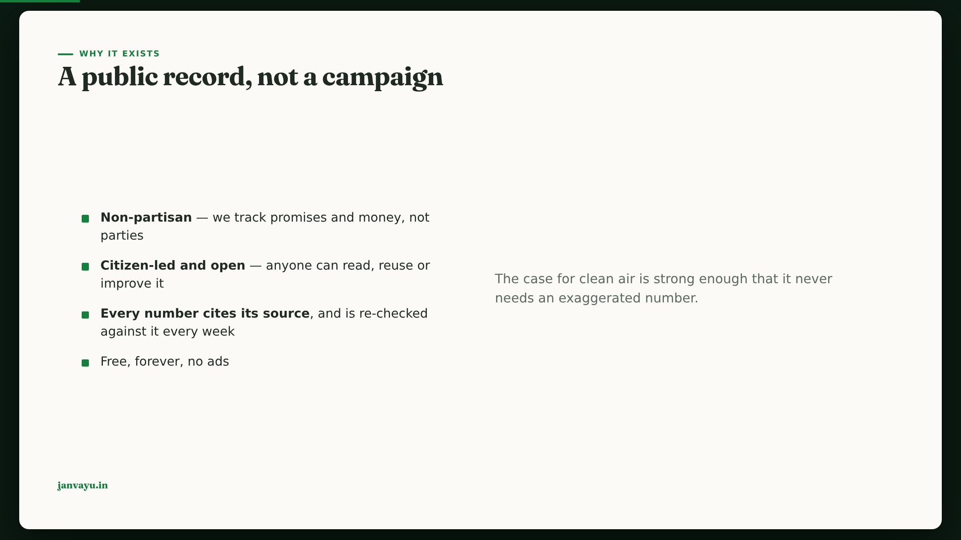
Notes:
Establish trust posture early: independence, sourcing, and the self-fact-checking discipline are the platform’s backbone.

Slide 5
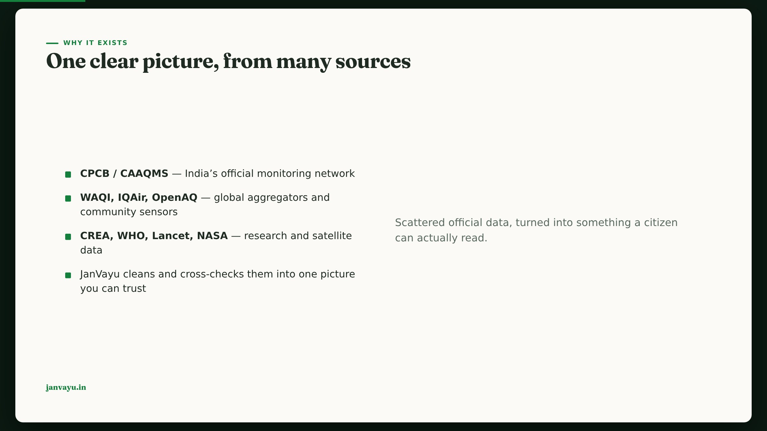
Notes:
The value-add is synthesis and honesty, not owning sensors. Name the sources so users can verify.

Slide 6

Notes:
Chapter 2 — The live picture. The real-time surfaces — the parts people check daily.

Slide 7

Notes:
Walk the dashboard top to bottom; point out the city selector drives the whole page.

Slide 8
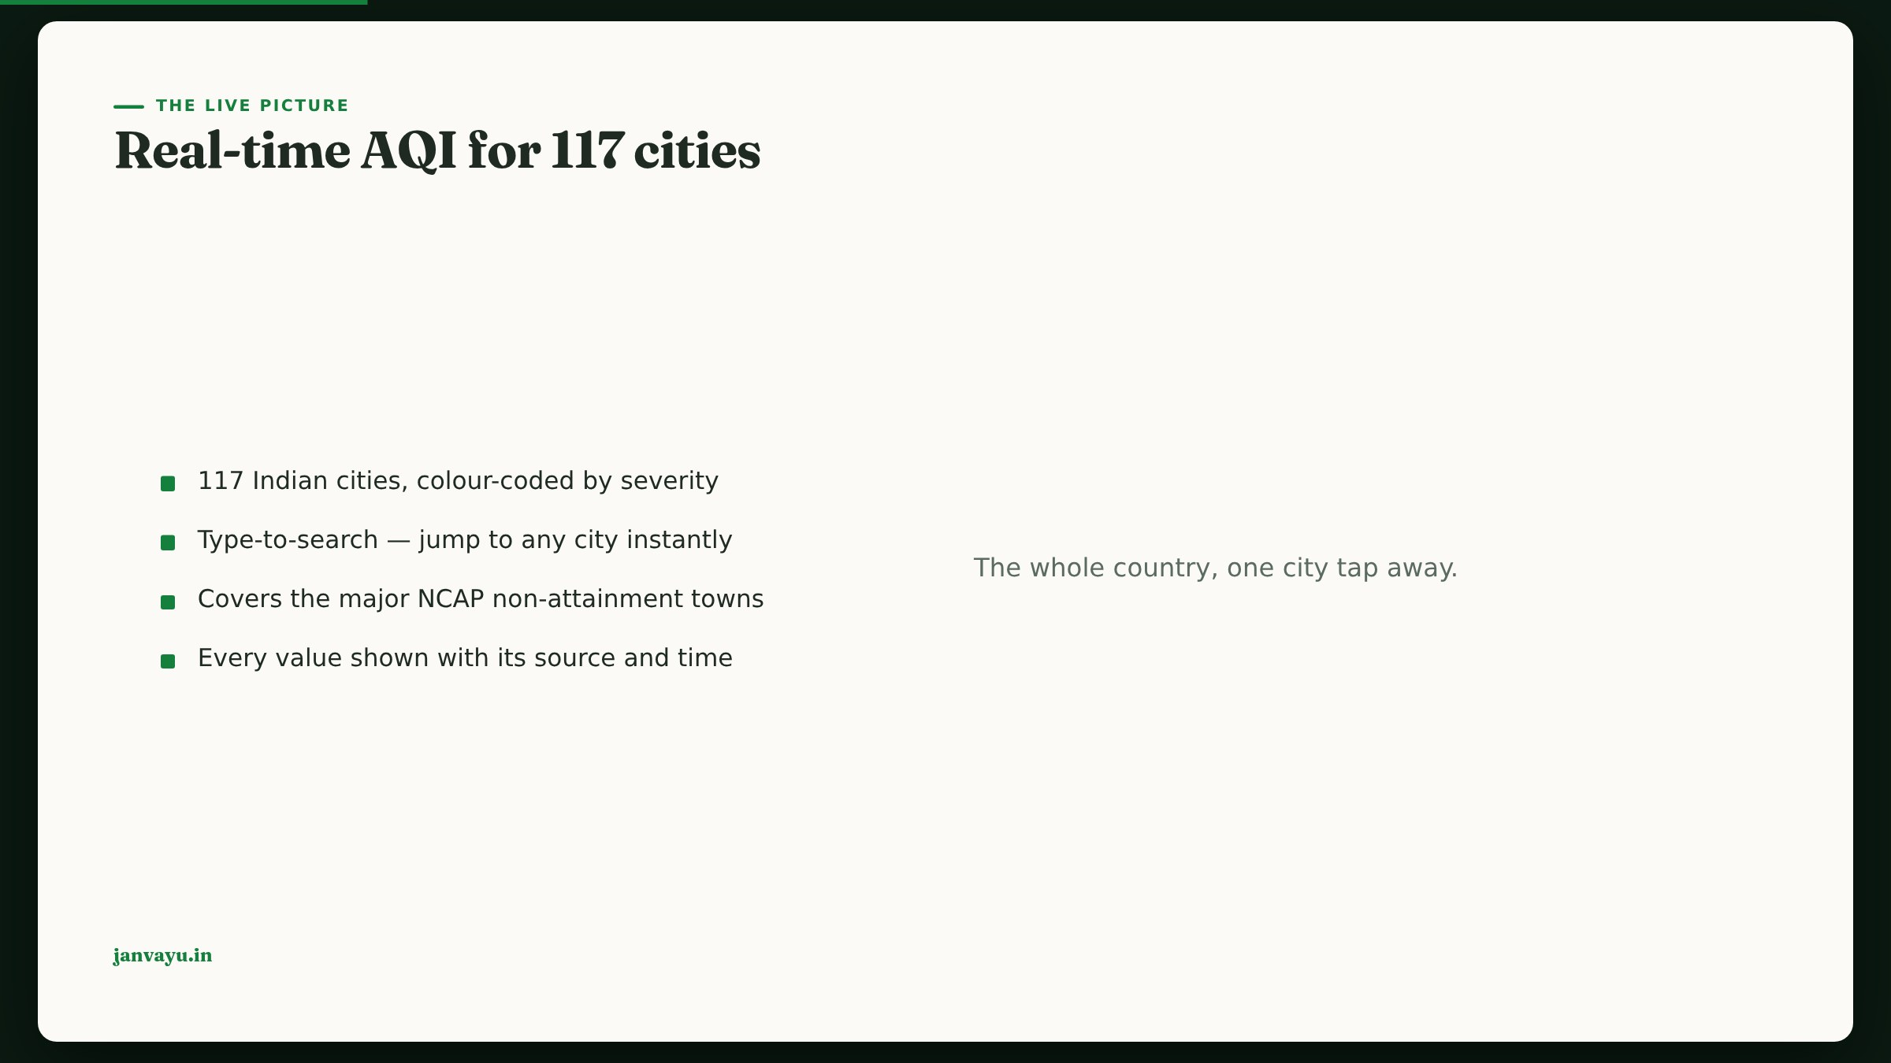
Notes:
Core cities load live; the rest load when picked, to stay inside the data source’s free tier — but that’s a build detail, not something the reader needs on screen.

Slide 9
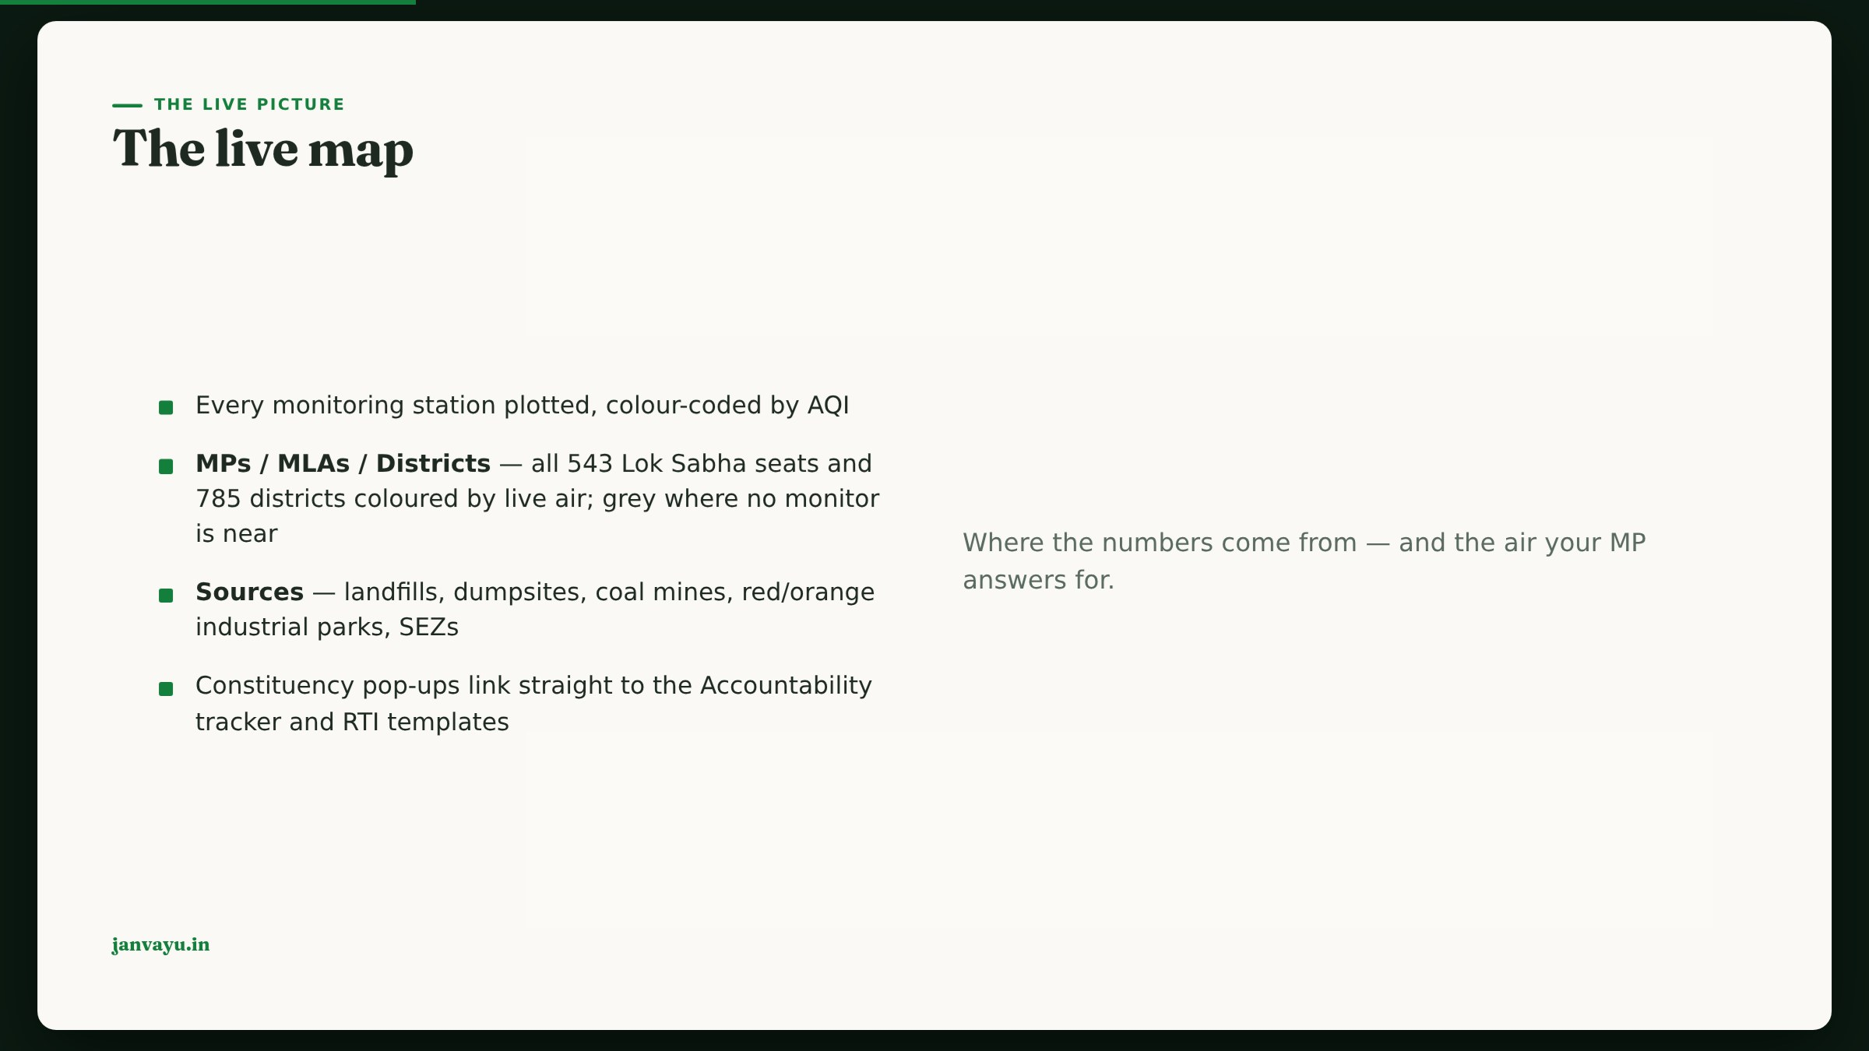
Notes:
Emphasise the grey constituencies: that is the real monitoring gap, not a rendering error. Boundaries and source locations come from indianopenmaps.com (SBM, LGD, GatiShakti mirrors), attributed on the map.

Slide 10
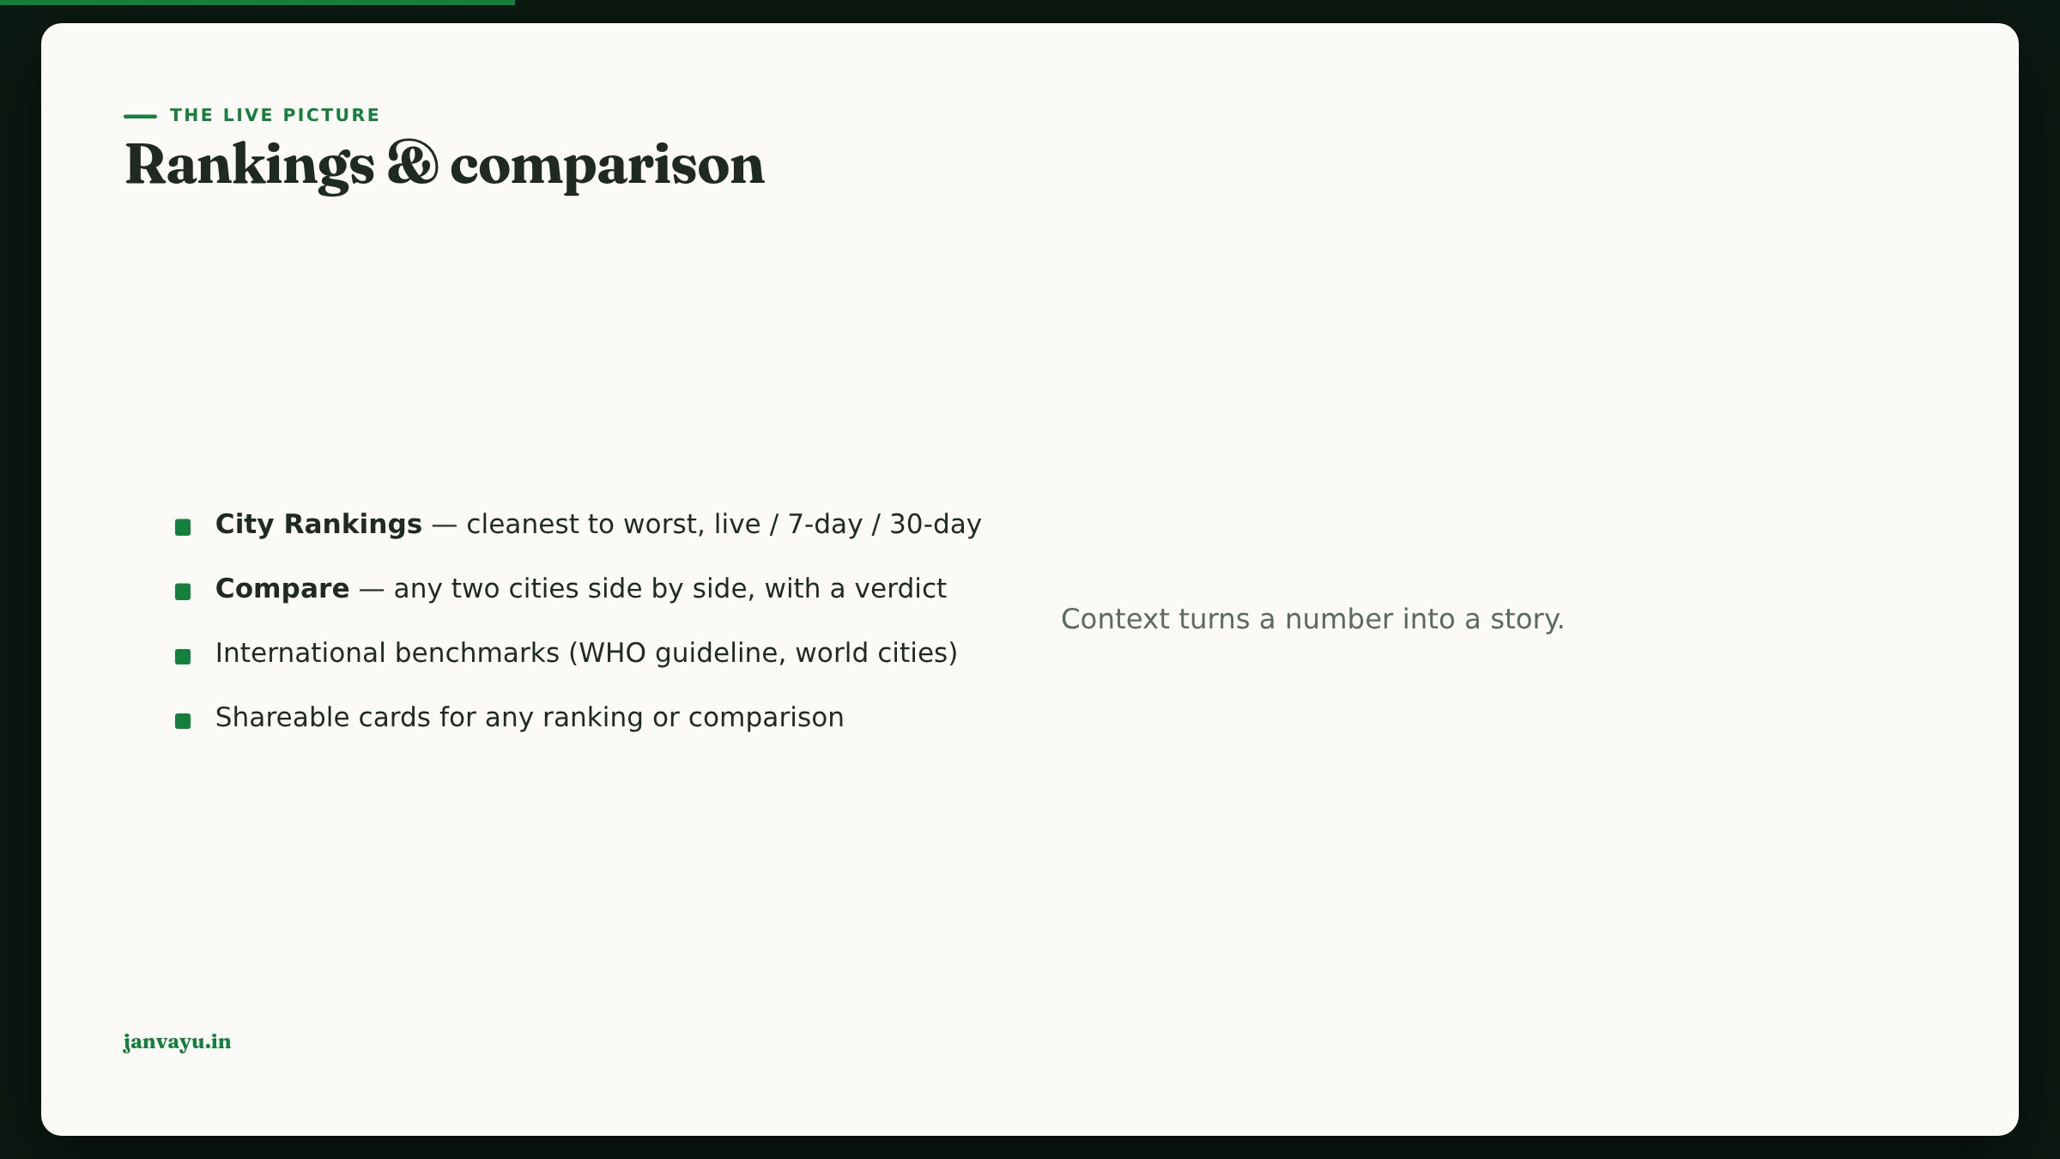
Notes:
Rankings and comparison are the most shared surfaces; show the share-card generator.

Slide 11
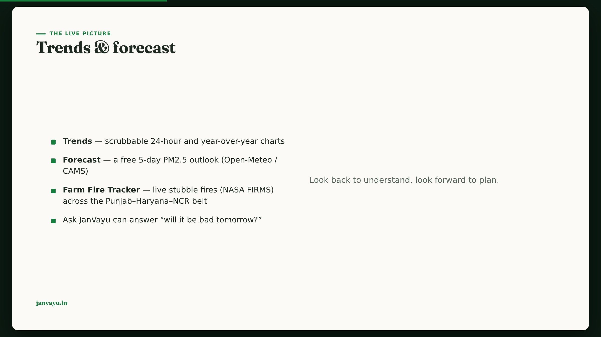
Notes:
The forecast is key-less and free; it feeds the chatbot’s tomorrow-answers too. Be honest about the fire map’s season — it peaks mid-Oct to late-Nov and is quiet the rest of the year.

Slide 12
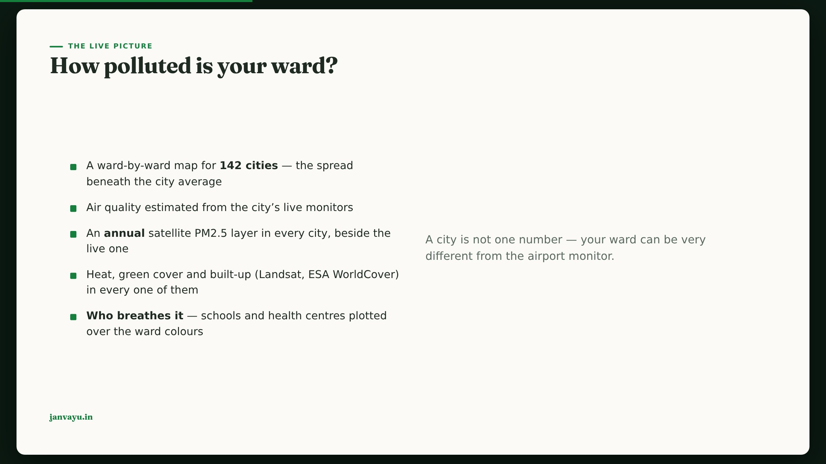
Notes:
Be honest on screen that the air layer is a live estimate of the citywide SPREAD, not a per-street reading; all five layers now cover all 142 cities. Five upstreams under different licences, and the credit under the map names the source for whichever city is on screen. Two things worth saying out loud here: every state capital is now mapped, including seven that never had a ward map — and Agartala (61 µg/m³ annual) is 2.5× the other Northeast capitals (Itanagar 24, Aizawl 24, Kohima 24), which nobody could see before. And in Bengal, Durgapur (63) and Asansol (61) beat Kolkata (49): the industrial belt, not the metro.

Slide 13
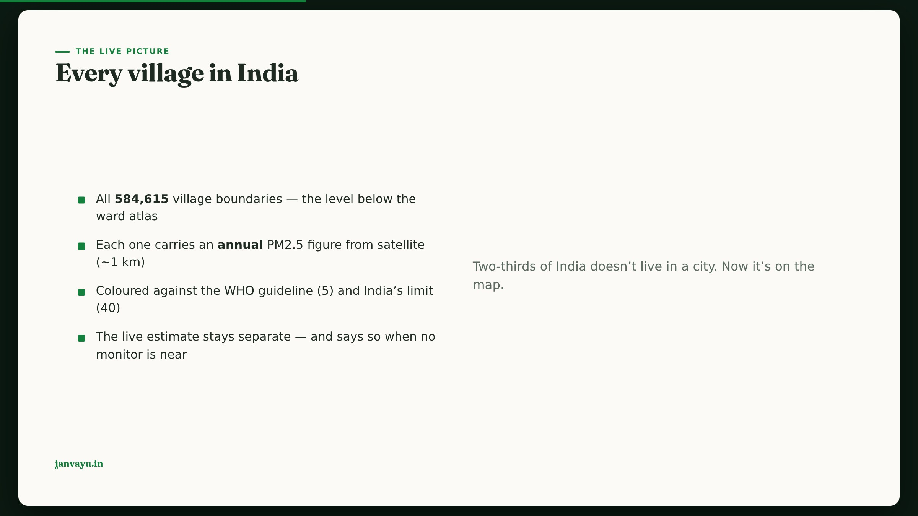
Notes:
The point of this slide is the monitoring gap: ~565 continuous CPCB stations against 584,615 villages, so the live network can never answer "how is my village's air". Satellite fills it on a DIFFERENT timescale — annual, not today. Keep the two apart out loud. Two honest caveats: a ~1 km product smooths hyperlocal sources (a kiln next door won't show), and it is modelled and calibrated, not measured in the village. The finding worth saying: not one Indian village meets the WHO guideline of 5, and 63.6% are above India's own limit of 40.

Slide 14
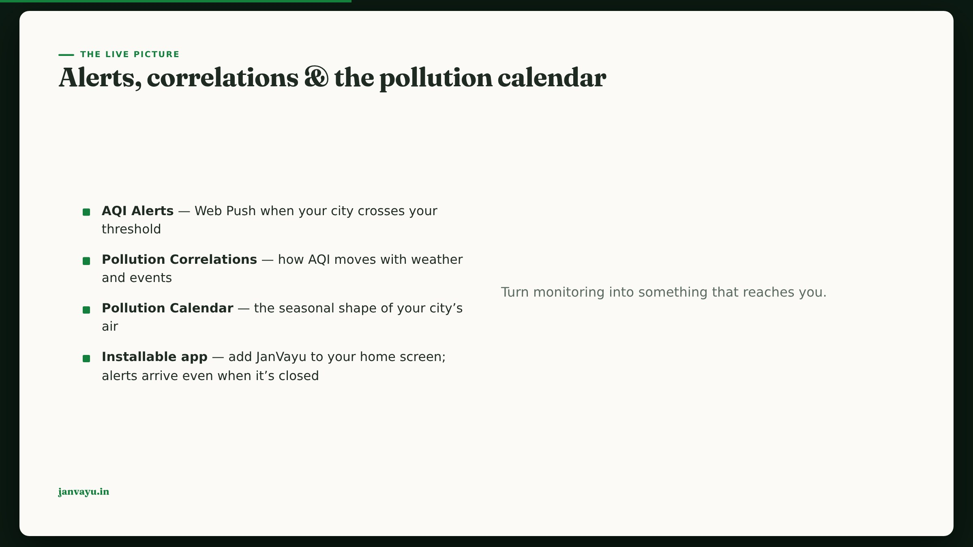
Notes:
Push is real VAPID web push; alerts are gated on a user-picked threshold. Both the main site and the standalone Ask JanVayu app install as PWAs on Android, iOS and desktop.

Slide 15

Notes:
Chapter 3 — Health & exposure. Translate the numbers into what they mean for a body.

Slide 16
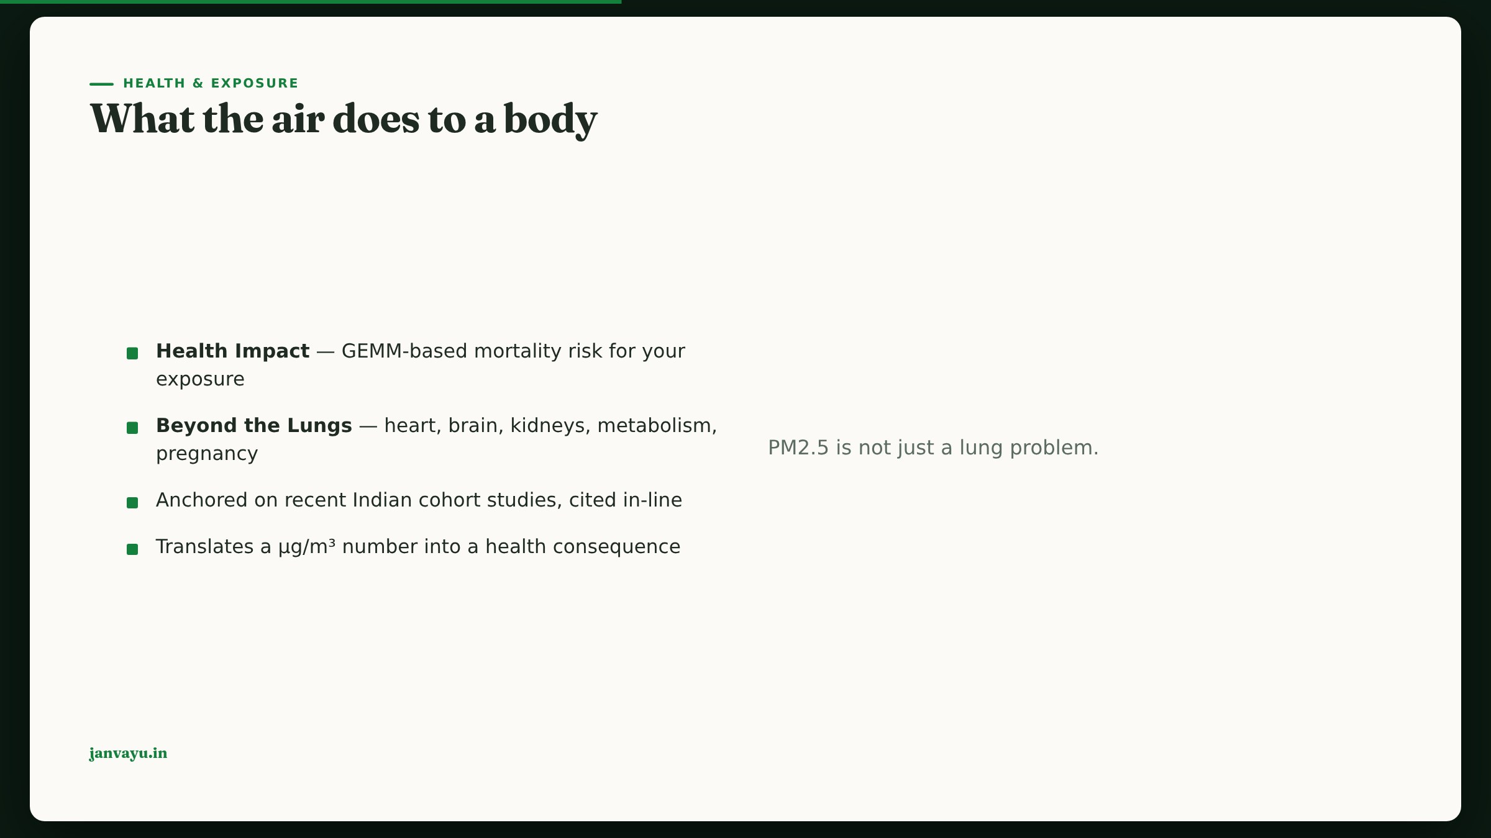
Notes:
Beyond-the-lungs is the emotional core; use the hand-drawn body diagram.

Slide 17
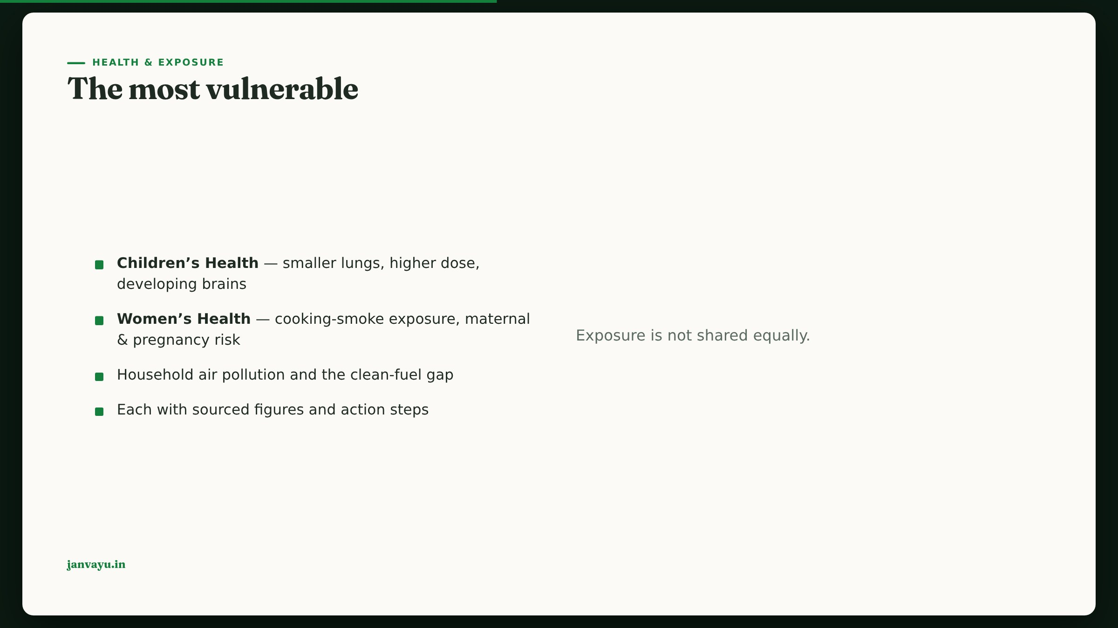
Notes:
Frame as an equity story; both panels carry the corrected, fact-checked figures.

Slide 18
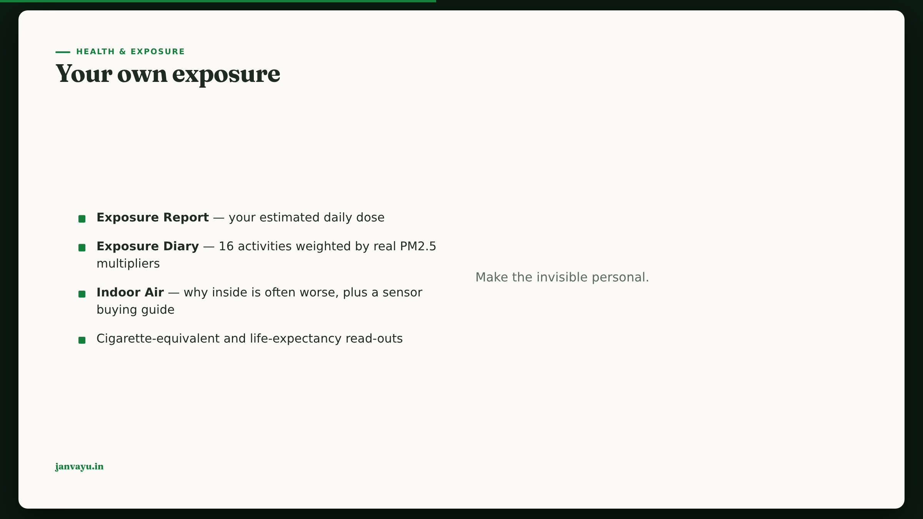
Notes:
The diary is a habit tool; note it is localStorage-only today.

Slide 19
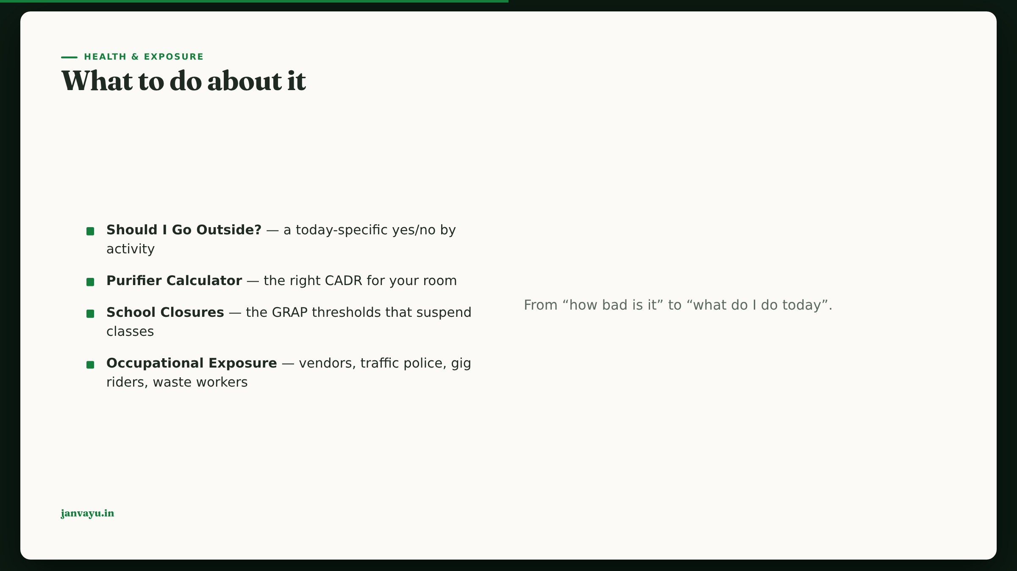
Notes:
These are the decision tools; the purifier sizing and GRAP rules are fact-checked.

Slide 20

Notes:
Chapter 4 — The economic bill. The macroeconomic case, for policy audiences.

Slide 21
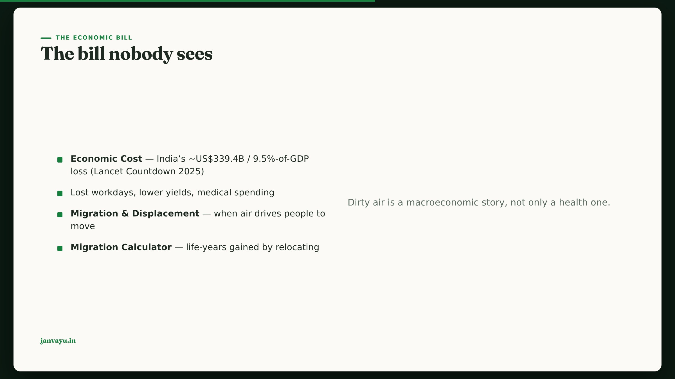
Notes:
Use the economy diagram; the $339B figure is the corrected, sourced value with its method noted.

Slide 22

Notes:
Chapter 5 — Following the money. Accountability — the differentiator versus a plain dashboard.

Slide 23
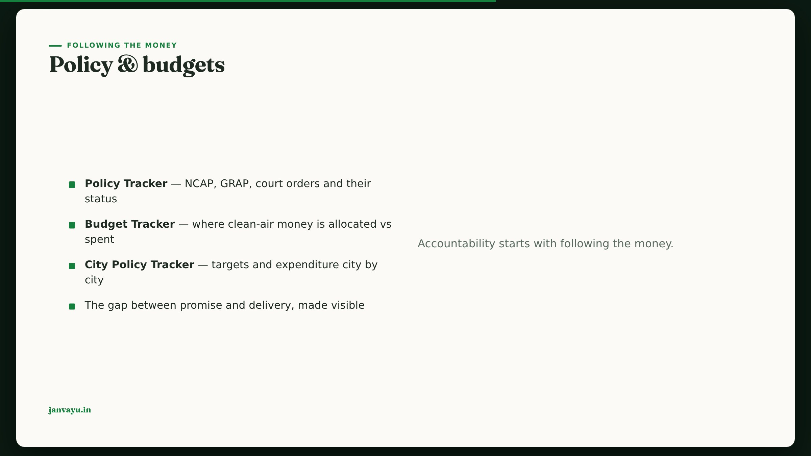
Notes:
Budget figures were refreshed to CREA 2026 in the fact-check; note the dust-vs-source mismatch.

Slide 24
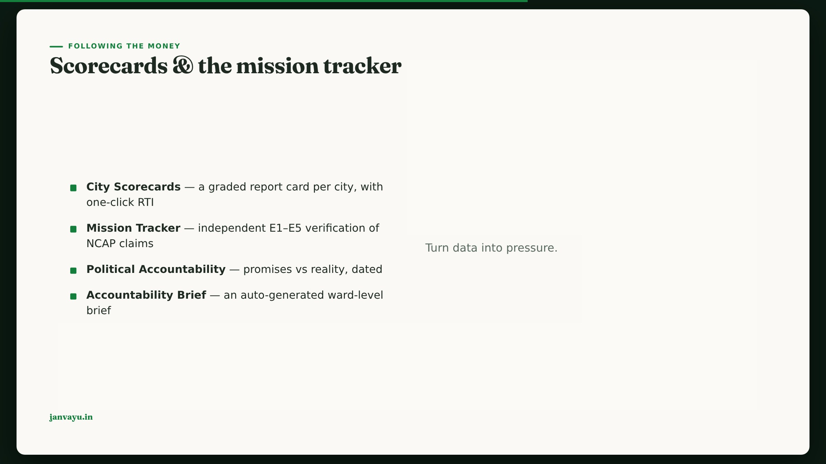
Notes:
The scorecard’s “File an RTI” pre-fills the RTI Assistant for that city.

Slide 25
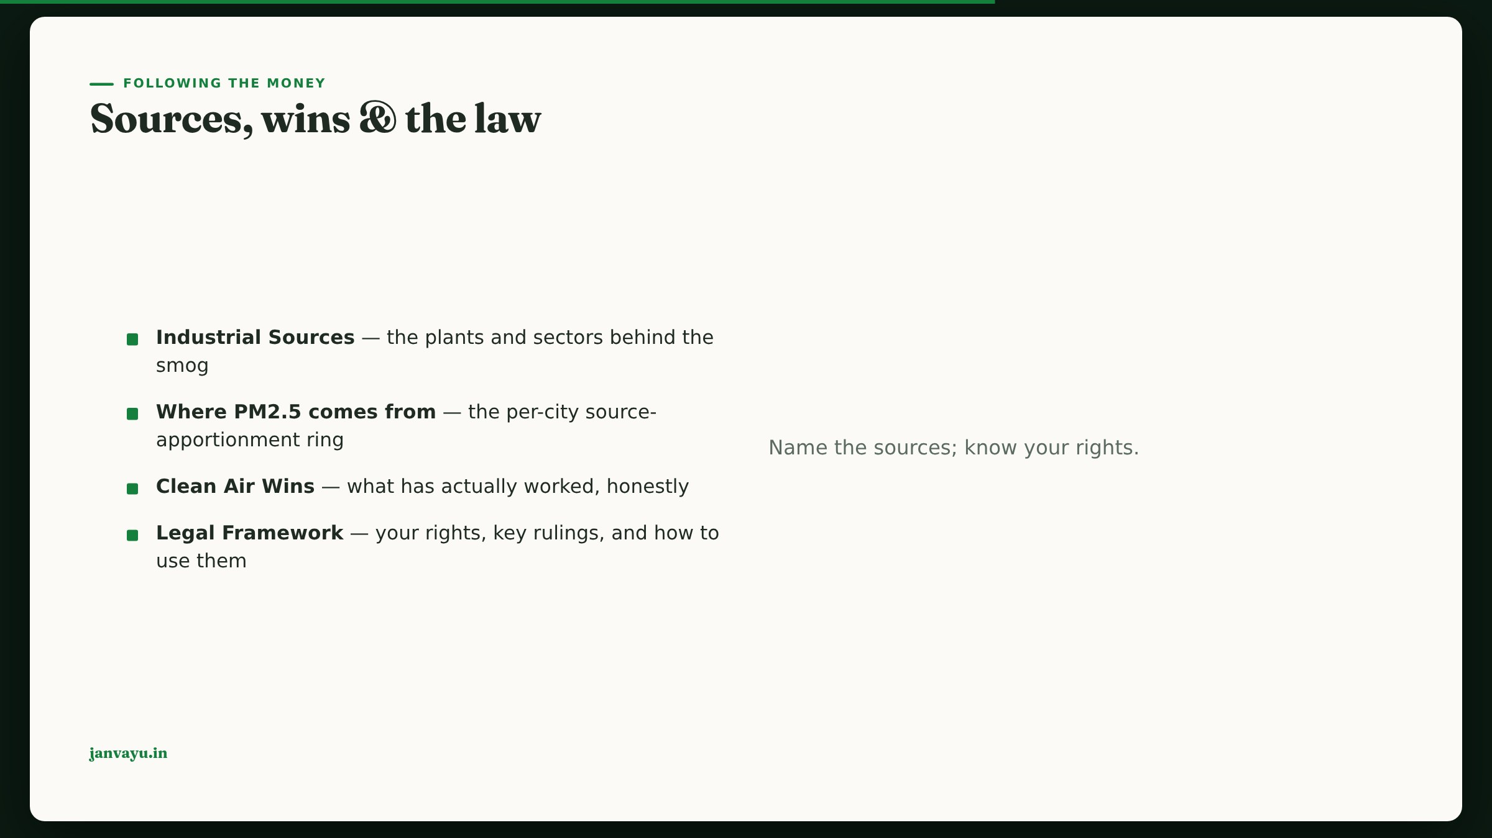
Notes:
The apportionment ring is the newest panel; each city cites its own study with a method caveat.

Slide 26
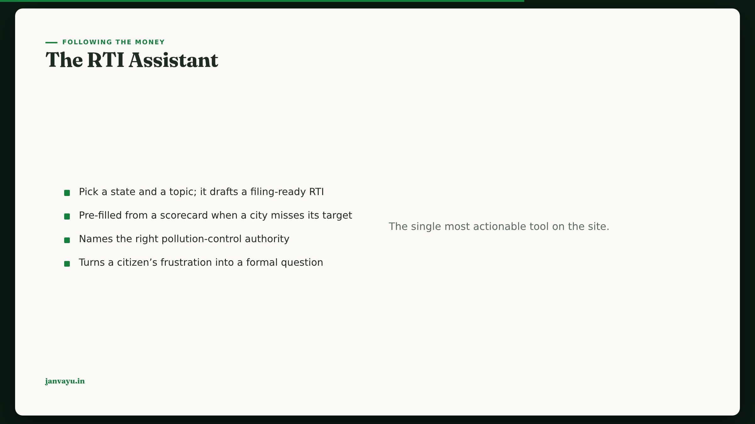
Notes:
Demo the scorecard → RTI hand-off; it’s the platform’s theory of change in one flow.

Slide 27

Notes:
Chapter 6 — Citizen action. Turn readers into participants.

Slide 28
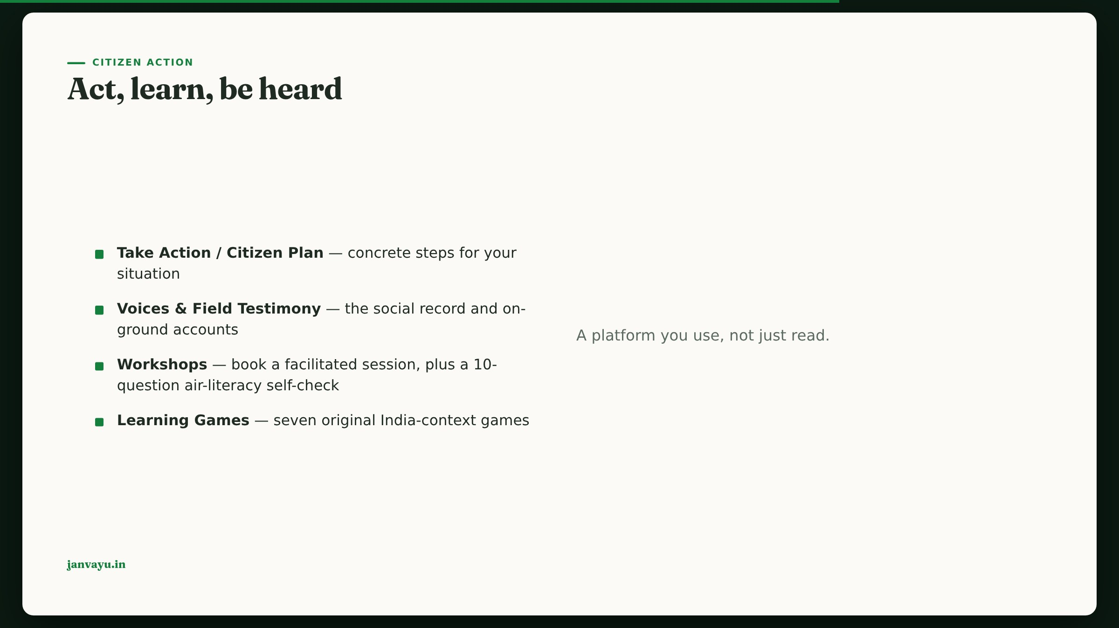
Notes:
Games + the new air-literacy quiz make this classroom-ready; workshops connect to a live facilitator.

Slide 29
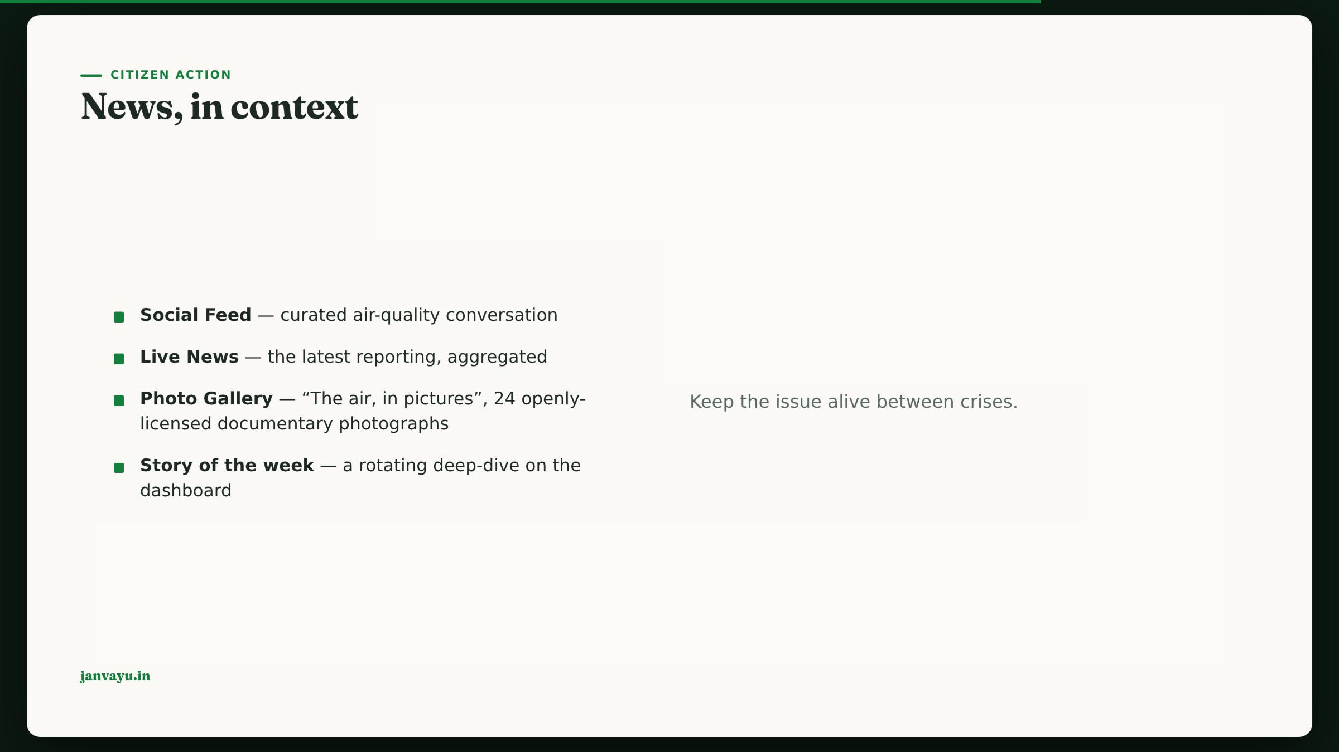
Notes:
Story-of-the-week rotates weekly with no deploy; it surfaces the blog. Every gallery photograph carries its own credit and source link.

Slide 30

Notes:
Chapter 7 — Tools & knowledge. The reference layer and the take-it-with-you surfaces.

Slide 31

Notes:
It answers from JanVayu’s own verified figures and cites them; an eval suite gates it against fabricated citations and invented orders or schemes.

Slide 32
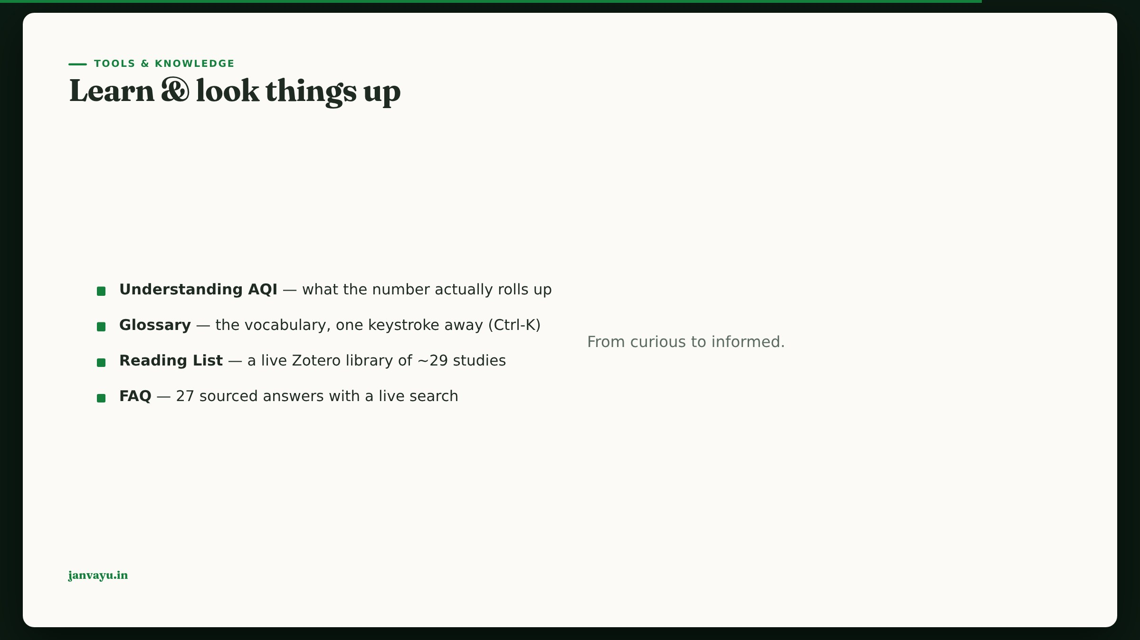
Notes:
Reading List is a real Zotero group; the AQI explainer’s CPCB-vs-EPA table was just corrected.

Slide 33
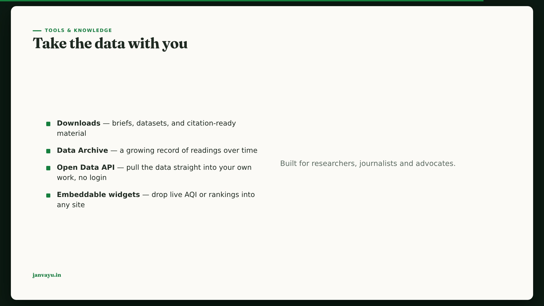
Notes:
The API + embeds are the “use JanVayu in your work” surface; licence and citation are included.

Slide 34

Notes:
Chapter 8 — Trust. Close the loop on why any of these numbers can be believed.

Slide 35
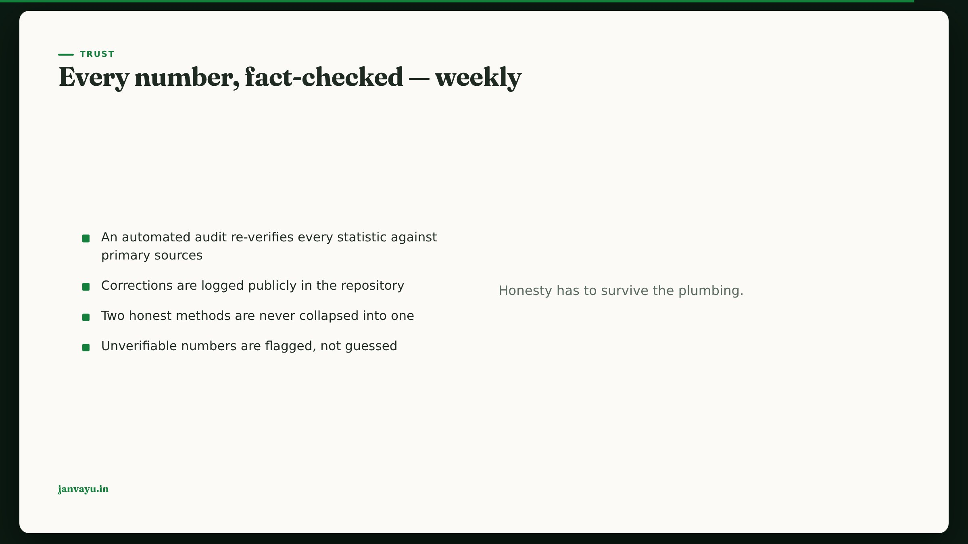
Notes:
This is what separates JanVayu from a marketing site; the weekly PR-for-review loop is real.

Slide 36
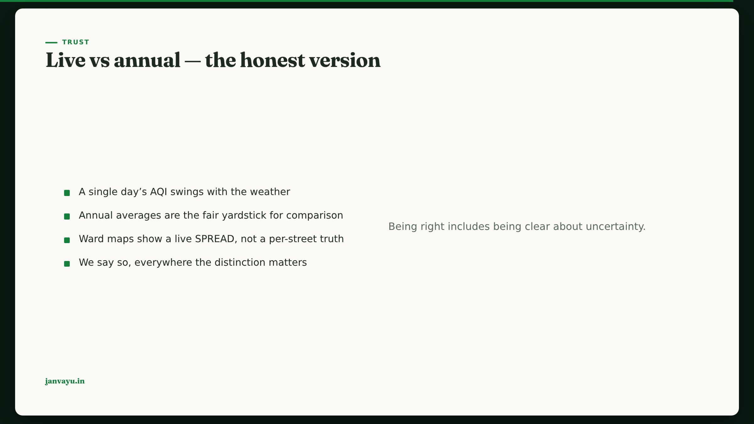
Notes:
The live-vs-annual honesty is a recurring theme; it protects the platform from over-claiming.

Slide 37

Notes:
Close on agency: the point of all this data is to be used. Point to the API, the RTI Assistant, and contribute@janvayu.in.

